Slide 1
Shared Environment accounting forum
April 9, 2024

Slide 2
Discussion topics
# | Topic | OBJECTIVE | Lead
1 | Year end update | Inform upcoming year end timeline | Erick Winger
2 | Transfer question | Closing out Grant | Erick Winger
3 | Receipt Accruals | Purpose and impact of receipt accruals, year end reporting | Erick Winger
Notes:
From Erika H via email:
Closing out a grant. A charge is placed off the grant on a non-federal placeholder due to “a reason”
Since accounting adjustments can’t be split charged (ie, we can’t take a fully debited expense and then adjust 20% on budget A grant and 80% on ICR) is best practice to:
Do a shared environment reclass even in the close of a grant? Are there flags there especially since the shared environment reclass doesn’t easily tie back to the original transaction
Do an accounting adjustment for the full amount which puts the grant in deficit and then ask GCA to perform a deficit transfer at the close of the grant
Or other?
I see issues with both but want some best practice guidance set up.

Slide 3
Year End Update

Slide 4
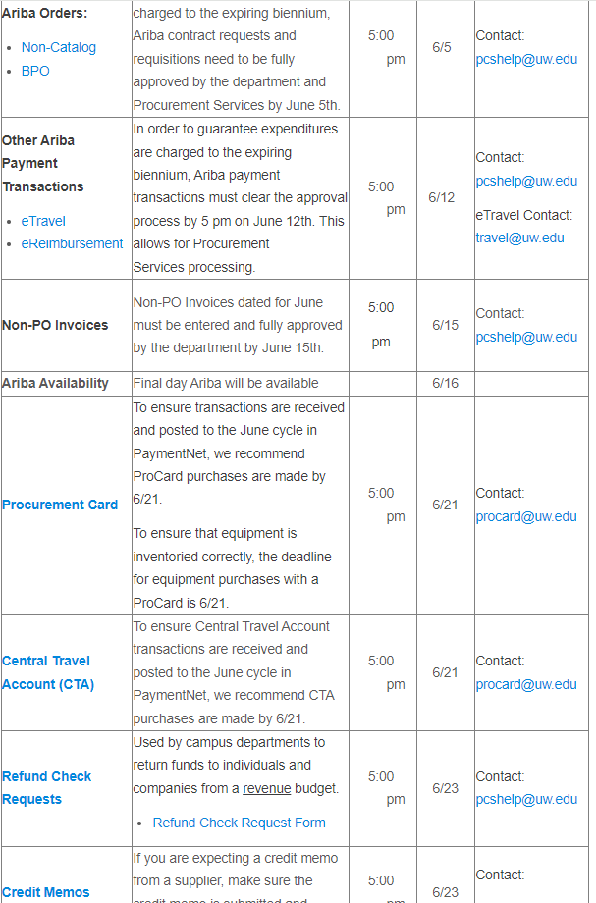
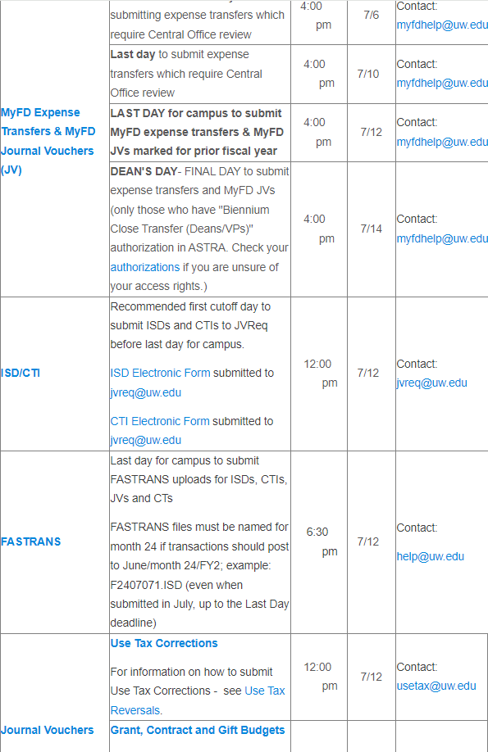
Biennium/FY close legacy process
Note: Legacy cutoff dates for procurement type activity in June, and journal type activity in July

Slide 5
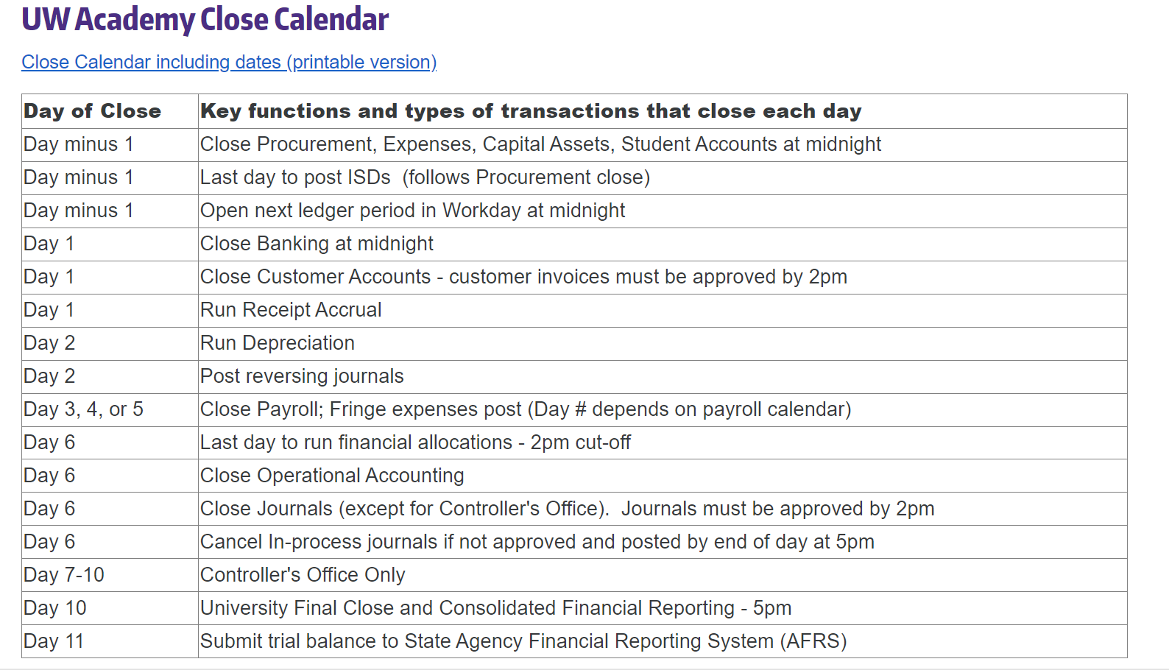
Current close calendar view

Slide 6
Year end close planning discussions (sample)
Procurement – Initial meeting Wed 4/3
Grants – Initial meeting Thu 4/4
Student Financial Services – Mon 4/8 @ 1:30PM
Treasury – Mon 4/8 @ 2:30PM
Integrations/SWIFT – Tue 4/9 @ 9AM
Merchant Fees – Tue 4/9 @ 9:30AM
Banking – Thu 4/11 @ 8:30AM
Payroll – Thu 4/11 @ 4PM
EIO – Fri 4/12 @ 9:30AM
Integrations – Fri 4/12 @ 2PM
More detailed calendar to be shared in May

Slide 7
Closing Out Grant (expense transfers)

Slide 8
Grant close out – accounting adjustment vs. SE reclass
Example: A charge is placed off the grant on a non-federal placeholder
Since accounting adjustments can’t be split (we can not take a fully debited expense and then transfer 20% of the non-federal placeholder to a grant and 80% to ICR). What is best practice?:
Do a shared environment reclass even in the close of a grant? Are there flags especially since the shared environment reclass doesn’t easily tie back to the original transaction – Preferred for amount accuracy, needs support/explanation, use original transaction reference in the line memo
Do an accounting adjustment for the full amount which puts the grant in deficit and then ask GCA to perform a deficit transfer at the close of the grant

Slide 9
Receipt Accruals

Slide 10
Receipt Accruals
Purpose: recognize expense in the period in which goods or services have been received
Receipt accruals post expense and an accrued liability (accrued receipts), similar in concept to accrued salaries and wages
This entry will be setup to post the last day of the period and reverse immediately following on the first day of the next period.
The receipt accrual will continue to repeat creating a reversing entry monthly until the actual invoice is received and processed, generating accounts payable (opposed to accrued receipts)
Debit – Expense
Credit – Accrued Receipts

Slide 11
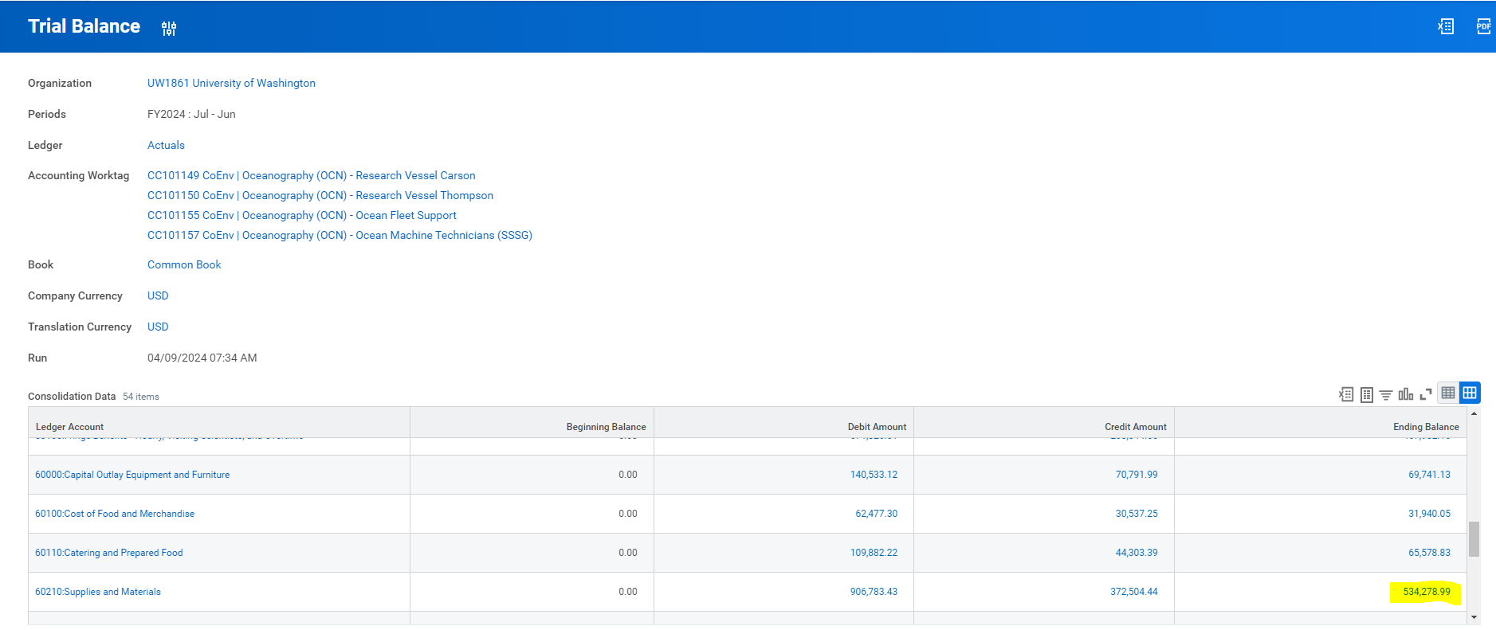
Receipt Accruals – Trial Balance Expense

Slide 12
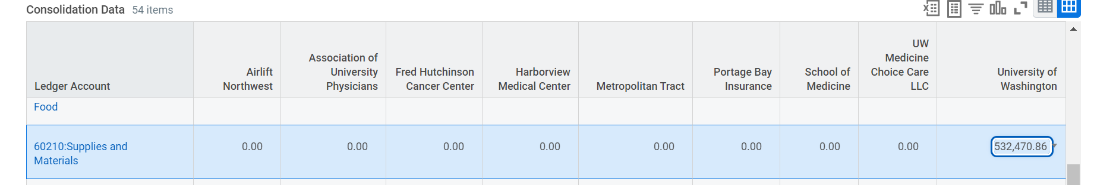
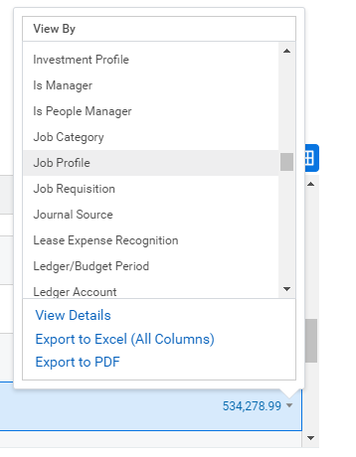
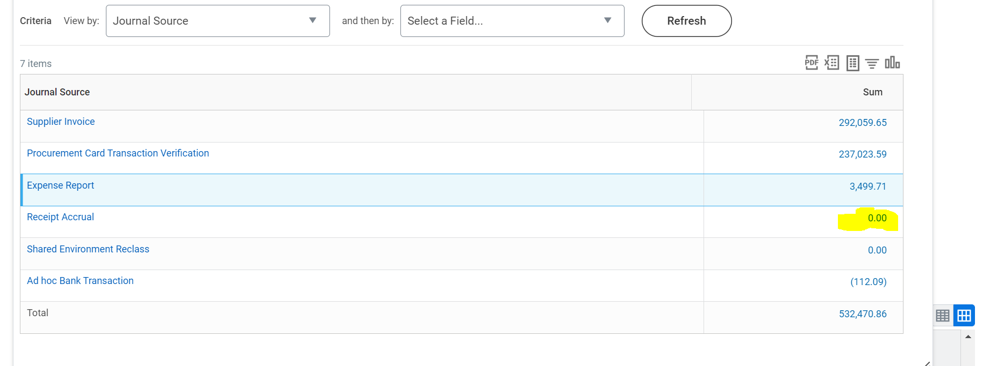
Receipt Accruals
Drill into expense amount by journal source
Drill into receipt accruals (‘blue’ 0.00 means there are transactions)

Slide 13
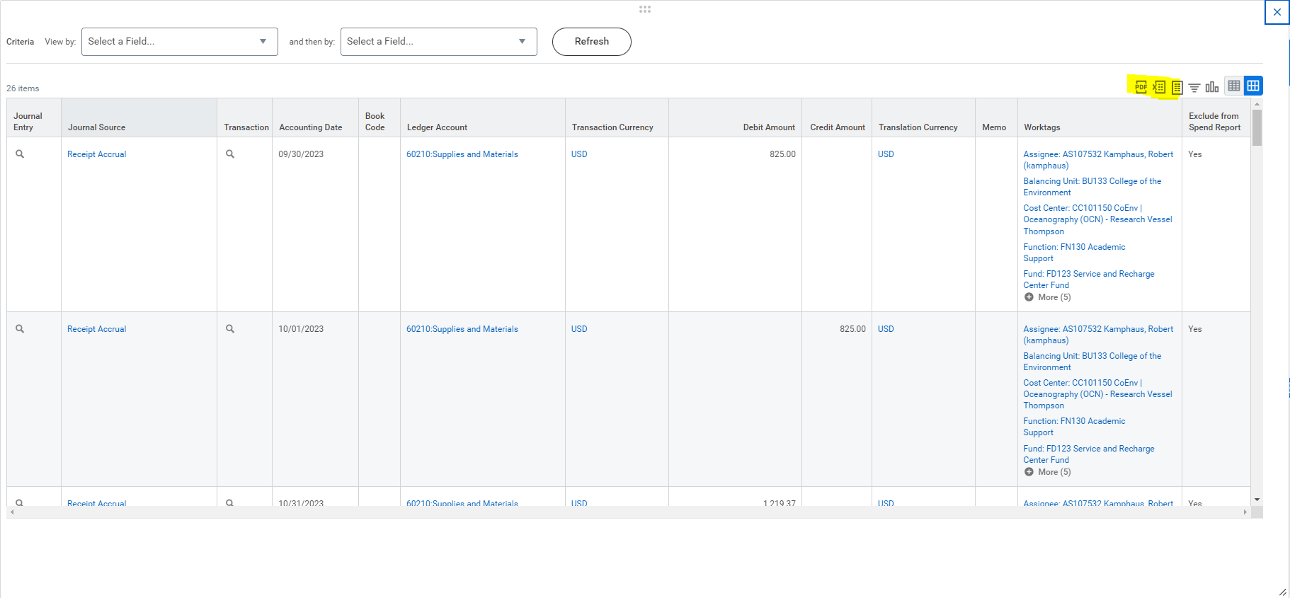
Receipt Accruals
Extract journal lines into Excel

Slide 14
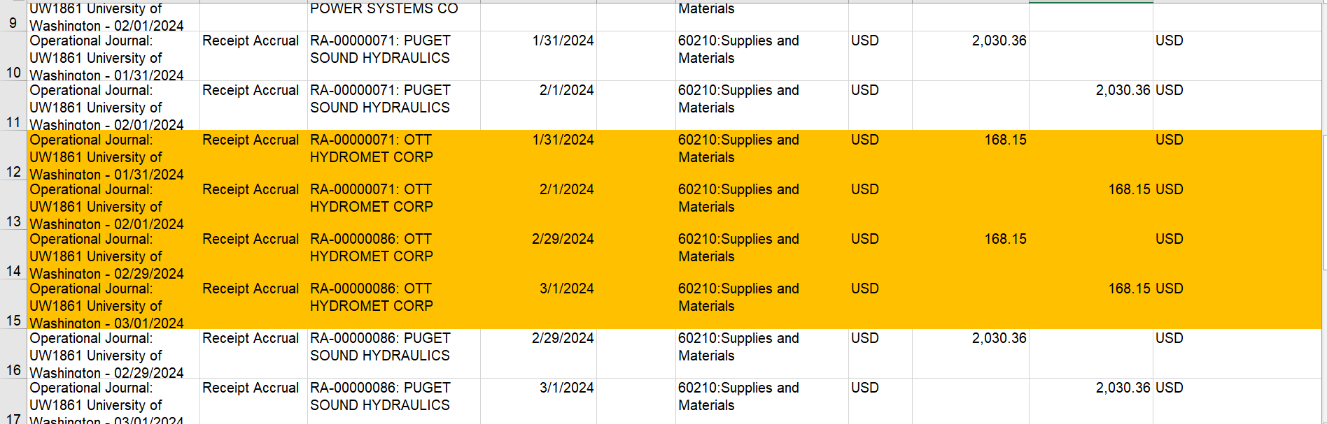
Receipt Accruals

Slide 15
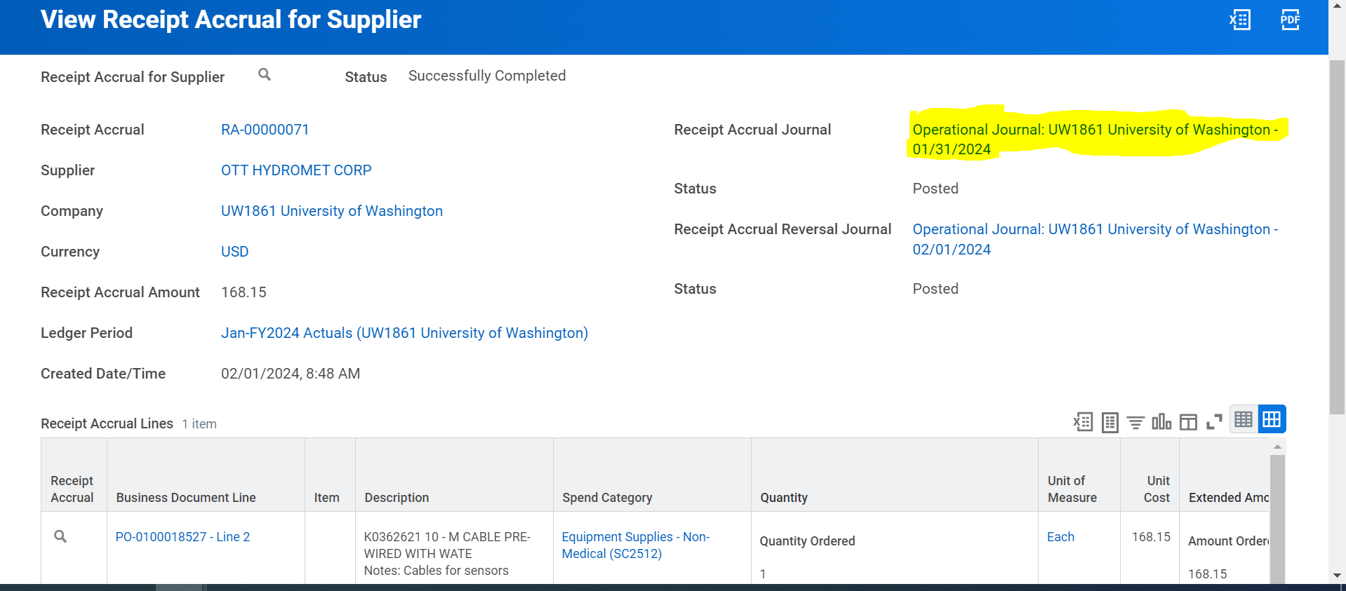
Receipt Accruals
Notice the multiple (monthly) receipt accrual operational journals

Slide 16
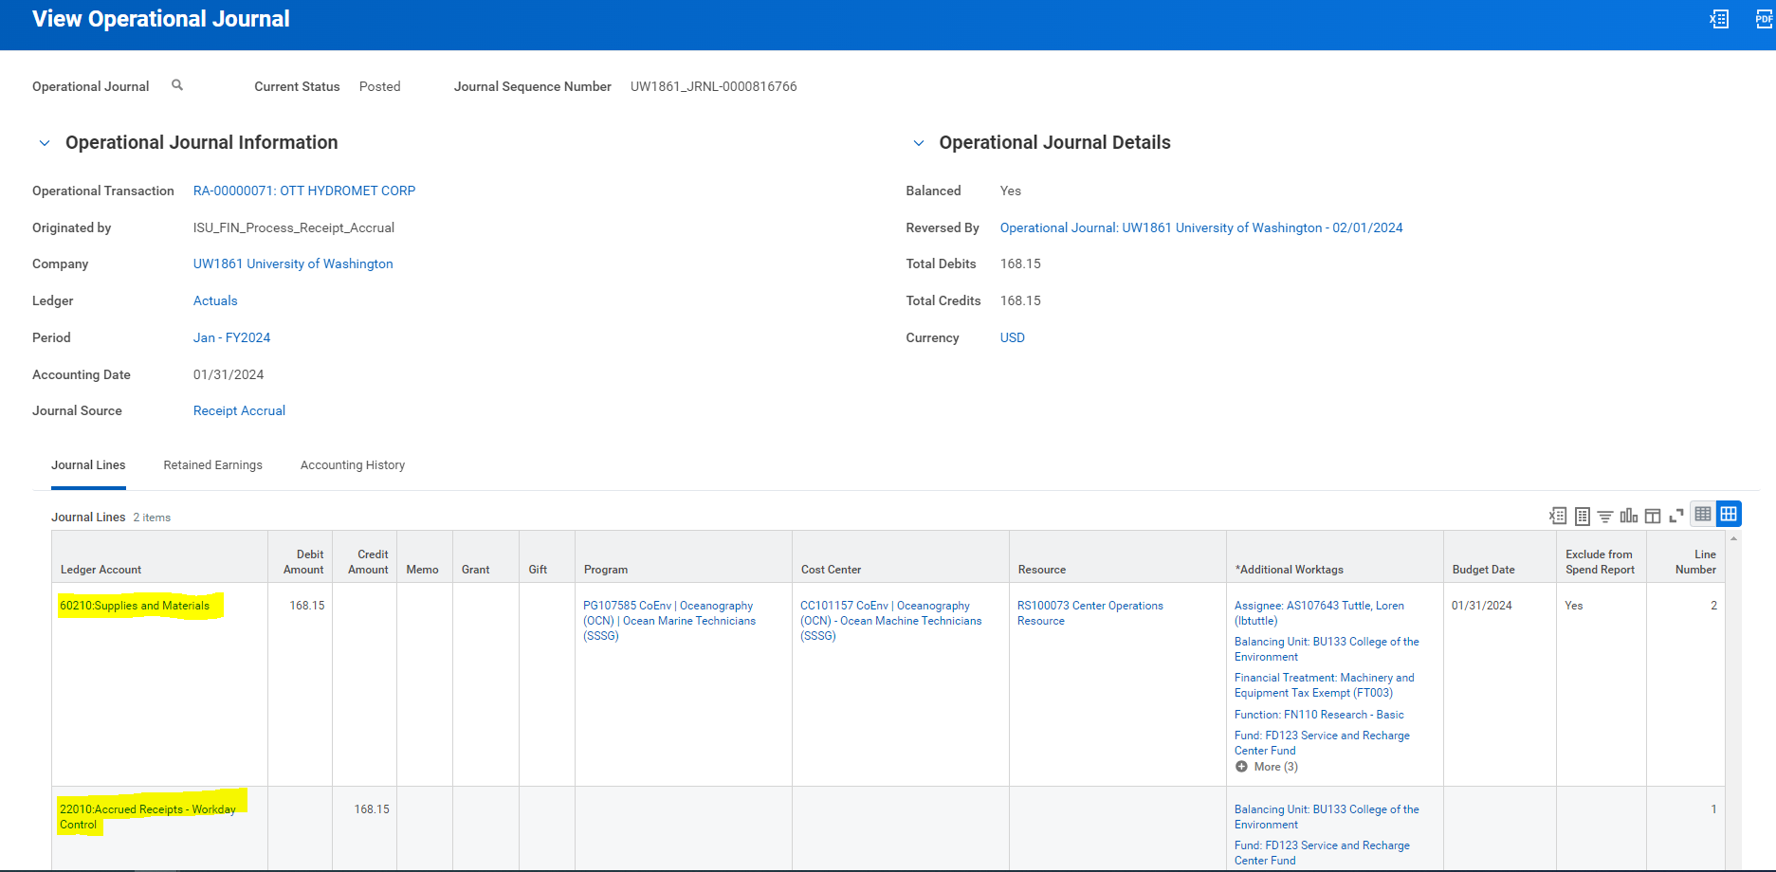
Receipt Accruals
The 22010 Accrued Receipts only posts to balancing worktags, not cost center (similar to Accounts Payable)

Slide 17
Reference documents –

Slide 18
SE Accounting Forum Web Page – Decks & Recordings https://finance.uw.edu/fr/node/87 Finance> Financial Reporting> Shared Environment Accounting Forum

Slide 19
Future Discussion Topics
# | Topic | OBJECTIVE | Tentative Date
1
2
3
4
5

