Slide 1
Shared Environment
FDM Bootcamp Series #1 – Ledger accounts
September 10, 2024

Slide 2
FDM Bootcamp Series #1 Ledger accounts – agenda
# | Topic | OBJECTIVE | Lead | Time
1 | Bootcamp Series | Goals & Audience Series Preview & Today’s Focus | Erick | 10
2 | Accounting Worktag Overview | Example Report - R1300 Refresher: What are Accounting Worktags Connections From the Categories to the Financial Statements Overview of Account Posting Rules & Custom Validations Selecting Spend Categories or Revenue Categories & Ledgers | Christina | 40
3 | UW Accounting Principles | Matching Principles Accrual vs Cash Basis | Erick | 10
4 | Financial Statement Walk-Thru | What’s the difference between income statement vs balance sheet vs trial balance (eg accrual – expenses vs liabilities and how it shows on reports; assets) | Christina | 30
5 | Wrap Up | Resources What’s Next | Christina | 10
Notes:
Balance within each session: being in WD vs ppt; how to navigate in WD to find the answers

Slide 3
Bootcamp Series Overview

Slide 4
Goals & Audience
Key Audience:
  Shared Environment (SE) Accountant roles
Goals:
  To strengthen SE accounting knowledge, based on UW needs and Workday setups.
  To create future job aids to build accounting knowledge in support of UW accounting principles and reporting needs.
    Leverage for all users performing WD transactions across all campuses

Slide 5
FDM Bootcamp Series Preview
Series #1 - Accounting Fundamentals
  Accounting Worktag Overview
  UW Accounting Principles
  Wrap Up
Series #2 – UW Specific Setups Deep Dive
  Journal Source types and purposes
  Accounting Journal types
  Revenue and Spend Categories for Operational Journals
  Financial Statement
  Book Codes
  Wrap up
Series #3 – Net Position
  How to interpret your data
  Corrections
Series #4 – Reporting
  Planning and budgeting reports
Notes:
Look to re-do finance literacy seminars with Foster as requirement for those who will receive an accountant security role
2 interest accounts
How to navigate
Specifics w/concrete example in first session, then go into weeds and other examples in deep dive

Slide 6
Today’s Focus
Accounting Worktag Overview
  R1300 Example Report
  Refresher: What are Accounting Worktags
  Connections From the Categories to the Financial Statements
  Overview of Account Posting Rules and Custom Validations
  Selecting Spend Categories or Revenue Categories and Ledgers
UW Accounting Principles
Financial Statements and their Sections
Wrap Up
  Resources
  What’s the Next Session

Slide 7
Accounting Worktags Overview

Slide 8
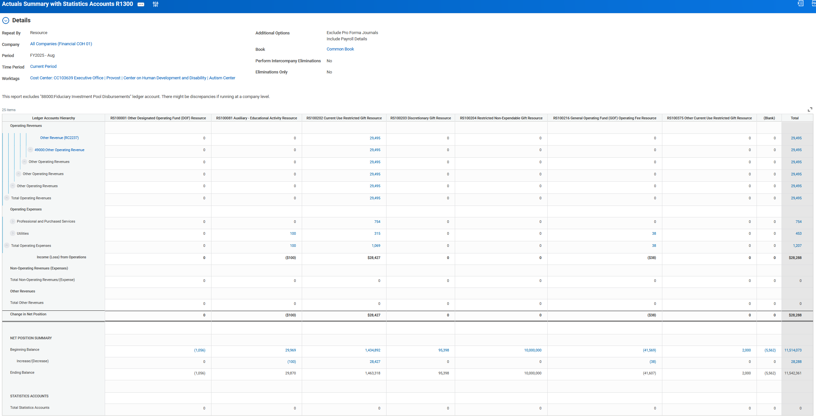
Notes:
Let’s start by taking a look at a report y’all are probably familiar with: R1300 Actuals Summary and Statistics Accounts.
In this example, we’ve run it for the Autism Center for FYTD25.
What is our goal when we’re looking at this report? It’s to monitor the financial health of the selected unit. Maybe we need to report externally with this report as a basis, maybe we want to do some analysis to see how the funding is being spent on activities within a selected unit.
Today we’re focusing on how Accounting Worktags support reporting.

Slide 9
Revenue Category
Ledger Account
Ledger Account Summary 7
Ledger Account Summary 6
Ledger Account Summary 5
Ledger Account Summary 4
Notes:
This report includes the Ledger Account Summaries, Ledger Worktag, and Revenue and Spend Categories. Not all reports display it in an expandable format like this one has been configured to do, sometimes users will have to click on a value and use the “view by” functionality to get to the Revenue or Spend Category detail level instead. Note that this report starts with the largest worktag, the Ledger Account Summary, and as you open the expansion with the arrows, you are going increasingly granular. The top line is now the most detailed accounting worktag, the Revenue Category.
So let’s refresh ourselves on the purpose of each of these worktags

Slide 10
Refresher: What are Accounting Worktags
Ledger Worktag – These support accounting operations and reporting needs of Balancing Units at minimum, up through UW’s audited financial statements. Granularity is obtained through a combination of Ledger and Revenue or Spend Category.
  Hierarchy is called a “Ledger Account Summary”
  In the primary hierarchy, Ledger Account Summary level 5 is where UW’s financial reporting takes place
  Ledgers are the only worktags that are “smart-numbered” in Workday, to align with industry standards:
    e.g. 10XXX – Cash and Cash Equivalents
    e.g. 30XXX – Net Position
    e.g. 40XXX-49XXX – Operating Revenues
Notes:
The Ledger Worktag is what makes up UW’s “general ledger”. They’re at a level that supports UW’s enterprise accounting and when aggregated with the Ledger Account Summary, they can be turned into UW’s enterprise financial statements or other reports for third parties

Slide 11
Refresher: What are Accounting Worktags
Revenue Category Worktag – detailed “sub-ledger” worktags designed to answer the question “What is being sold?”
  Level of granularity is not necessarily uniform across the enterprise
Spend Category Worktag – detailed “sub-ledger” worktags designed to answer the question “What is being purchased?”
  Relatively standard across the enterprise (e.g. generally everyone has a need of “Office Supplies”) but units still have different reporting needs, hence the many different “supplies” related Spend Categories
Notes:
Revenue Categories are not necessarily uniform across the enterprise as different units sell different products or services to each other or 3rd parties and track the granularity in different ways. For example, we don't expect UWIT to just sell "Technology Services" to the schools and colleges, and would expect UWIT's tracking to be more granular. MAA nor Central Finance/Controller's Office are not requiring that units track at the rate level either, so it is really up to the individual units to determine the level of granularity that works best for managing their operations and reporting.
In regards to Spend Categories, these are actually more standard across the enterprise. Almost everyone is allocated overhead from OPB, everyone has utilities, etc. Where we see differentiation is in supplies and purchased services. College of Arts and Sciences wants to have Theatre Supplies differentiated from Office Supplies or UWM wants to see Medical Equipment Supplies separately from Computer Supplies. From an Enterprise standpoint, they are all Supplies and Materials, but at a unit level, they want that reporting and operational granularity. Also, Spend Categories are not detailed to the level of Blue Wire A vs Red Wire B as there are still Workday Procurement Items and Expense Items that are even more granular, that are mapped to the most appropriate Spend Categories.
For both Revenue Categories and Spend Categories, we want to reduce the vagueness that we had in the old Financial System. That's why you don't see Revenue or Spend Categories with the words "Other" or "Miscellaneous" very much. They don't answer the questions, what is being sold or what is being purchased.

Slide 12
Connections From the Categories to the Financial Statements
Ledger Account Summary 4
Highest Level of R1300
Ledger Account Summary 5
Financial Statement “grouping”
Ledger Account Summary 6
Ledger Account Summary 7
Ledger Account
Ledger Account
APR
APR
Revenue Category Hierarchy Level 2
Spend Category Hierarchy Level 2
Revenue Category Hierarchy Level 3
Spend Category Hierarchy Level 3
Revenue Category
Spend Category
Notes:
So think back to the report, R1300. We have the Revenue or Spend Category and Ledger, but how do they connect to each other?
Note that the APRs are based off of hierarchy level 2, as shown, but there are some unique exceptions like payroll and capital assets where the link the ledger is driven by the category itself

Slide 13
What is an Account Posting Rule (APR)?
Connection between Revenue or Spend Categories and Ledgers is generally at hierarchy level 2
Revenue or Spend Category Hierarchy Level 2 names generally coincide with the Ledger they map to.
  The exception to this are the compensation related Accounting Worktags, which are driven by special payroll configuration related to job codes and other data. Questions related to this should be directed to the Payroll team.
These combinations will be predetermined and restricted by the APR. Users are not allowed to use a combination that doesn’t exist.
Specific APR configuration to direct mappings based on Balancing Unit and Company has been created to support UW’s enterprise reporting.
  E.g. if a school uses a Revenue Category it would generally be directed to Sales and Services of Educational Departments, whereas if an auxiliary unit uses that same Revenue Category it would be directed to Auxiliary Revenue.
Notes:
APRs are Workday backend configuration that defines the relationship between Revenue Categories or Spend Categories and Ledgers.
We’re not going to get into the weeds here, but here’s a few points that will help us in a little bit.

Slide 14
Custom Validations
Resource: Custom Validation List – https://uwconnect.uw.edu/finance?id=kb_article_view&sysparm_article=KB0033525
Notes:
So as I just mentioned on the last slide that there are guide rails built into Workday to keep people on the straight and narrow. Limiting the mapping between Spend or Revenue Categories and Ledgers is due to a Custom Validation.
There are a lot of Custom Validations out there, you’ve probably seen those red flags on transactions. There are also areas or gaps where there should be more guardrails put into place, if you come across something like that, where you’re questioning if a user really should be doing X, Y, or Z, please reach out so that we can analyze that.

Slide 15
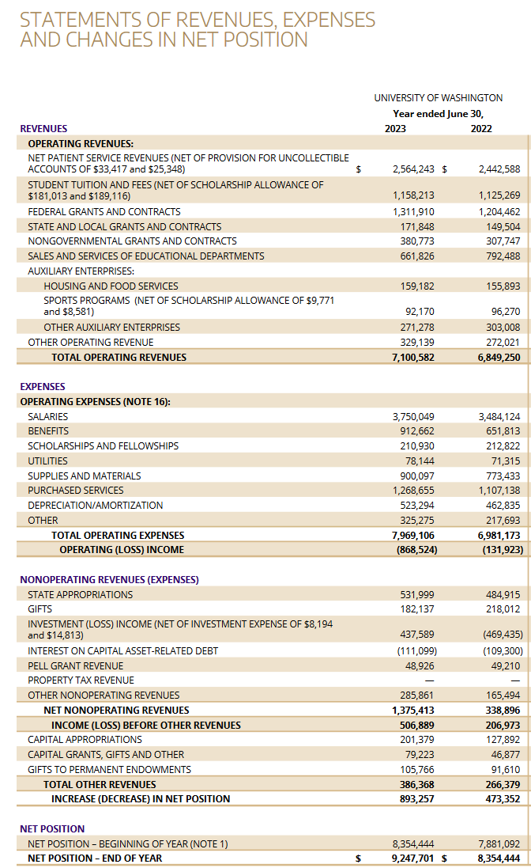
How to select a Category & Ledger Combination (Top Down Approach)
Resource: Ledger Knowledge Article
Resource: Revenue Category Knowledge Article
Notes:
Now that we have covered the basics of Accounting Worktags, let’s walk through some examples on navigating and determining the Revenue Category based on the resources that are available.
Let’s say a user knows where they need to report to on the enterprise financials.
For example, the user needs to report a revenue stream that rolls up somehow into Sales and Services of Educational Departments.
Navigate to Knowledge Article – Ledger > Click Ledger Listing link > Filter on LAS05 to “Sales and Services of Educational Departments” > Scroll to left (if necessary) and note the ledgers listed
In this case it’s simple enough, still Sales and Services of Educational Departments Revenue. So we’ve identified that the Ledger worktag we’ll be using is 43000. Now we want to identify the Revenue Category.
Navigate to Knowledge Article – Revenue Category > Click Revenue Listing link > Filter under “APR Check” for 43000: Sales and Services of Educational Departments”
Now you have the list of all Revenue Categories that map to that specific Ledger. Unfortunately at this time, we don’t have a defined “purpose” or “use” definition for each RC, but it’s in the works for future listings. It really is amazing to see the breadth of revenue streams that are happening across UW.
Please take note of the comment section in column “M”. Workday Configurators try to note if there are any special configurations to be aware of, such as if an Auxiliary Unit uses an RC originally designed for/by an Educational Unit, the mapping will be to Other Auxiliary Revenue and vice versa.
If when you’re looking for a Revenue Category or Spend Category and you can’t find it in the section you thought it should be in, or at all, please reach out and ask. Don’t try to put it somewhere else like “Other Operating Revenue” with the intention to fix it some other time. The saying is “tomorrow never comes”. It’s possible that there’s a category out there that meets your requirements, it’s just under a different name as this is an enterprise-wide listing. Or maybe a new one should be created to differentiate from other categories and meet your reporting needs.
Take one or two more scenarios from the audience.

Slide 16
How to select a Category & Ledger Combination (Bottom Up Approach)
Resource: Ledger Knowledge Article
Resource: Spend Category Knowledge Article
Notes:
Let’s try to find the appropriate Spend Category and Ledger combination for the scenario of hiring a third party to come to your unit to help your team understand how to navigate Workday Accounting Worktags
Navigate to Knowledge Article – Spend Category > Click Spend Category Listing link
You could start by filtering for worktags containing the word “training”. Looks like there’s a lot of various ones so let’s see if limiting it by Hierarchy 3 helps. Training and Educational Expense (SC2097) is simple and straightforward. Then check the attributes to make sure they align with your usage. You can also see the ledger in column G. If you want to go an extra step, you could also look at the Ledger Listing and see where it rolls up to the enterprise financials.
Take one or two more scenarios from the audience.

Slide 17
Break – 3 min

Slide 18
UW’s Accounting Principles

Slide 19
UW Accounting Principles
Debits and Credits, Net Position
Debit/Credit Summary – provides a summary of how to increase or decrease Ledger accounts
 | Balance Sheet |  |  | Income Statement
Account Range | (1XXXXX) Assets | (2XXXX) Liabilities | (3XXXX) Net Position {Fund Balance} | (4XXXX) Revenues | (5XXXX-6XXXXX) Expenses
To INCREASE or show a positive amount | Debit | Credit | Credit | Credit | Debit
To DECREASE or show a negative amount | Credit | Debit | Debit | Debit | Credit
Notes:
Erick TO ADD
-Accountants at UW need to understand that debits and credits are not the same as positives, (ex. Debit expense and credit expense.. Not “plus and minus”)… you could post this on your desktop.
How does net position work (current year vs. prior year, YE rollforward, rev/exp flow to net position, revenue transfers are current year revenue and impact net position) – go deeper in future session

Slide 20
UW Accounting Principles
Debits and Credits, closing to net position
Debit/Credit Summary – example of closing to net position (ignoring balance sheet)
 | Balance Sheet |  |  | Income Statement
Account Range | (1XXXXX) Assets | (2XXXX) Liabilities | (3XXXX) Net Position {Fund Balance} | (4XXXX) Revenues | (5XXXX-6XXXXX) Expenses
Increase expense |  |  |  |  | Debit $100
Increase revenue |  |  |  | Credit $200
Close Expense to NP |  |  | Debit $100 |  | Credit $100
Close Revenue to NP |  |  | Credit $200 | Debit $200
Balance… |  |  | Credit $100 | $0 | $0
Notes:
Erick TO ADD
Net position is a balance sheet account, but it also acts as the result of the income statement (it is net income). The results of the income statement flow through (close to) the balance sheet.
How does net position work (current year vs. prior year, YE rollforward, rev/exp flow to net position, revenue transfers are current year revenue and impact net position) – go deeper in future session
UW operates in accordance with guidelines established under the Governmental Accounting Standards Board (GASB).
- Net Position Classifications and how it is calculated
- Income Statement Sections
-alignment of choice of a revenue category, with a ledger, with a LAS, with a section of the financial statement
how in FAS some of the accruals were budgets. Now theyre ledgers and theyre going to show up in the balance sheet which is accessed at the Balancing Unit level and not at the individual CC level. One note to pepper in where appropriate or opportunity allows is that budget should follow accrual basis also. Since actuals are accrued, budget should also - but the budget tool doesn't do any accrual automatically, so as planners, they need to be aware and plan correctly.
UW also operates on an accrual basis for accounting, which means that we recognize revenue and related expenses when they’re earned, not when we receive cash in the bank

Slide 21
UW Accounting Principles
Debits and Credits, closing to net position
Debit/Credit Summary – example of closing to net position (ignoring balance sheet)
 | Balance Sheet |  |  | Income Statement
Account Range | (1XXXXX) Assets | (2XXXX) Liabilities | (3XXXX) Net Position {Fund Balance} | (4XXXX) Revenues | (5XXXX-6XXXXX) Expenses
Increase expense |  |  |  |  | Debit $100
Increase revenue |  |  |  | Credit $200
Close Expense to NP |  |  | Debit $100 |  | Credit $100
Close Revenue to NP |  |  | Credit $200 | Debit $200
Balance… |  |  | Credit $100 | $0 | $0
Revenue $ 200
Expense $ 100
Net Income $ 100
Revenue $ (200)
Expense $ 100
Net Income $ (100)
OR
Notes:
Erick TO ADD
Net position is a balance sheet account, but it also acts as the result of the income statement (it is net income). The results of the income statement flow through (close to) the balance sheet.
How does net position work (current year vs. prior year, YE rollforward, rev/exp flow to net position, revenue transfers are current year revenue and impact net position) – go deeper in future session
UW operates in accordance with guidelines established under the Governmental Accounting Standards Board (GASB).
- Net Position Classifications and how it is calculated
- Income Statement Sections
-alignment of choice of a revenue category, with a ledger, with a LAS, with a section of the financial statement
how in FAS some of the accruals were budgets. Now theyre ledgers and theyre going to show up in the balance sheet which is accessed at the Balancing Unit level and not at the individual CC level. One note to pepper in where appropriate or opportunity allows is that budget should follow accrual basis also. Since actuals are accrued, budget should also - but the budget tool doesn't do any accrual automatically, so as planners, they need to be aware and plan correctly.
UW also operates on an accrual basis for accounting, which means that we recognize revenue and related expenses when they’re earned, not when we receive cash in the bank

Slide 22
UW Accounting Principles
Debits and credits, accrual vs. cash
Debit/Credit Summary – example of transactions, full balance sheet
 | Balance Sheet |  |  | Income Statement
Account Range | (1XXXXX) Assets | (2XXXX) Liabilities | (3XXXX) Net Position {Fund Balance} | (4XXXX) Revenues | (5XXXX-6XXXXX) Expenses
ACCRUE expense (AP) |  | Credit $100 |  |  | Debit $100
ACCRUE revenue (AR) | Debit $200 |  |  | Credit $200
Close Expense to NP |  |  | Debit $100 |  | Credit $100
Close Revenue to NP |  |  | Credit $200 | Debit $200
Balance… | Debit $200 | Credit $100 | Credit $100 | $0 | $0
Notes:
Erick TO ADD
-Accountants at UW need to understand that debits and credits are not the same as positives, (ex. Debit expense and credit expense.. Not “plus and minus”)
How does net position work (current year vs. prior year, YE rollforward, rev/exp flow to net position, revenue transfers are current year revenue and impact net position) – go deeper in future session
UW operates in accordance with guidelines established under the Governmental Accounting Standards Board (GASB).
- Net Position Classifications and how it is calculated
- Income Statement Sections
-alignment of choice of a revenue category, with a ledger, with a LAS, with a section of the financial statement
how in FAS some of the accruals were budgets. Now theyre ledgers and theyre going to show up in the balance sheet which is accessed at the Balancing Unit level and not at the individual CC level. One note to pepper in where appropriate or opportunity allows is that budget should follow accrual basis also. Since actuals are accrued, budget should also - but the budget tool doesn't do any accrual automatically, so as planners, they need to be aware and plan correctly.
UW also operates on an accrual basis for accounting, which means that we recognize revenue and related expenses when they’re earned, not when we receive cash in the bank

Slide 23
UW Accounting Principles
Debits and credits, accrual vs. cash
Debit/Credit Summary – example of transactions, full balance sheet
 | Balance Sheet |  |  | Income Statement
Account Range | (1XXXXX) Assets | (2XXXX) Liabilities | (3XXXX) Net Position {Fund Balance} | (4XXXX) Revenues | (5XXXX-6XXXXX) Expenses
ACCRUE expense (AP) |  | Credit $100 |  |  | Debit $100
ACCRUE revenue (AR) | Debit $200 |  |  | Credit $200
Close Expense to NP |  |  | Debit $100 |  | Credit $100
Close Revenue to NP |  |  | Credit $200 | Debit $200
Balance… | Debit $200 | Credit $100 | Credit $100 | $0 | $0
Assets (AR) $ 200
Liabilities (AP) $ (100)
Net Position $ (100)
Revenue $ (200)
Expense $ 100
Net Income $ (100)
Notes:
Erick TO ADD
-Accountants at UW need to understand that debits and credits are not the same as positives, (ex. Debit expense and credit expense.. Not “plus and minus”)
How does net position work (current year vs. prior year, YE rollforward, rev/exp flow to net position, revenue transfers are current year revenue and impact net position) – go deeper in future session
UW operates in accordance with guidelines established under the Governmental Accounting Standards Board (GASB).
- Net Position Classifications and how it is calculated
- Income Statement Sections
-alignment of choice of a revenue category, with a ledger, with a LAS, with a section of the financial statement
how in FAS some of the accruals were budgets. Now theyre ledgers and theyre going to show up in the balance sheet which is accessed at the Balancing Unit level and not at the individual CC level. One note to pepper in where appropriate or opportunity allows is that budget should follow accrual basis also. Since actuals are accrued, budget should also - but the budget tool doesn't do any accrual automatically, so as planners, they need to be aware and plan correctly.
UW also operates on an accrual basis for accounting, which means that we recognize revenue and related expenses when they’re earned, not when we receive cash in the bank

Slide 24
UW Account Principles
GASB classifications
  Income Statement
  Operating vs. non-operating
  Net position classifications
    Restricted Expendable
    Restricted Non Expendable
    Unrestricted
    Net Investment in Capital Assets
Matching Principle
  Accruing revenue and expense (in example)
    Matches the earning of revenue and incurring expense in the period related to the activity
    Collecting cash is disconnected from the revenue and expense recognition
    We will build on this concept in future sessions
Notes:
UW operates in accordance with guidelines established under the Governmental Accounting Standards Board (GASB).
- Net Position Classifications and how it is calculated
- Income Statement Sections
-alignment of choice of a revenue category, with a ledger, with a LAS, with a section of the financial statement
how in FAS some of the accruals were budgets. Now theyre ledgers and theyre going to show up in the balance sheet which is accessed at the Balancing Unit level and not at the individual CC level. One note to pepper in where appropriate or opportunity allows is that budget should follow accrual basis also. Since actuals are accrued, budget should also - but the budget tool doesn't do any accrual automatically, so as planners, they need to be aware and plan correctly.
UW also operates on an accrual basis for accounting, which means that we recognize revenue and related expenses when they’re earned, not when we receive cash in the bank

Slide 25
Sections of the Financial Statements

Slide 26
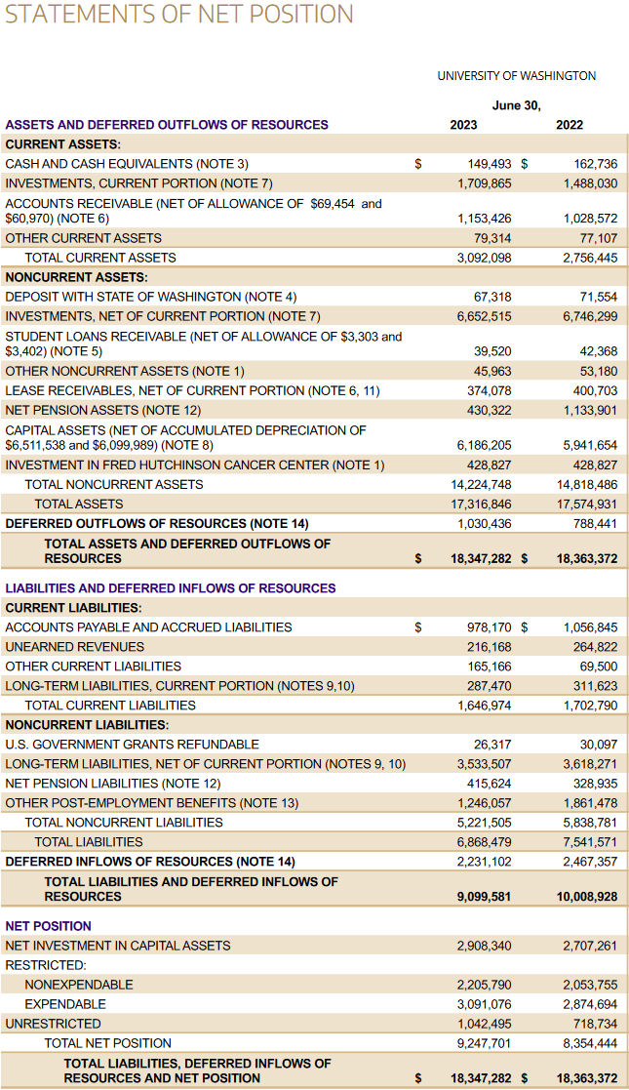
Sections of the Financial Statements
(Balance Sheet)
(Income Statement)
Notes:
Prior to Workday, there wasn’t really the array of reports and ability to see financial activity, so not everyone may be as familiar with how accruals actually appear, so we want to highlight the sections that are applicable to most units.
First is the Balance Sheet, which is on the left side of the screen. In UW’s enterprise financials, it’s called the Statement of Net Position. This financial statement shows what a unit owns (assets) and what is owed to other entities (liabilities), and probably most important to a lot of y’all, the Net Position. You can run Balance Sheets at a Balancing Unit level or Company level.
Key sections are Assets. This is where you’re going to see values related to things that your unit owns. Besides the standard Cash and AR and Capital Assets that you think of when you hear the term “asset”, I’m going to call out a couple ledgers that might be important to y’all that previously may have been handled by individual FAS Budget Numbers.
- Prepaid Expenses map to Assets. What’s a prepaid expense. It’s when you pay upfront for a service or good, like you pay for an annual insurance policy. Instead of expensing it all at once, you divide the expense by 12 and incrementally expense it over the service period.
- Security Deposits you’ve put down for a lease also maps to Assets
- Field Advances are considered Other Receivables, which are Assets.
For Liabilities, this section is going to have the amounts that the unit owes to others
- Unearned Revenue. Like you’ve committed to providing Lab Services and they’ve paid the first installment or even the full contract amount, but the contract starts next month. You haven’t earned that revenue yet, so just in case that contract or activity is cancelled and you have to refund that cash, it’s considered Unearned Revenue.
- Accrued Salaries and Benefits are here in the liability section. We get paid for the periods 1-15 and then 16-end of the month. That end of the month payment doesn’t happen until sometime the following month, so we have to accrue for it and put that expense in the period that it actually happened in.
- Deposits. We have a few units that collect deposits for various things, like bike lockers. You don’t actually own that money and it will be returned at the end of whatever designated period, so it’s a liability.
Lastly, the Net Position section on the Balance Sheet. (also called equity, retained earnings, or reserves). In Workday we have a couple of Net Position ledgers, one for current year, which is a running total that ties to the current year income statement, and the other is accumulated prior year net position. Pause for Erick to note about the Fund breakout within Net Position as that visibility is new.
The statement on the right is the Income Statement, where you have the revenue and expenses. There’s also the non-operating section. The split between Operating and Non-Operating is determined by GASB. Units generally will only see these lines in very specific situations, like Gift Revenue.

Slide 27
Sections of the Financial Statements
Notes:
When we’re creating transactions, we want to be mindful of where the activity ends up on the Income Statement.
For example, in the Revenue Section, if we’re not earning Sponsored Grant Revenue, we shouldn’t be transacting on Ledgers that roll up to the Non-Governmental Grants and Contracts section on the Income Statement. If you’re an Auxiliary unit, you won’t be earning revenue in the “Sales and Services of Educational Departments” section. We’ve tried to set up APRs and Custom Validations to limit crossing wires, but sometimes there are gaps, and those should be brought to our attention if you see users transacting in areas that don’t seem right.

Slide 28
Sections of the Financial Statements
Notes:
Similarly, in the expense section, for the most part, Salaries and Benefits are going to be driven by Payroll so you shouldn’t be touching Accounting Worktags in that section. Same with Depreciation, which is driven by the Capital Asset process.

Slide 29
Sections of the Financial Statements
Notes:
And as I mentioned before, the Non-Operating section will be for specific instances like Pell Grants, State Appropriations, or Gifts. If for some reason you find that you’re booking activity to a Spend or Revenue Category that maps to “Other Non-Operating Revenues or Losses”, you might want to take a pause and re-evaluate if the correct Category has been selected

Slide 30
Wrap Up

Slide 31
High Level Do’s and Don’ts
Do – use In/Out ledgers together
  Ledgers represent the transferring in and out of funds, costs, overhead, etc. need to be used in combination with each other for both the debit and credit of the journal.
Do – use the correct overhead
  47300/47310 Institutional Overhead is for use by FPB to distribute enterprise overhead expenses. 47400/47410 Organizational Overhead is for use by Dean and Central Offices for distributing overhead within their Balancing Units.
Do – create Revenue Categories for the revenue streams and Spend Categories for the expenses you need to report on
  the categories are there for you to transact on and there isn’t a more granular reporting tag for Revenue Category, and Purchase Item or Expense Item won’t always apply
Don't – transact on ledgers generated by Workday processes, such as depreciation expense or payroll and benefit expenses
Don't – transact on ledgers that contain system names, as those were built for integrating and reconciling with those specific systems
  e.g. 12200 Accounts Receivable - Student Database (SDB)
Notes:
In/Out ledgers. - Look at the account type for the In/Out ledgers and make sure you're selecting a corresponding Revenue or Spend Category to go along with that account type. Revenue Types need Revenue Categories, Expense Types need Spend Categories

Slide 32
Resources
What I really needed was an accounting bootcamp: https://uwnetid.sharepoint.com/sites/UWFTChangeNetwork/SitePages/Finance-Literacy-Catalog.aspx?OR=Teams-HL&CT=1636485345294
I just needed the list of Revenue Categories and what Ledger they map to: https://uwconnect.uw.edu/finance?id=kb_article_view&sysparm_article=KB0033117
Where’s that list of Spend Categories Again?: https://uwconnect.uw.edu/finance?id=kb_article_view&sysparm_article=KB0032449
Can you just tell me what XYZ Ledger purpose is: https://uwconnect.uw.edu/finance?id=kb_article_view&sysparm_article=KB0033039
Custom Validation List – https://uwconnect.uw.edu/finance?id=kb_article_view&sysparm_article=KB0033525

Slide 33
What’s Next – Draft
Series #2 – UW Specific Setups Deep Dive
  Journal Source types and purposes
  Accounting Journal types
  Revenue and Spend Categories for Operational Journals
  Financial Statement

