Slide 1
Shared Environment
FDM Bootcamp Series #1
– UW Specific setup Deep Dive
October 8, 2024

Slide 2
FDM Bootcamp Series #2 – UW Specific Setup deep dive
# | Topic | OBJECTIVE | Lead | Time
1 | Bootcamp Series | Series Overview Goals & Audience Recap Series #1 & Series #2 Pre-req Today’s focus | Erick | 5
2 | Initiating Transactions in Workday | Types Purposes | Christina | 5
3 | Refresh | Custom Validations Account Posting Rules | Christina | 5
4 | Behind the Scenes | Examples of each type | Erick | 90
6 | Wrap Up | Resources What’s the Next | Christina | 5

Slide 3
Bootcamp Series

Slide 4
Goals & Audience
Key Audience: Shared Environment (SE) Accountant focus
Goals:
  To strengthen SE accounting knowledge, based on UW needs and Workday setups.
  To create future job aids to build accounting knowledge in support of UW accounting principles and reporting needs.
    Leverage for all users performing WD transactions across all campuses

Slide 5
FDM Bootcamp Series Preview
Series #1 - Accounting Fundamentals – Recap & Pre-req to #2
  Accounting Worktag Overview
  UW Accounting Principals
  Financial Statements
Series #2 – UW Specific Setups Deep Dive
  Initiating Transactions in Workday
  Refresh – Custom Validations & Account Posting Rules (APR’s)
  Behind the Scenes
Series #3 – Net Position
  How to interpret your data
  Corrections
Series #4 – Reporting
  Planning and budgeting reports
  Book Codes

Slide 6
Today’s Focus
Overview
  Recap Series #1 & Series #2 Pre-req
Initiating Transactions in Workday
Refresh
  Custom Validations
  Account Posting Rules
Behind the Scenes
  Examples of each type
Wrap Up
  Resources
  What’s the Next Session
Notes:
How APR’s work with these *

Slide 7
Initiating Transactions in Workday

Slide 8
How do Transactions Start in Workday
Integration
Operational Transactions
Manual Journals
Notes:
Transactions start in Workday generally through the following ways
- Integrations
- Operational Transactions
- Manual Journals

Slide 9
How do Transactions Start in Workday
Integration
  Similar to a manual journal, but configured in the source system
Operational Transactions
  Workday System-generated journals from the various functional areas
Manual Journals
  Enter journals manually, specifying both the Revenue or Spend Category and the Ledger
  Can load journals via an EIB spreadsheet
  Use book codes to adjust default set of books (Financial Reporting, Year End Adjustments, etc.)
  Specify an accounting journal source
Notes:
We'll walk through examples of each one in a little bit, but let's first talk about the differences in initiating journals in different ways.
Integrations and Manual Journals are similar in that you need to specify both the Revenue or Spend Category and the Ledger. If you recall our first bootcamp session, we noted that the Revenue or Spend Category combinations with Ledgers are restricted by the Account Posting Rule (APR) configuration. So no matter how end users are entering in transactions, the combinations are the same.
For integrations, the configuration differs on how much is baked into the integrating system. End users may have the same flexibility as workday to access the breadth of available Spend or Revenue Categories, or they may be limited to ones specifically identified and configured. At the end of the day, the integrated worktags will still need to align with the configuration in Workday.
Operational transactions are initiated through Workday Business Processes. Vendor Bills, Customer Invoices, Expense Reports, Deferred Revenue, Internal Service Deliveries, and many more type of processes exist where transactions are generated behind the scenes. End Users typically only need to select the Revenue or Spend Category and a couple of driver FDM worktags, and Workday configuration will populate and book the journal entry. We encourage users to initiate, correct, or adjust transactions as much as possible at the source. That means going back to the original Customer Invoice or Expense Report, etc. And adjusting the original documents. This is the cleanest way of operating in Workday. Of course that means issues have to be caught and corrected in the same period before it closes.
Lastly, manual journals are just that. Manually entering transactions into Workday. Users with the security able to create manual journals have a lot of power, but with that, there's a lot of responsibility. Users will need to specify the Revenue or Spend Category and the Ledger, make sure the sign or debit/credit is correct. Users will also need to specify the Book Code, which separates accounting activity in layers based on reporting needs. We'll talk more about Book Codes in a later bootcamp session. Lastly, users will also need to specify the journal source, which will help differentiate the origin and purpose of the transaction, from other transactions.

Slide 10
Refresh: Account Posting Rules (APR’s) and Custom Validations (CV’s)

Slide 11
Account Posting Rule (APR) Impact on Transactions
Integration
  As long as you set up the integration correctly, the APR won’t raise any flags and you don’t have to do anything further
Operational Transactions
  Users select a Revenue Category or Spend Category. Behind the scenes, the system is pulling in the Ledger based on the configured APR
Manual Journals
  Users will need to know the connection between the RC/SC and the Ledger. These combinations will be predetermined and restricted by the APR. Users will not be allowed to use a combination that doesn’t exist
Notes:
Calling back to the first bootcamp a couple of weeks ago, APRs serve as the guard rails or drivers for the accounting worktags of each transaction.
Out of the three types, Operational Journals are the only ones that end users only need to specify the Revenue or Spend Category as Workday will add the Ledger based on the Account Posting Rules. A caveat is that end users will need to understand the attributes of the Spend Categories they select as that will indicate whether or not they can use them in the business process.
For both the Integration and Manual journal types, end users will need to not only select the Spend or Revenue Category, but also identify the correct Ledger. Please refer to the first FDM Bootcamp for using the resources to make these determinations.

Slide 12
Custom Validations
Custom Validations are back-end rules that either raise a flag or prevent a transaction from being completed.
Custom Validations that we focus on are:
  Is the mapping used between Revenue Category or Spend Category and Ledger in line with what has been configured for the Account Posting Rule mappings
  Does your security role(s) allow you to use a specific Journal Source, or does it block you from posting to a specific Ledger
Notes:
As we noted in the previous session, Custom Validations are the restrictions configured in Workday.

Slide 13
What happens when I run into an error when posting a transaction?
Read the help text for the Custom Validation
  Ex – FIN103 FIN - Accounting Journal Contains Restricted Ledger Account – “Accounting Journal Contains Restricted Ledger Account”
    What are you trying to accomplish with this transaction? Book an Accrual? Recognize Revenue?
    Did you select the right Revenue Category or Spend Category and Ledger Combination based on your Balancing Unit?
    Do you have the correct security role to transact on the selected ledger?
Resource: Revenue Category Listing (show how to select a Revenue Category and trace it through to the Ledger)
Resource: Spend Category Listing (show how to select a Spend Category and trace it through to the Ledger)
Resource: Custom Validation Listing
Notes:
There's a lot of different facets of a transaction to think about.
Sometimes these flags aren't easy to resolve, so please refer to the Custom Validation listing resource and reach out through UW Connect if you need additional assistance.

Slide 14
Behind the Scenes: Journal Sources and examples

Slide 15
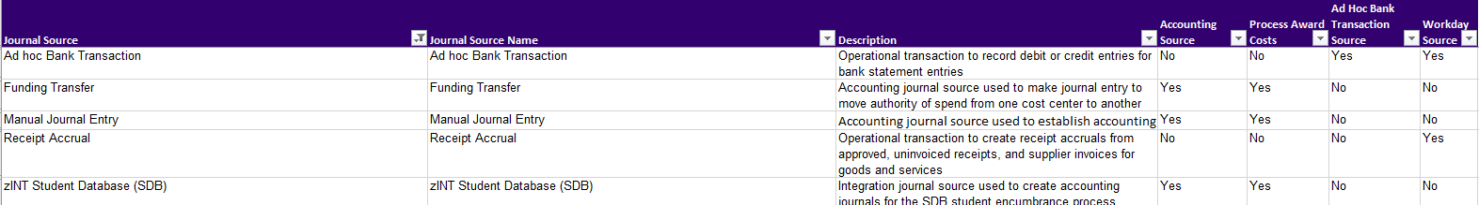
Transaction Origins are Categorized by Journal Source
Integration – begin with zINT
  Ex – zINT Student Database (SDB)
Operational Transactions
  Ad Hoc Bank Transaction (AHBT)
  Receipt Accrual
  Many more…
Manual Journals
  Funding Transfer
Resource: Journal Source Listing
Notes:
There is a new resource, a knowledge article of the various Journal Sources and their purpose. The link will be at the end.

Slide 16
What happens behind the scenes with these Journal Sources
Integration
  The appropriate Revenue Category worktag, and any other worktag that was determined to be necessary when setting up the integration (such as the Program worktag), needs to be identified in the source system.
  Ex – zINT Student Database (SDB)
    In order to account for Tuition in Workday, Student Fiscal Services (SFS) has set up SDB to send the Company and Ledger worktags, plus a driver worktag and Revenue Category worktag based on the type of activity occuring.
    UW1861 Company worktag + 40000: Student Tuition and Fees + Course Fees in Addition to Tuition (RC1124) + Program worktag as a driver (brings in the Cost Center, Balancing Unit, etc.)
Notes:
In the case of SDB it has been designed to use multiple drivers..
Grants, gifts, programs or combination cost center/resource can be drivers.
SDB is accountable for sending revenue category and Ledger combinations that are still subject to the custom validation, they do not work like operational journals where the SC/RC will populate the ledger
Talk about how the information looks like when it gets to the unit

Slide 17
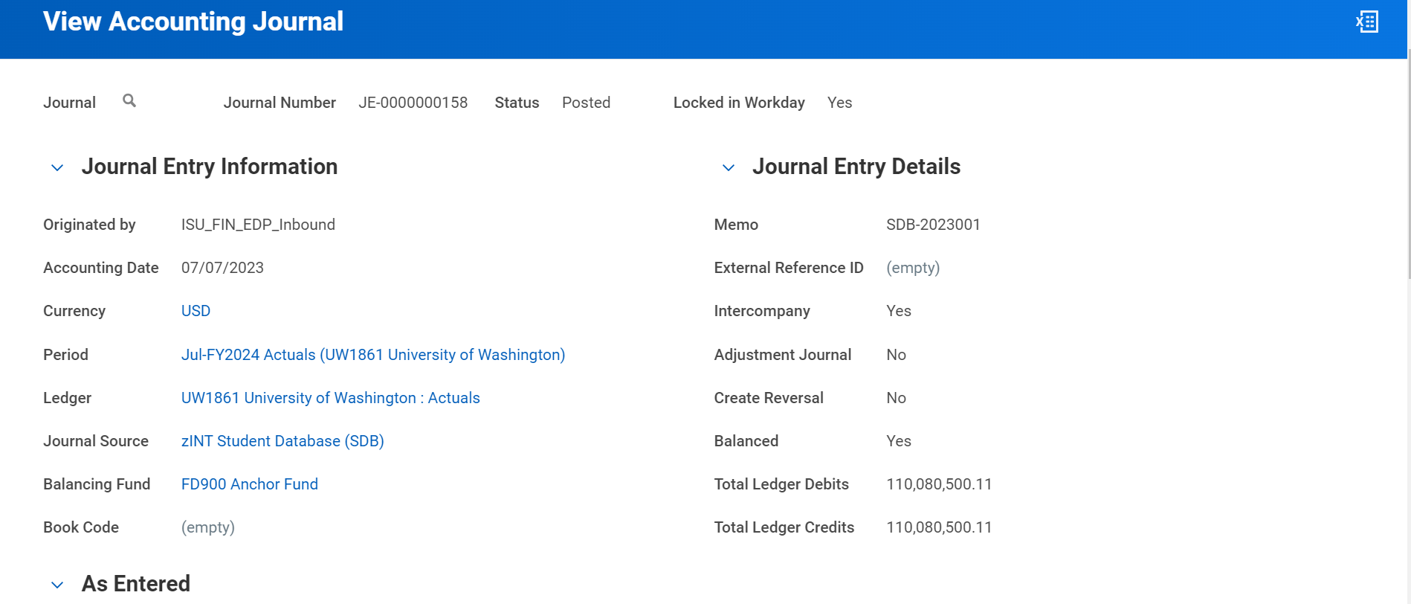
Header
X

Slide 18
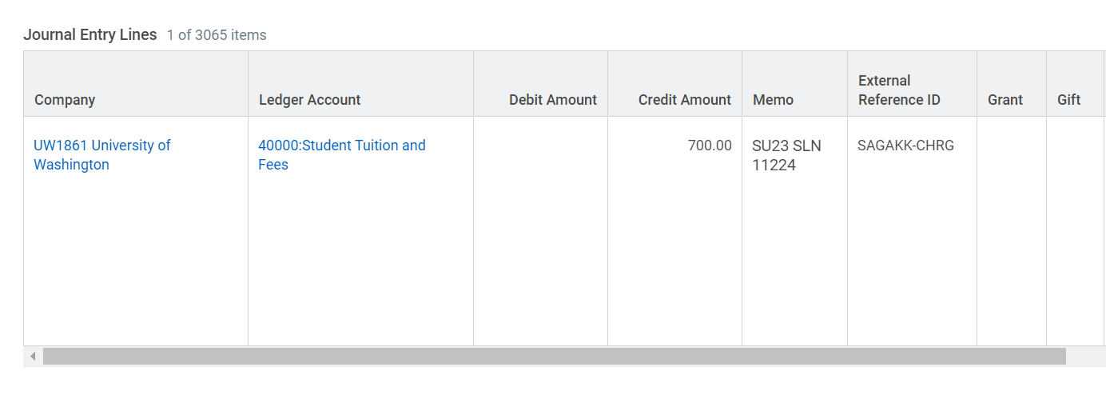
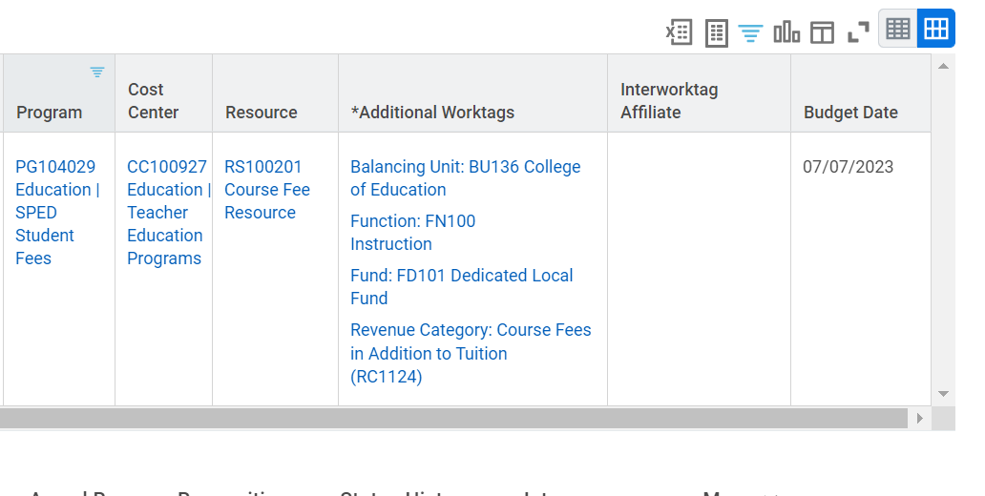
Line Detail

Slide 19
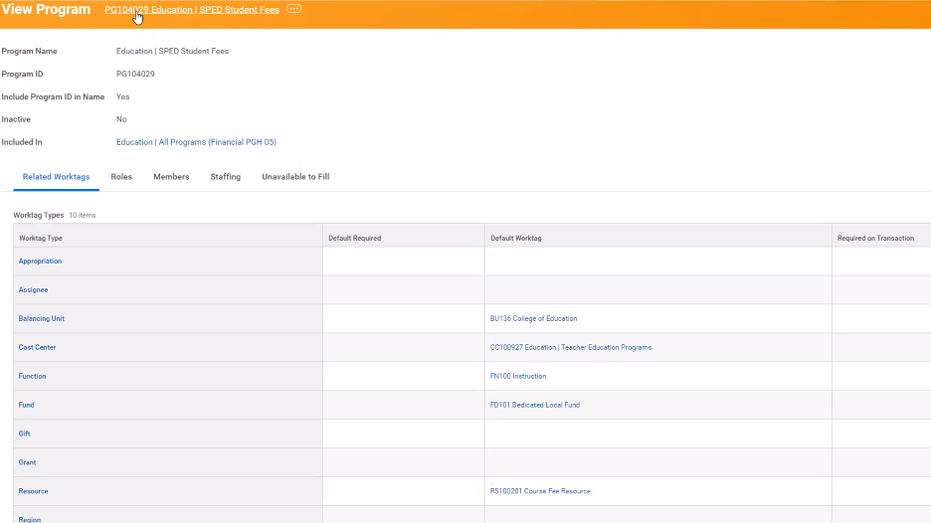
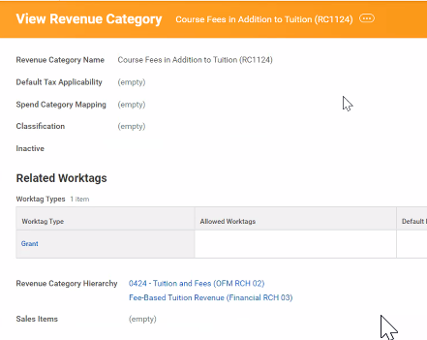
X
X
Notes:
Add example – Christina to help

Slide 20
What happens behind the scenes with these Journal Sources
Operational Transactions
  Users select the Revenue Category or Spend Category that represent the revenue or expense being captured, and behind the scenes, Workday creates an accounting journal with the appropriate debit and credit, reducing the need for users to have accounting knowledge, and ensuring consistent accounting treatment across UW.
  Ex – Ad Hoc Bank Transaction (AHBT)
  Ex – Receipt Accrual
Notes:
Highlight the APR dictating the ledger

Slide 21
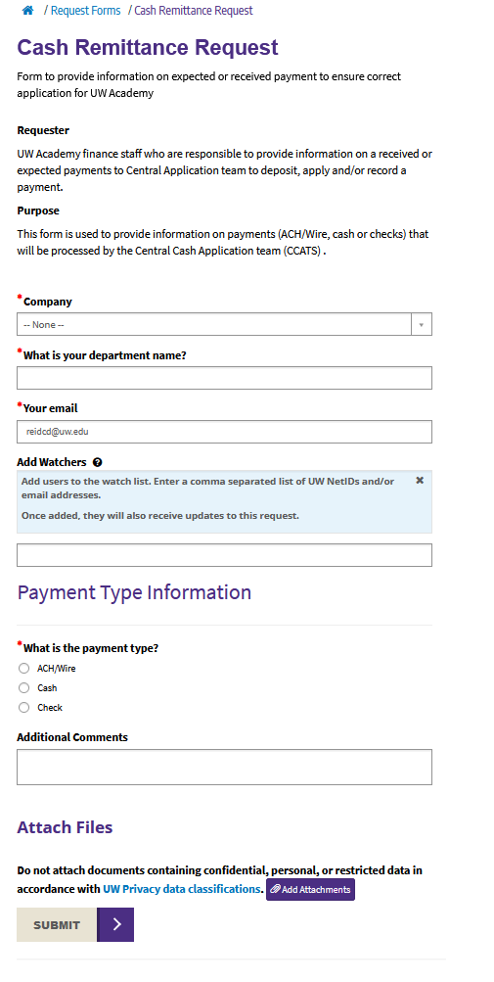
Ex. – Ad Hoc Bank Transaction Initiation
UW Connect Finance Request Form
Notes:
AHBT is initiated in a request form or upon request from Treasury
Discuss the desire to use customer invoices wherever possible, CCATS can apply a deposit to a customer invoice and the accounting is already dictated by the customer invoice (and revenue recognition is timely.

Slide 22
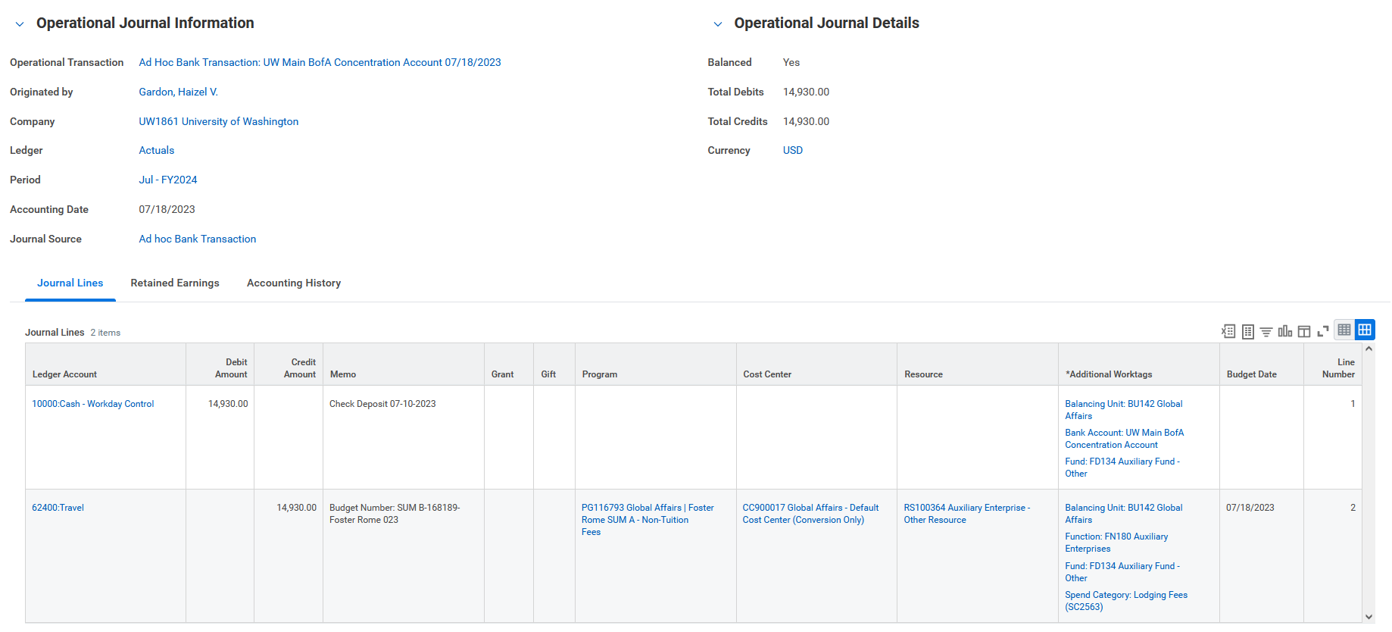
Ex. – Ad Hoc Bank Transaction: Journal
X
Notes:
AHBT is initiated in a request form or upon request from Treasury
CASH is required, there is no choice to but to use cash on one side – this is an interesting example, it is crediting travel expense (rather than increasing revenue it is decreasing expense… remember session 1, credits increase revenue and decrease expense).

Slide 23
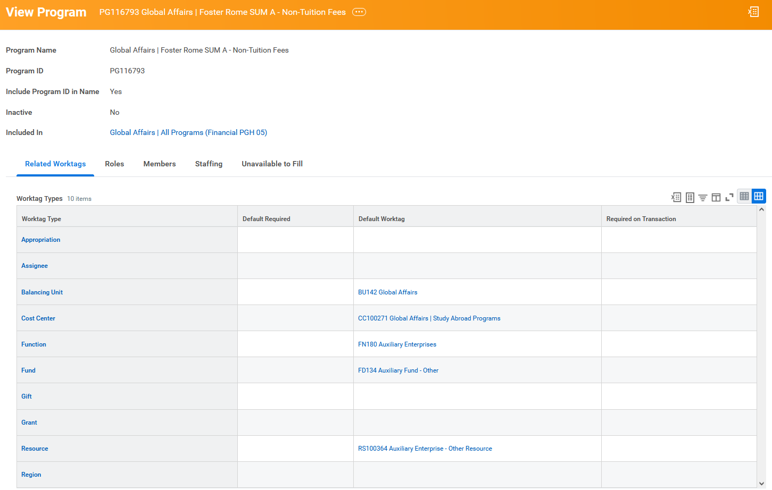
Ex. – Ad Hoc Bank Transaction: Program

Slide 24
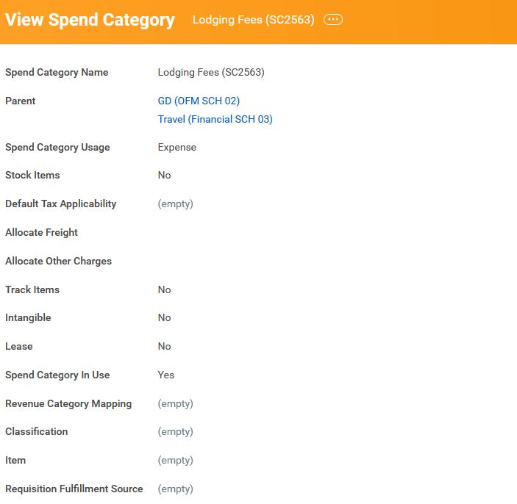
Ex. – Ad Hoc Bank Transaction: Revenue Cat.

Slide 25
Ex. – Receipt Accruals – Refresh
Purpose: recognize expense in the period in which goods or services have been received
Receipt accruals post expense and an accrued liability (accrued receipts), similar in concept to accrued salaries and wages
This entry will be setup to post the last day of the period and reverse immediately following on the first day of the next period.
The receipt accrual will continue to repeat creating a reversing entry monthly until the actual invoice is received and processed, generating accounts payable (opposed to accrued receipts)
Debit – Expense
Credit – Accrued Receipts

Slide 26
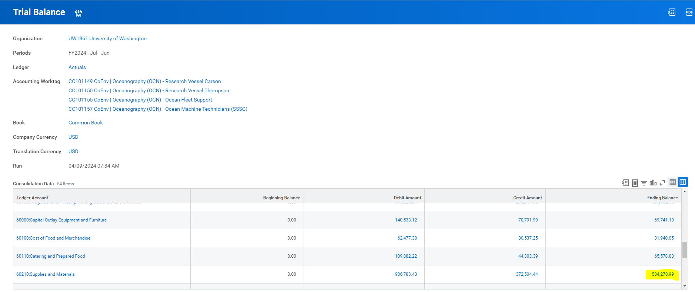
Ex. Receipt Accruals – Trial Balance Expense

Slide 27
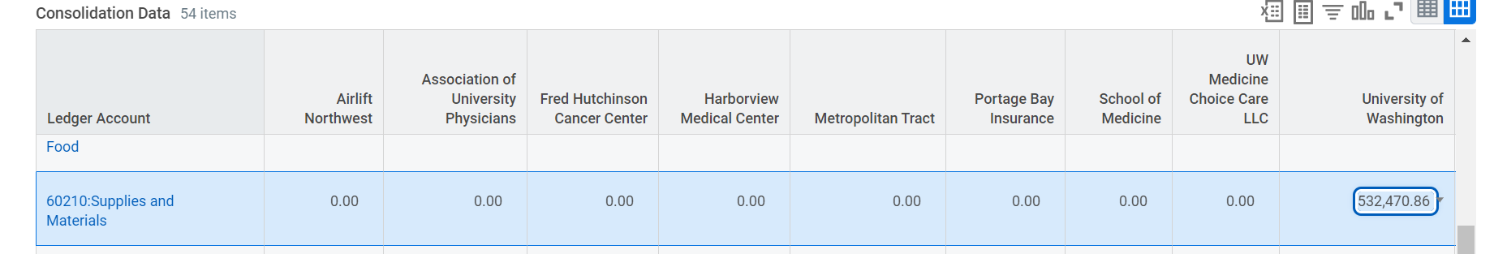
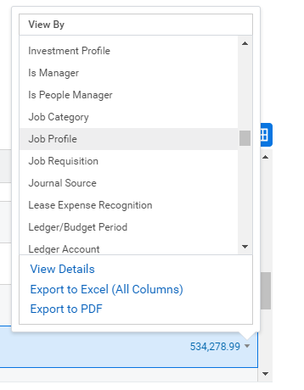
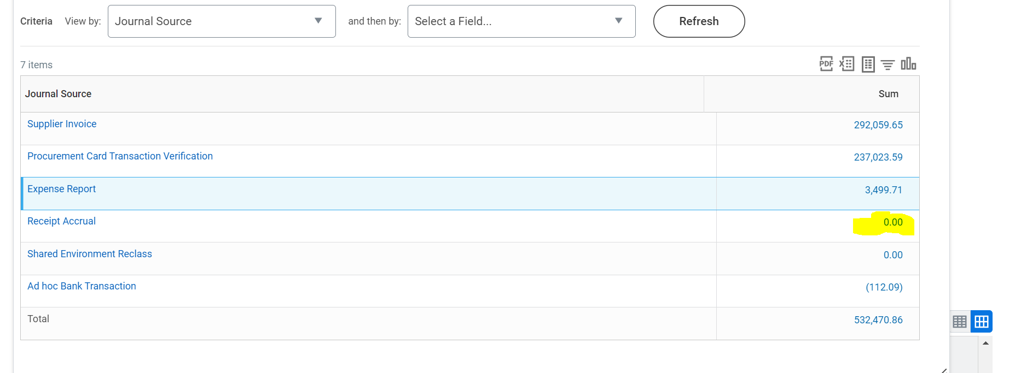
Ex. Receipt Accruals
Drill into expense amount by journal source
Drill into receipt accruals (‘blue’ 0.00 means there are transactions)

Slide 28
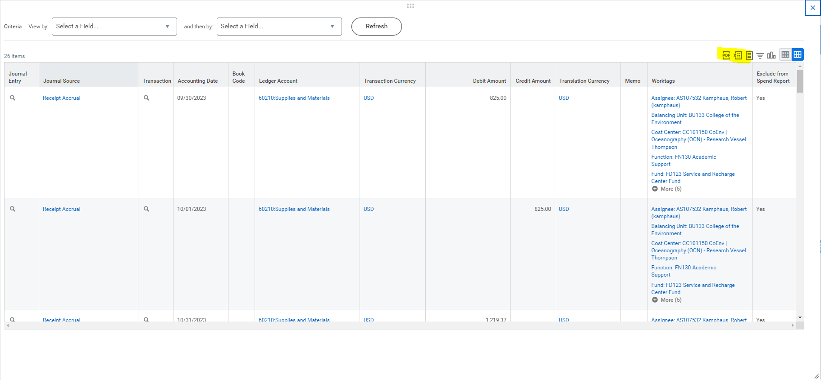
Ex. Receipt Accruals
Extract journal lines into Excel

Slide 29
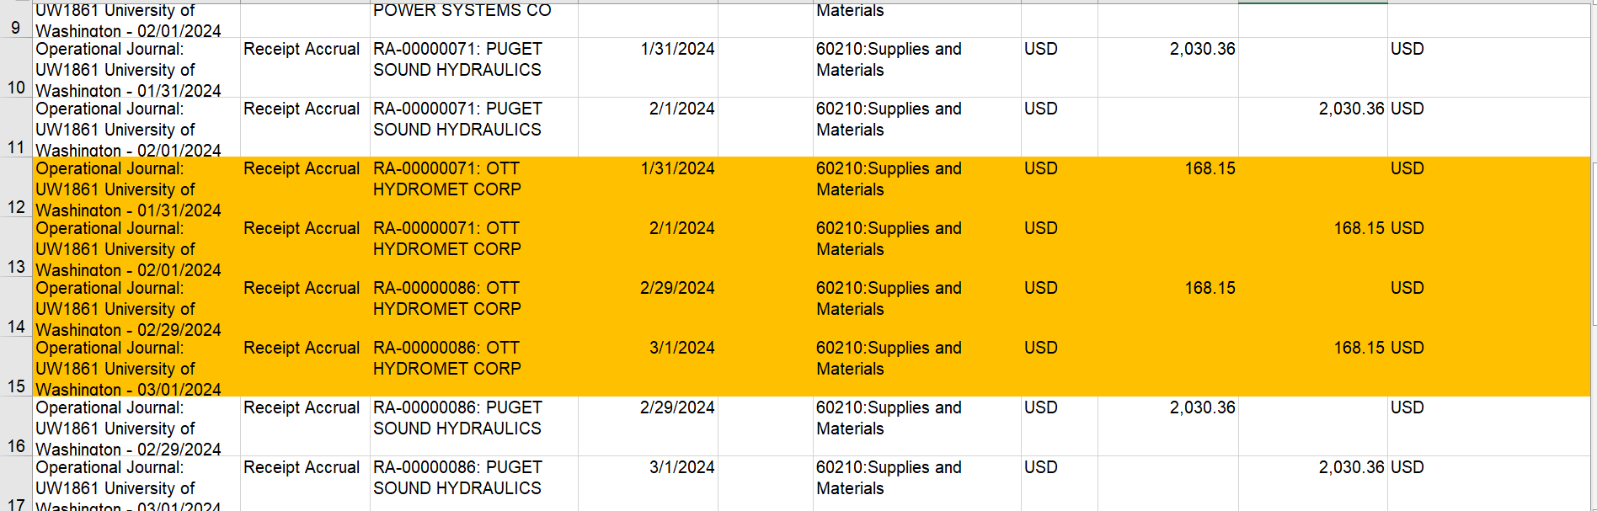
Ex. Receipt Accruals
Supplier Invoice comes in (March 2024)
Debit $168.15 (60210 Supplies and Materials)
Credit $168.15 (Accounts Payable)
Notes:
Remember back to the income statement vs. balance sheet (income statement is period activity, balance sheet carries a balance)
You are left seeing $168.15 of Expense in January -- February and March net to zero in supplies expense
Balance sheet has seen the accrued receipts account zeroed out as well, and left with a balance in Accounts Payable
Eventually cleared when paid/settled, and reduces cash.
You are left with expense in January (remember.. Reduces your NET POSITION per calculation) and a liability in the form of accrued receipts, then later AP until finally cleared and reduces cash.

Slide 30
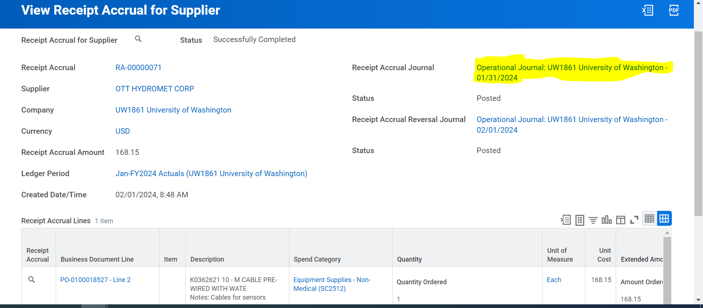
Ex. Receipt Accruals
Notice the multiple (monthly) receipt accrual operational journals

Slide 31
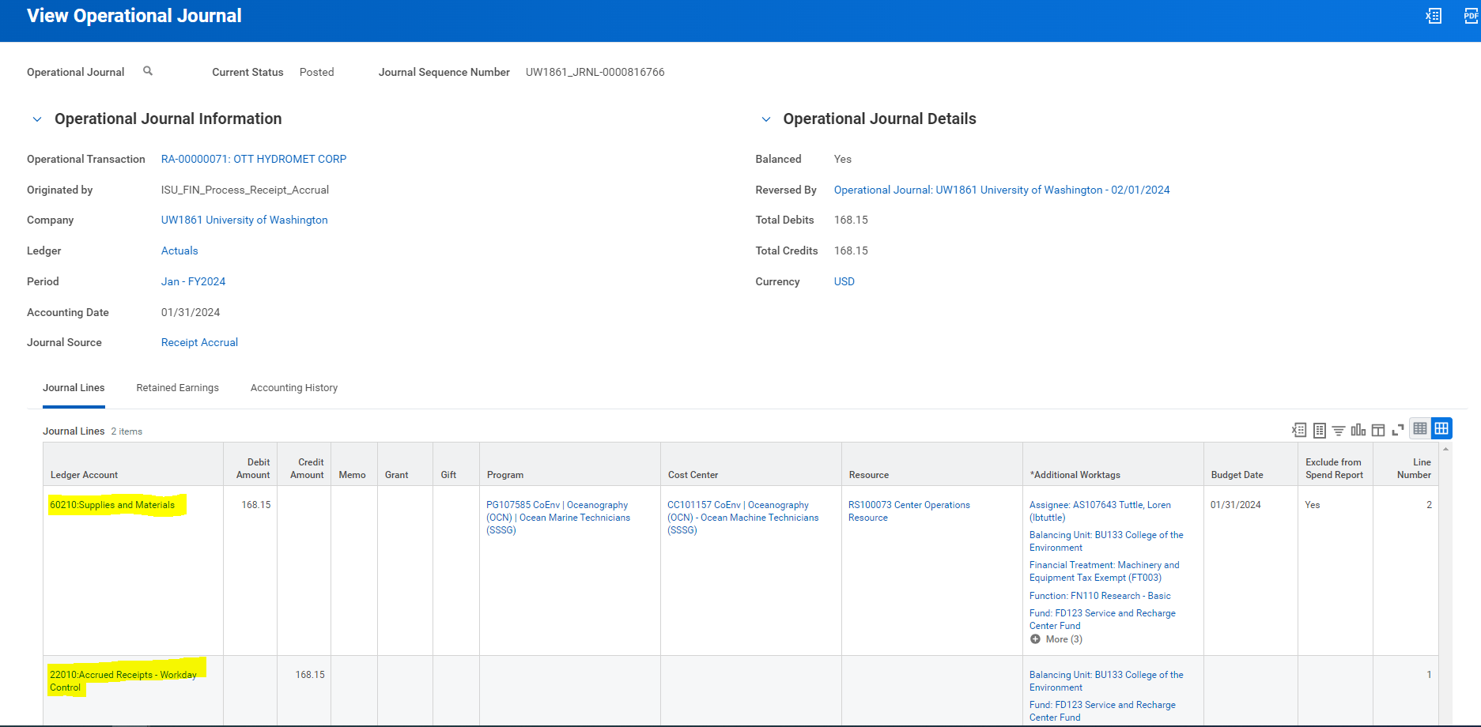
Ex. Receipt Accruals
The 22010 Accrued Receipts only posts to balancing worktags, not cost center (similar to Accounts Payable)
Notes:
Accrued receipts.. And eventually AP will only hit the balancing worktags (balancing units)

Slide 32
What happens behind the scenes with these Journal Sources
Manual Journals
  Ex – Funding Transfer
Reference
  Income Statement Self Eliminating Ledger Accounts R1287.10
Notes:
Funding Transfer & Expense Transfer
Highlight CVs – Ledger and Category combo is restricted based on existing APR
Highlight eliminating combo of ledgers
Resource matches, rev and spend category go with the Ledger via APR CV, and must use the ledgers together
Using driver worktags have to be careful.. Can use program as driver but be careful that if using two programs that you don’t end up crossing resource or fund

Slide 33
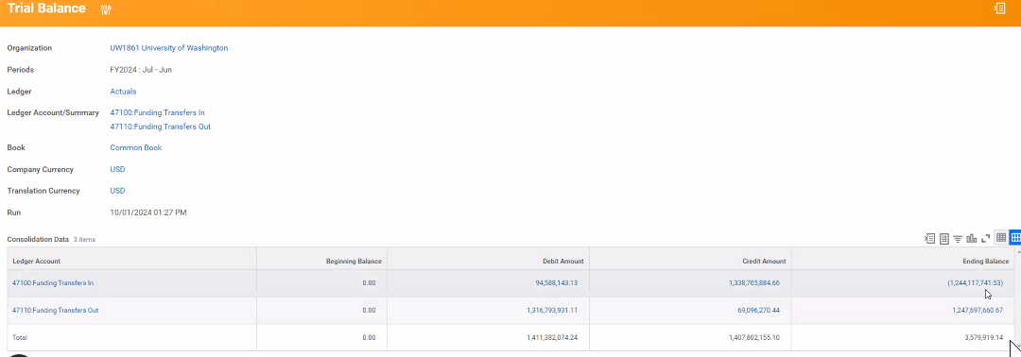
Ex. Manual Journal – Funding Transfer
X

Slide 34
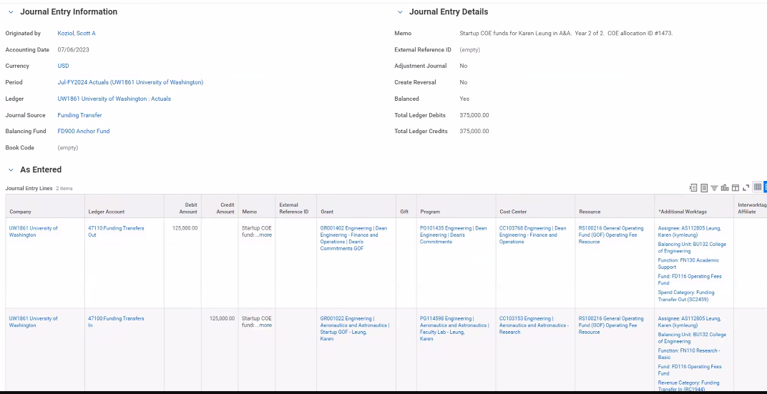
Ex. Manual Journal – Funding Transfer
X
Notes:
Funding Transfer & Expense Transfer
Highlight CVs – Ledger and Category combo is restricted based on existing APR
Highlight eliminating combo of ledgers – CV can’t work across multiple lines, like making sure they balance or are used in pairs.
DO not cross funds or resources unless explicitly allowed via the user guide
Using driver worktags have to be careful.. Can use program as driver but be careful that if using two programs that you don’t end up crossing resource or fund
Another example: JE-0000177513 School of Dentistry

Slide 35
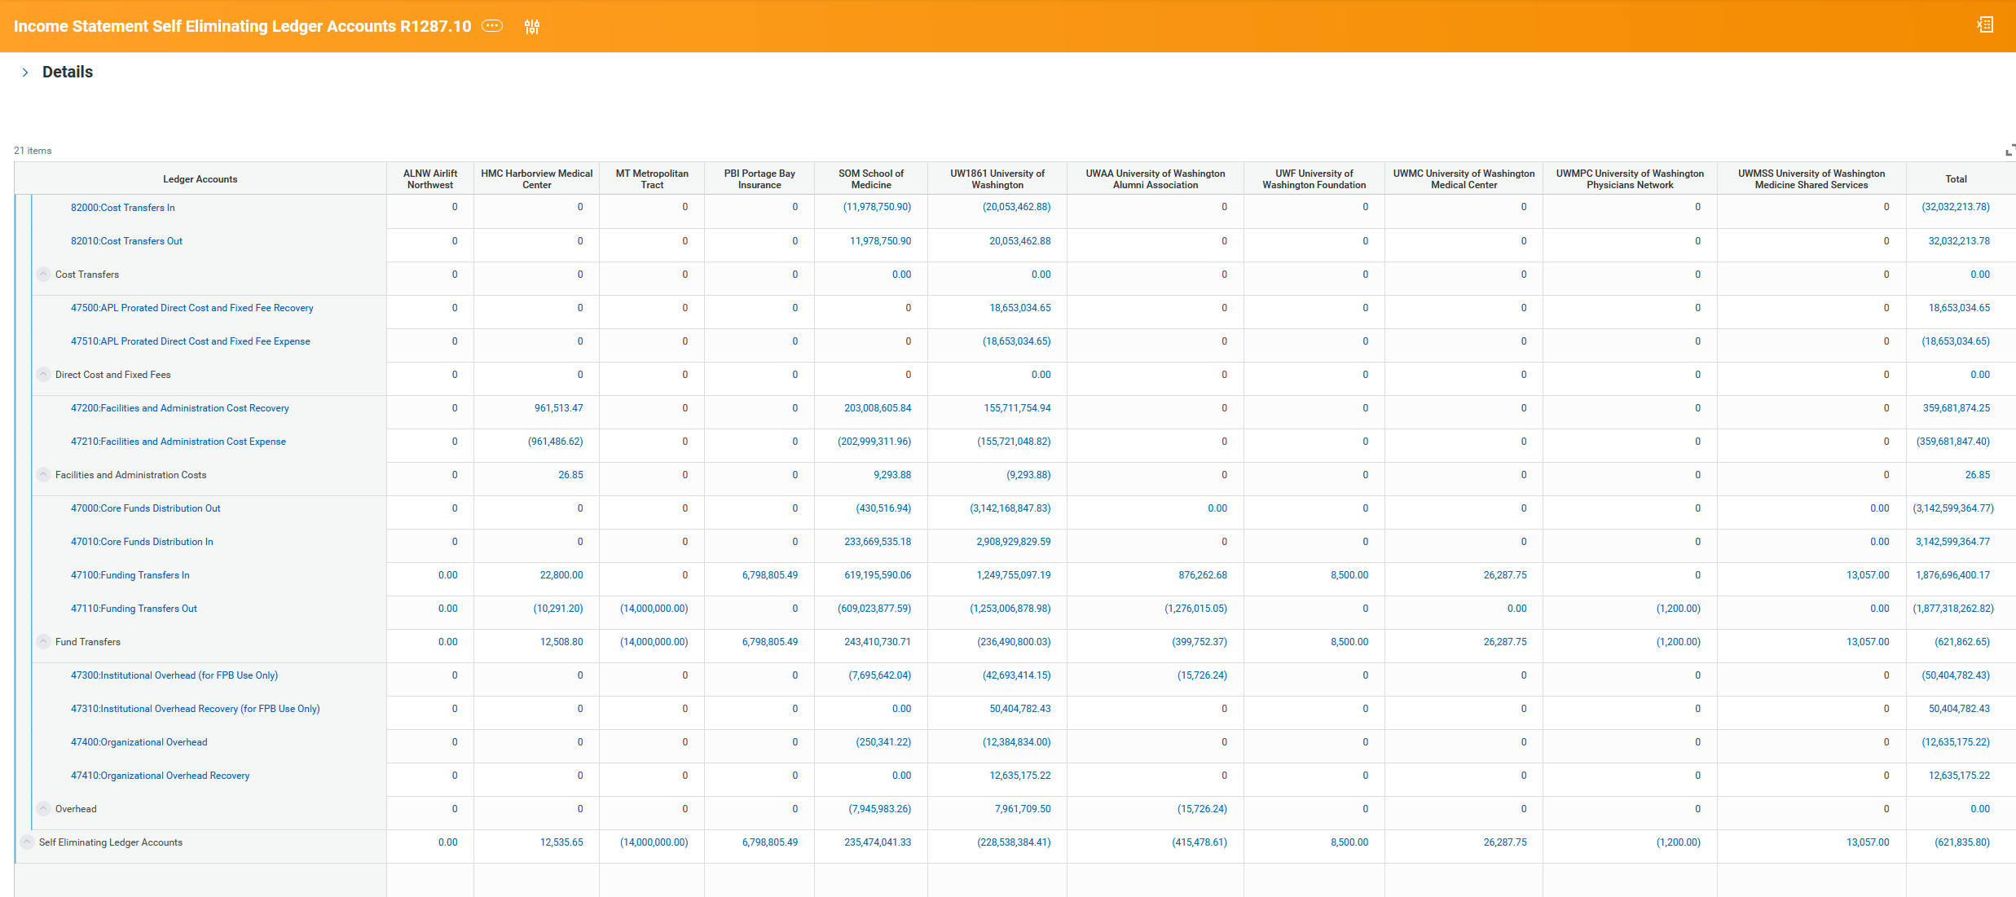
Notes:
Explain the concept of “gross-up” of revenues and expenses, drive home the importance of using combos

Slide 36
Wrap Up

Slide 37
High Level Do’s and Don’ts
Do – use In/Out ledgers together
  Ledgers represent the transferring in and out of funds, costs, overhead, etc. need to be used in combination with each other for both the debit and credit of the journal.
Do – create Revenue Categories for the revenue streams and Spend Categories for the expenses you need to report on
  the categories are there for you to transact on and there isn’t a more granular reporting tag for Revenue Category, and Purchase Item or Expense Item won’t always apply
Don’t – cross fund or resource worktag
Don't – transact on ledgers that contain system names, as those were built for integrating and reconciling with those specific systems
  e.g. 12200 Accounts Receivable - Student Database (SDB)
Notes:
In/Out ledgers. - Look at the account type for the In/Out ledgers and make sure you're selecting a corresponding Revenue or Spend Category to go along with that account type. Revenue Types need Revenue Categories, Expense Types need Spend Categories

Slide 38
Resources
Accounting Bootcamp Link
Ledger and Ledger Account Summary List
Revenue Category List with general APR references
Spend Category List with general APR references
Custom Validation List
Journal Sources List

Slide 39
What’s Next
Series #3 – Net Position
  How to interpret your data
  Corrections
Notes:
All of these transactions impacted your net position… next session we will follow the flows in/out of net position.

Slide 40
Reference documents

