Slide 1
Shared Environment FDM Bootcamp Series #3 – Net Position
November 12, 2024

Slide 2
FDM Bootcamp Series #3 – Net position
# | Topic | OBJECTIVE | Lead | Time
1 | Bootcamp Series | Series Overview Goals & Audience Today’s focus | Erick | 5
2 | Introduction | Multi-dimensional net position Book Code (include book vs book code) | Erick | 40
3 | Examples Review | Clearing Net Position to inactivate Program Clearing Net Position to inactivate Program but… things in the wrong places What to avoid | Scott | 15
4 | Recap the Basics – How to interpret your data | Multi-dimension report viewing Deficit (what is or isn’t) R1300 and various reports | Scott/Erick | 15
5 | Corrections | Parameters (introduction to book codes, enterprise impact & rollup) Net Position – what not to do | Erick | 20
6 | Wrap Up | Resources & UWCF tickets Q&A (time dependent) What’s the Next | Christina | 20
Notes:
Monitoring for net position should be a regular/weekly activity not just a MEC activity
How do SE’s get support after this session?
Gen Feedback form Ticket (denote acctg)

Slide 3
Bootcamp Series

Slide 4
Key Goals & Audience
Key goals - to strengthen SE accounting knowledge, based on UW needs and Workday setups by:
Not teaching you to memorize the rules, but helping you understand the principles undergirding the rules:
A list of rules that encompasses all activity at the UW would be too long to memorize. More important is to understand what the rules are for and where they come from. In this way, you will apply them consistently to both common and uncommon situations.
It’s not necessarily doing what always has been done, but also asking ‘why’ are we now doing it this way? Or even what is the right way to do it now?
The need to see big picture accounting and reporting world, then be able to look at the transactions with this in mind
To create future job aids to build accounting knowledge in support of UW accounting principles and reporting needs.
Will be leveraged for all users performing WD transactions across all campuses
Audience: Shared Environment (SE) Accountant focus
Notes:
Add to second bullet that not only what is the right way to do it.. But what direction are we headed in our maturity
We are still on a journey

Slide 5
FDM Bootcamp Series Preview
Series #1 - Accounting Fundamentals – Recap & Pre-req to #2
Accounting Worktag Overview
UW Accounting Principals
Financial Statements
Series #2 – UW Specific Setups Deep Dive
Initiating Transactions in Workday
Refresh – Custom Validations & Account Posting Rules (APR’s)
Behind the Scenes
Series #3 – Net Position
Example Review
How to interpret your data
Corrections
Series #4 – Reporting
Planning and budgeting reports
Book Codes
Demos/deep dives
R1300
Compare to what’s available outside of WD (Adaptive, BI Portal, use of Cubes)

Slide 6
Today’s Focus
Introduction
Multi-dimensional net position
Book Code (books and book codes)
Examples Review
Clearing Net Position to inactivate Program
Clearing Net Position to inactivate Program but… things in the wrong places
The Basics – How to interpret your data
Multi-dim report viewing
Deficit (what is or isn’t)
R1300 and various reports
Corrections
When to do… (transaction type, expense transfer)
Where can I…
Parameters (book vs book code)
Notes:
First two sessions with a lot of focus granularity of revenue and expense – how transactions initiate from SC and RC and flow through to P&L
Net Position is focus on the impact of P&L transactions on net position

Slide 7
Introduction

Slide 8
Refresh: Accounting Principles
Debits and Credits, Net Position
Debit/Credit Summary – provides a summary of how to increase or decrease Ledger accounts
 | Balance Sheet |  |  | Income Statement
Account Range | (1XXXXX) Assets | (2XXXX) Liabilities | (3XXXX) Net Position {Fund Balance} | (4XXXX) Revenues | (5XXXX-6XXXXX) Expenses
To INCREASE or show a positive amount | Debit | Credit | Credit | Credit | Debit
To DECREASE or show a negative amount | Credit | Debit | Debit | Debit | Credit
Notes:
Erick TO ADD
-Accountants at UW need to understand that debits and credits are not the same as positives, (ex. Debit expense and credit expense.. Not “plus and minus”)… you could post this on your desktop.
How does net position work (current year vs. prior year, YE rollforward, rev/exp flow to net position, revenue transfers are current year revenue and impact net position) – go deeper in future session

Slide 9
Refresh: Accounting Principles
Debits and credits, accrual vs. cash
Debit/Credit Summary – example of transactions, full balance sheet
 | Balance Sheet |  |  | Income Statement
Account Range | (1XXXXX) Assets | (2XXXX) Liabilities | (3XXXX) Net Position {Fund Balance} | (4XXXX) Revenues | (5XXXX-6XXXXX) Expenses
ACCRUE expense (AP) |  | Credit $100 |  |  | Debit $100
ACCRUE revenue (AR) | Debit $200 |  |  | Credit $200
Close Expense to NP |  |  | Debit $100 |  | Credit $100
Close Revenue to NP |  |  | Credit $200 | Debit $200
Balance… | Debit $200 | Credit $100 | Credit $100 | $0 | $0
Notes:
Erick TO ADD
-Accountants at UW need to understand that debits and credits are not the same as positives, (ex. Debit expense and credit expense.. Not “plus and minus”)
How does net position work (current year vs. prior year, YE rollforward, rev/exp flow to net position, revenue transfers are current year revenue and impact net position) – go deeper in future session
UW operates in accordance with guidelines established under the Governmental Accounting Standards Board (GASB).
- Net Position Classifications and how it is calculated
- Income Statement Sections
-alignment of choice of a revenue category, with a ledger, with a LAS, with a section of the financial statement
how in FAS some of the accruals were budgets. Now theyre ledgers and theyre going to show up in the balance sheet which is accessed at the Balancing Unit level and not at the individual CC level. One note to pepper in where appropriate or opportunity allows is that budget should follow accrual basis also. Since actuals are accrued, budget should also - but the budget tool doesn't do any accrual automatically, so as planners, they need to be aware and plan correctly.
UW also operates on an accrual basis for accounting, which means that we recognize revenue and related expenses when they’re earned, not when we receive cash in the bank

Slide 10
Refresh: Accounting Principles
Debits and credits, accrual vs. cash
Debit/Credit Summary – example of transactions, full balance sheet
 | Balance Sheet |  |  | Income Statement
Account Range | (1XXXXX) Assets | (2XXXX) Liabilities | (3XXXX) Net Position {Fund Balance} | (4XXXX) Revenues | (5XXXX-6XXXXX) Expenses
ACCRUE expense (AP) |  | Credit $100 |  |  | Debit $100
ACCRUE revenue (AR) | Debit $200 |  |  | Credit $200
Close Expense to NP |  |  | Debit $100 |  | Credit $100
Close Revenue to NP |  |  | Credit $200 | Debit $200
Balance… | Debit $200 | Credit $100 | Credit $100 | $0 | $0
Assets (AR) $ 200
Liabilities (AP) $ (100)
Net Position $ (100)
Revenue $ (200)
Expense $ 100
Net Income $ (100)
Notes:
Net credit = net income
Which increases net position (credit)
In some reports, such as r1300 this increase may be reflected as a positive number (so credit increase is positive)

Slide 11
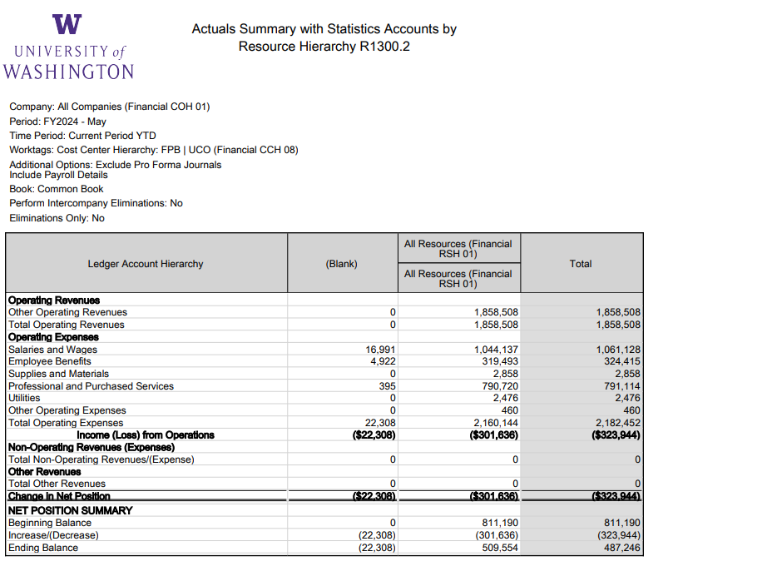




Actuals Summary/Income Statement
Notes:
In Session 1 we spent some time on operating revenues and expenses, non operating, the underlying spend/rev categories… now we see how they flow through to net position
R1300 shows (loss) as negative
Therefore (decrease) in net position
This report shows flow of P&L hitting CCH UCO and affect on NP – discuss how the worktags that make up the rev/exp flow through to NP

Slide 12
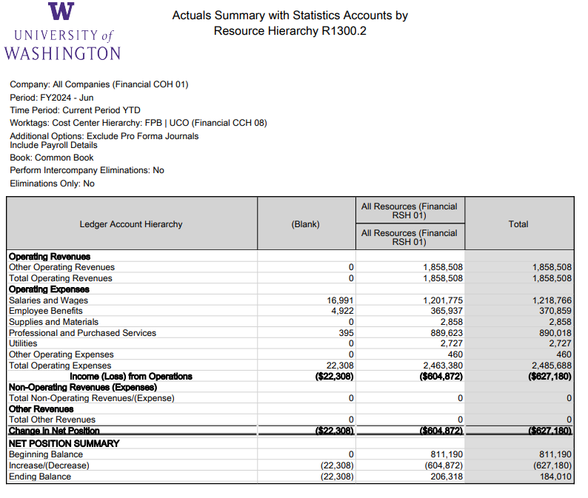




Actuals Summary/Income Statement
Blank Resource $22,308 Debits
Results in (Loss)
Net Position deficit of ($22,308) will carry forward to FY2025
Notes:
Move ahead to June (end of year) there is a loss of (627)K
Decrease in net position of (627)K leaves ending balance of 184K
There is a loss of 22,308K in blank resource??
Notice in the blank resource that the “positive” expenses result in a loss

Slide 13
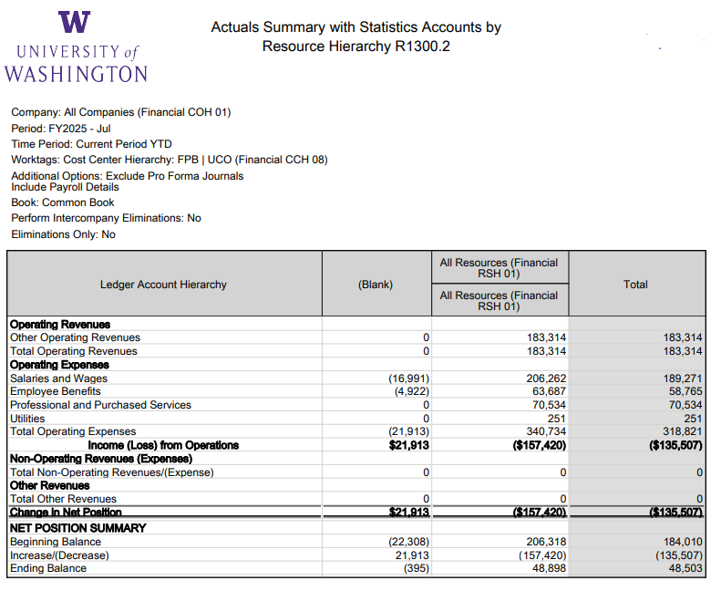





Actuals Summary/Income Statement
Payroll Accounting Adjustment processed to add Resource
Net Position deficit of ($22,308) carried forward in blank resource
Notes:
The net position balance of 184K rolled forward as beginning balance. But we can break this down to many dimensions, including resource. The (22,308) deficit rolled forward but in July it was transferred via payroll account adjustment. Added resource.
Notice that the “negative” in expense results in “income” in the blank resource
**Consider pulling up workday to drill into the PAA

Slide 14
Actuals Summary/Income Statement
Notes:
Let’s take a look at the 70K of expenses in purchased services in July. I want to drill in by other worktags, let’s start with program.

Slide 15
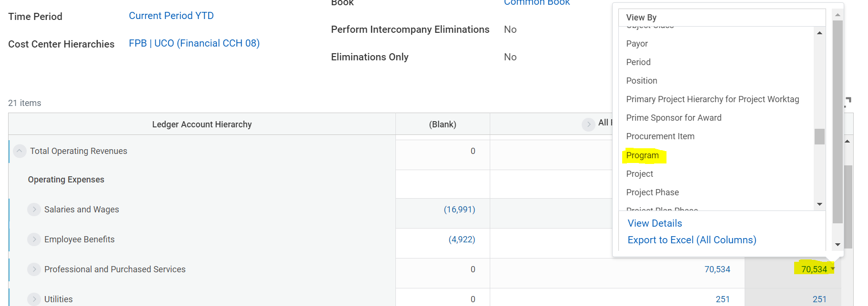
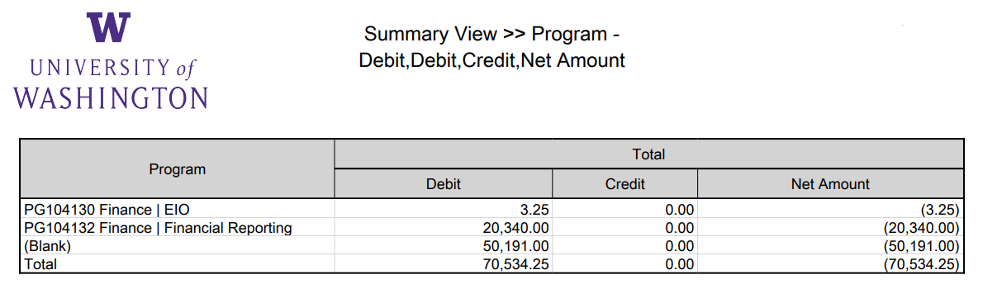
Multi-dimensional net position
Notes:
Lets’ drill in by program worktag – this is July (you can see blank because they rolled forward with blank program
20K assigned, 50K is blank program
I wonder which resources that 50K is posted to – we first drilled in by program, now let’s look by program and resource

Slide 16
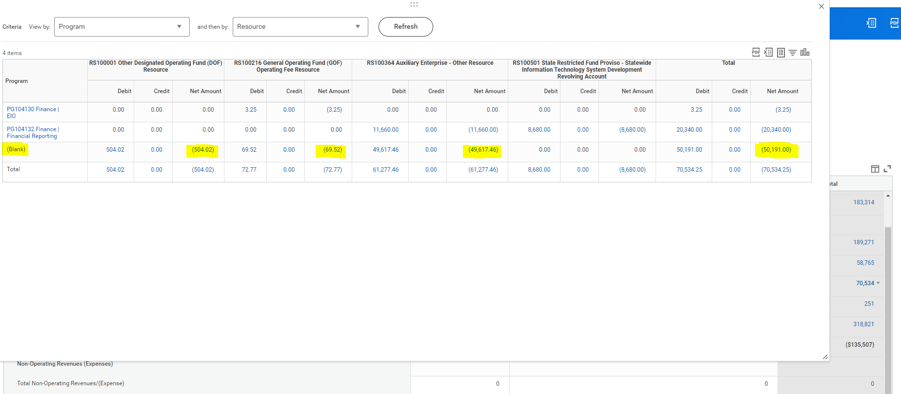
Multi-dimensional net position
Notes:
I see here that 49K of blank program is mostly in auxiliary resource – maybe it belongs to EIO or Financial Reporting (or I need another program?)
We can see here that P&L transactions can have multi-dimensional worktags (resource and program, as well as CC).. And they will affect net position

Slide 17
Multi-dimensional net position: Takeaways
Every revenue and expense transaction impacts net position, the “retained earnings” worktags present on transactions will be present in net position
Cost Center, Grant, Gift, Program, Project, Resource, Assignee
More importantly; when a revenue or expense transaction does NOT include a worktag, that worktag will not flow through to net position
R1300 drill-down can facilitate identifying transactions that derived blank program, resource or other worktags
Net position rolls forward with worktag distinctions (even blank)
Notes:
Transactions start in Workday generally through the following ways

Slide 18
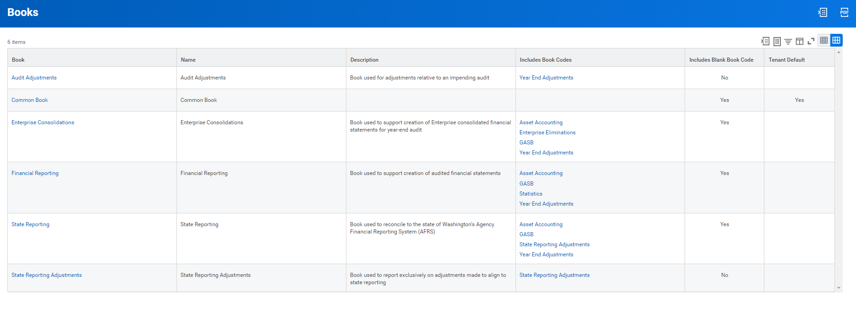
Books and Book Codes
Book is a “collection” of book codes
Common = Blank
but
Blank is more than common
Notes:
A book is a collection
A book code can be in many books (common is best example)
Common Book used on most reports
Financial Reporting is second most likely view
All else – typically for central use
Most important aspect of financial reporting book is the inclusion of the asset accounting book

Slide 19
 | Common | Asset | Combined
Expense | $ 48,000 | $ (48,000) | $ -
Capital Asset | $ - | $ 48,000 | $ 48,000
 | $ - | $ - | $ -
 | $ - | $ - | $ -
Net Position | $ (48,000) |  | $ (48,000)
Common Book vs. Financial Reporting Book
Equipment purchase $48,000
Common Book
$48,000 Expense [reduces net position = typically restricted expendable or unrestricted]
Financial Reporting Book (Asset Book Code)
($48,000) Expense [reverses effect on net position = in 400 series fund]
$48,000 Capital Asset [creates capital asset = 400 series fund]
Original Fund
400 fund series
 | Blank Book Code | Asset Book Code | Financial Reporting Book
Expense | $ 48,000 | $ (48,000) | $ -
Capital Asset | $ - | $ 48,000 | $ 48,000
Accounts Payable | $ (48,000) | $ | $ (48,000)
 | $ - | $ - | $ -
Net Position - Fund Original | $ 48,000 |  | $ 48,000
Net Position - Fund 400 |  | $ (48,000) | $ (48,000)
Original Fund
400 fund series
Notes:
We’ll explain later the nature of the 400 series funds
Even though this has a net zero effect on expense in the financial reporting book on expense – it is NOT net neutral on fund $48,000 debit in original, ($48,000) credit in 400 series.
This will come back to when we look at r1300 using the common book vs. financial reporting book

Slide 20
Net Position – Book view
 | Cost Center CC999999 - Common Book
Revenue |  | Month 1 | Month 2 | Month 3 | Total
 | Sales and Services | $ 10,000 | $ 10,000 | $ 10,000 | $ 30,000
 | Other Revenue | $ 1,000 | $ - | $ 1,000 | $ 2,000
 | Total Revenue | $ 11,000 | $ 10,000 | $ 11,000 | $ 32,000
Expense
 | Salaries and Wages | $ 7,000 | $ 7,000 | $ 7,000 | $ 21,000
 | Benefits | $ 3,000 | $ 3,000 | $ 3,000 | $ 9,000
 | Supplies and Materials | $ 50,000 * | $ 1,000 |  | $ 51,000
 | Depreciation
 | Total Expense | $ 60,000 | $ 11,000 | $ 10,000 | $ 81,000
Net income (loss) |  | $ (49,000) | $ (1,000) | $ 1,000 | $ (49,000)
Net Position
 | Beginning Balance | $ 50,000 | $ 1,000 | $ -
 | Increase (Decrease) | $ (49,000) | $ (1,000) | $ 1,000
 | Ending Balance | $ 1,000 | $ - | $ 1,000
Equipment:
Cost: | $48,000
Life: | 24 months
Month Depr: | $2,000
Depreciation Schedule
 | Mo 1 | Mo 2 | Mo 3
Capital | $ 48,000
Depr | $ 2,000 | $ 2,000 | $ 2,000
Accum Depr | $ 2,000 | $ 4,000 | $ 6,000
Net | $ 46,000 | $ 44,000 | $ 42,000
*Supplies and Materials include $48,000 Equipment
Notes:
Let’s go back to the R1300 view (look at multiple months side by side)
Comment on the matching principle – does the $48,000 equipment directly relate to the revenue earned in the period?
Explain the concept of the depreciation schedule – align the cost of the asset with the revenue it will earn, spreads out the cost

Slide 21
Net Position – Book view
 | Cost Center CC999999 - Financial Reporting Book
Revenue |  | Month 1 | Month 2 | Month 3 | Total
 | Sales and Services | $ 10,000 | $ 10,000 | $ 10,000 | $ 30,000
 | Other Revenue | $ 1,000 | $ - | $ 1,000 | $ 2,000
 | Total Revenue | $ 11,000 | $ 10,000 | $ 11,000 | $ 32,000
Expense
 | Salaries and Wages | $ 7,000 | $ 7,000 | $ 7,000 | $ 21,000
 | Benefits | $ 3,000 | $ 3,000 | $ 3,000 | $ 9,000
 | Supplies and Materials | $ 2,000 | $ 1,000 |  | $ 3,000
 | Depreciation | $ 2,000 | $ 2,000 | $ 2,000 | $ 6,000
 | Total Expense | $ 14,000 | $ 13,000 | $ 12,000 | $ 39,000
Net income (loss) |  | $ (3,000) | $ (3,000) | $ (1,000) | $ (7,000)
Net Position
 | Beginning Balance | $ 50,000 | $ 47,000 | $ 44,000
 | Increase (Decrease) | $ (3,000) | $ (3,000) | $ (1,000)
 | Ending Balance | $ 47,000 | $ 44,000 | $ 43,000
Equipment:
Cost: | $48,000
Life: | 24 months
Month Depr: | $2,000
Depreciation Schedule
 | Mo 1 | Mo 2 | Mo 3
Capital | $ 48,000
Depr | $ 2,000 | $ 2,000 | $ 2,000
Accum Depr | $ 2,000 | $ 4,000 | $ 6,000
Net | $ 46,000 | $ 44,000 | $ 42,000
Notes:
Comment on the matching principle – does the $48,000 equipment directly relate to the revenue earned in the period?

Slide 22
Net Position – Book view
 | Cost Center CC999999 - Common Book
Revenue |  | Month 1 | Month 2 | Month 3 | Total
 | Sales and Services | $ 10,000 | $ 10,000 | $ 10,000 | $ 30,000
 | Other Revenue | $ 1,000 | $ - | $ 1,000 | $ 2,000
 | Total Revenue | $ 11,000 | $ 10,000 | $ 11,000 | $ 32,000
Expense
 | Salaries and Wages | $ 7,000 | $ 7,000 | $ 7,000 | $ 21,000
 | Benefits | $ 3,000 | $ 3,000 | $ 3,000 | $ 9,000
 | Supplies and Materials | $ 50,000 * | $ 1,000 |  | $ 51,000
 | Depreciation
 | Total Expense | $ 60,000 | $ 11,000 | $ 10,000 | $ 81,000
Net income (loss) |  | $ (49,000) | $ (1,000) | $ 1,000 | $ (49,000)
Net Position
 | Beginning Balance | $ 50,000 | $ 1,000 | $ -
 | Increase (Decrease) | $ (49,000) | $ (1,000) | $ 1,000
 | Ending Balance | $ 1,000 | $ - | $ 1,000
 | Cost Center CC999999 - Financial Reporting Book
Revenue |  | Month 1 | Month 2 | Month 3 | Total
 | Sales and Services | $ 10,000 | $ 10,000 | $ 10,000 | $ 30,000
 | Other Revenue | $ 1,000 | $ - | $ 1,000 | $ 2,000
 | Total Revenue | $ 11,000 | $ 10,000 | $ 11,000 | $ 32,000
Expense
 | Salaries and Wages | $ 7,000 | $ 7,000 | $ 7,000 | $ 21,000
 | Benefits | $ 3,000 | $ 3,000 | $ 3,000 | $ 9,000
 | Supplies and Materials | $ 2,000 | $ 1,000 |  | $ 3,000
 | Depreciation | $ 2,000 | $ 2,000 | $ 2,000 | $ 6,000
 | Total Expense | $ 14,000 | $ 13,000 | $ 12,000 | $ 39,000
Net income (loss) |  | $ (3,000) | $ (3,000) | $ (1,000) | $ (7,000)
Net Position
 | Beginning Balance | $ 50,000 | $ 47,000 | $ 44,000
 | Increase (Decrease) | $ (3,000) | $ (3,000) | $ (1,000)
 | Ending Balance | $ 47,000 | $ 44,000 | $ 43,000
Equipment:
Cost: | $48,000
Life: | 24 months
Month Depr: | $2,000
Depreciation Schedule
 | Mo 1 | Mo 2 | Mo 3
Capital | $ 48,000
Depr | $ 2,000 | $ 2,000 | $ 2,000
Accum Depr | $ 2,000 | $ 4,000 | $ 6,000
Net | $ 46,000 | $ 44,000 | $ 42,000
Later we’ll discuss the nature/classification of this net position
(fund 400 series)
Notes:
In the common book all of the cost of the asset is expensed and therefore brings down your net position the entire cost, in the asset book the expense is removed (reclassed to asset account on bal sheet) the net position does not decrease… HOWEVER the $46,000??
The nature of the $43,000 net position.. Let’s come back to this after we explore the fund and net position classifications and resource relationships
This equipment may have been purchased with various funds (hypothetically for instance with FD100 general funds) – but we have purchased an asset

Slide 23
Books and Book Codes: Takeaways
Reflect different reporting perspectives
Book views will change the net position results
Common book primarily reflects all costs as decrease in net position
Financial Reporting book (and others) better align the recognition of expense with the earning of revenue (matching principle)
These views differ in how they align with budget
budget currently is more aligned with the common book, especially regarding grant funds
Notes:
Transactions start in Workday generally through the following ways

Slide 24
Examples Review

Slide 25
Workday
– Live Demo

Slide 26
Recap the Basics – How to interpret your data

Slide 27
Fund (Net Position Classifications) and Resource
Net Investment in Capital Assets (400 series)
Restricted
Non-Expendable (endowment principal, aka FAS 99-XXXX budgets)
Expendable (gifts, grants, etc.)
Unrestricted (ICR, general funds, auxiliary other, etc.)
Notes:
\

Slide 28
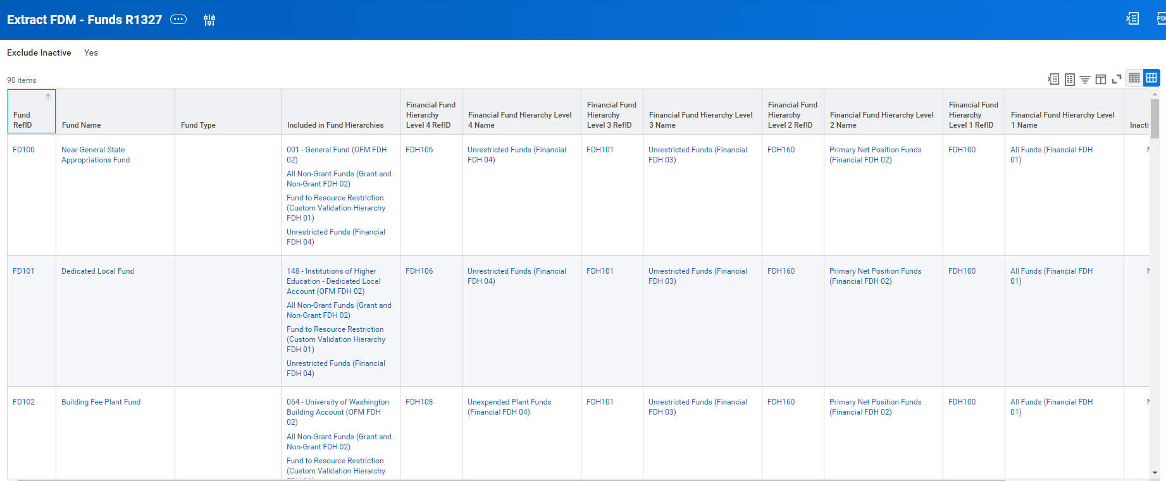
Fund (Net Position Classifications) and Resource
Notes:
If your CC has net position in FD100 it is “Unrestricted”

Slide 29
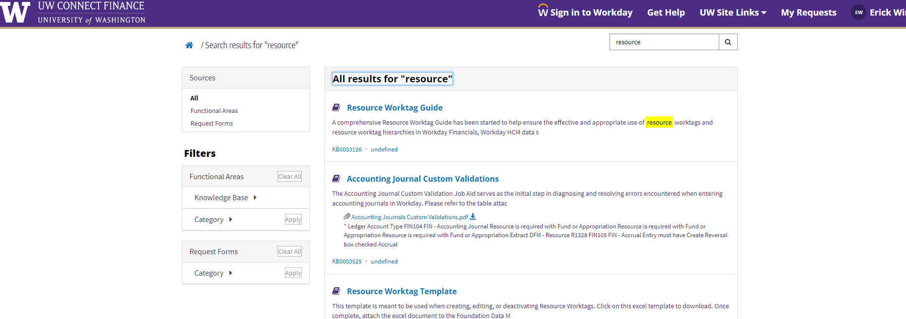
Fund (Net Position Classifications) and Resource
Notes:
Transactions start in Workday generally through the following ways

Slide 30
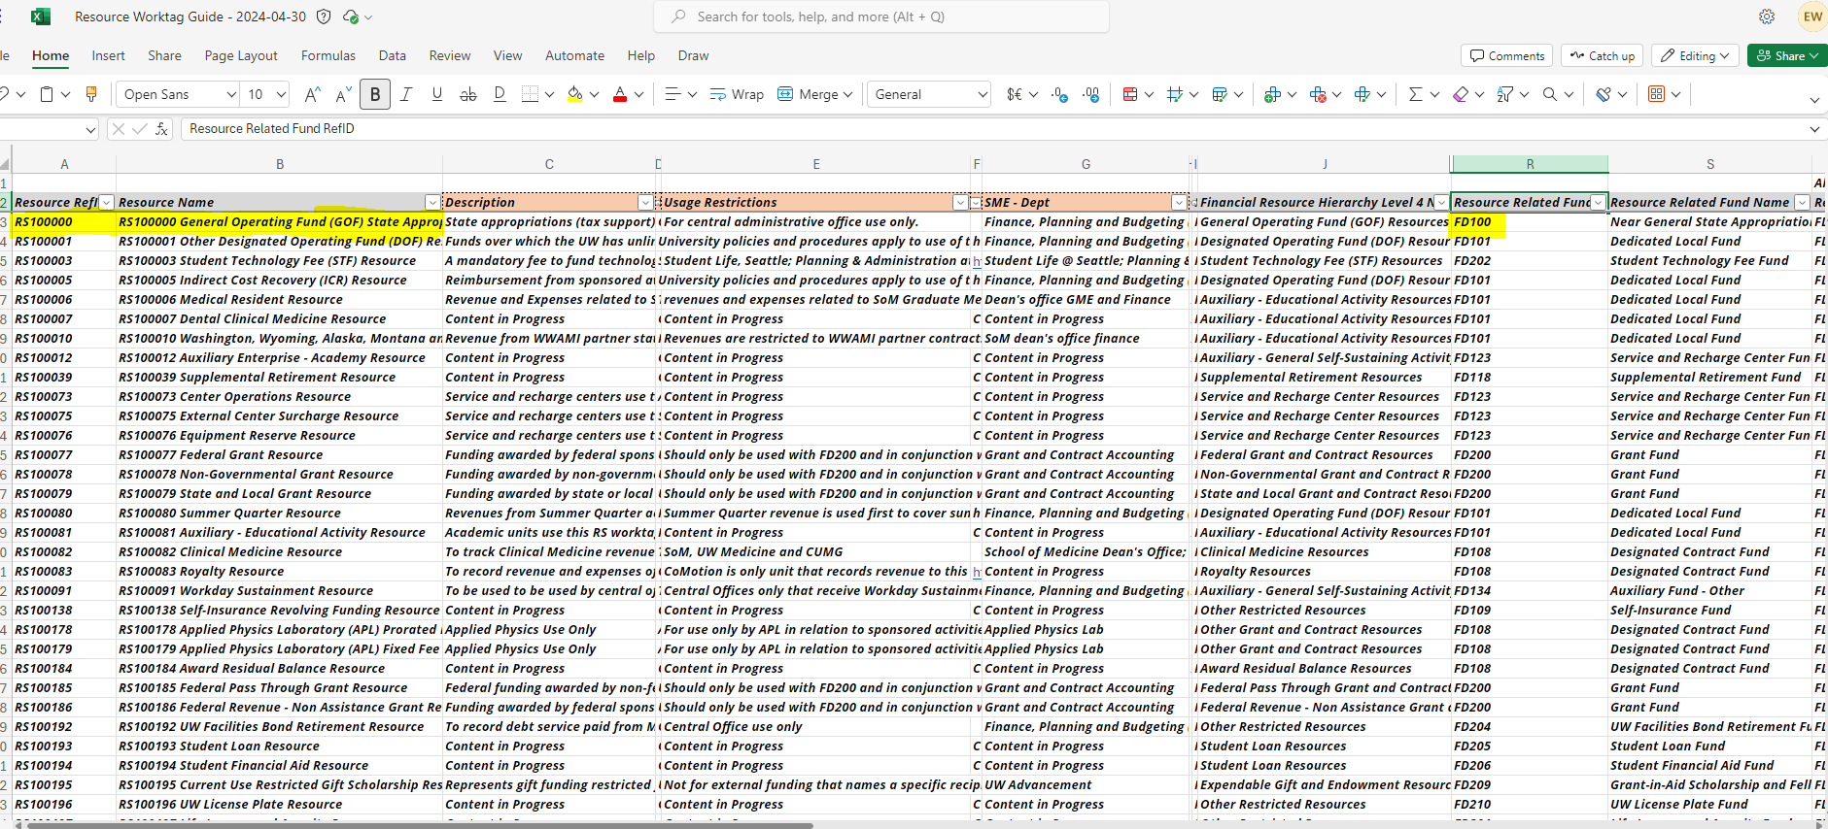
Fund (Net Position Classifications) and Resource
Notes:
Transactions start in Workday generally through the following ways

Slide 31
 | Common | Asset | Combined
Expense | $ 48,000 | $ (48,000) | $ -
Capital Asset | $ - | $ 48,000 | $ 48,000
 | $ - | $ - | $ -
 | $ - | $ - | $ -
Net Position | $ (48,000) |  | $ (48,000)
How NP changes classification - Assets
Equipment purchase $48,000
Common Book
$48,000 Expense [reduce net position = typically restricted expendable or unrestricted]
Asset Book
($48,000) Expense [reverses effect on net position = in 400 series fund]
$48,000 Capital Asset [creates capital asset = 400 series fund]
400 fund series
Net Investment in Capital Assets
Original Fund (FD100)
Unrestricted
 | Blank Book Code | Asset Book Code | Financial Reporting Book
Expense | $ 48,000 | $ (48,000) | $ -
Capital Asset | $ - | $ 48,000 | $ 48,000
Accounts Payable | $ (48,000) | $ | $ (48,000)
 | $ - | $ - | $ -
Net Position - Fund Original | $ 48,000 |  | $ 48,000
Net Position - Fund 400 |  | $ (48,000) | $ (48,000)
We have changed the net position from Unrestricted to Net Investment in Capital Assets
Original Fund
400 fund series
Notes:
We’ll explain later the nature of the 400 series funds
Even though this has a net zero effect on expense in the financial reporting book on expense – it is NOT net neutral on fund $48,000 debit in original, ($48,000) credit in 400 series.
This will come back to when we look at r1300 using the common book vs. financial reporting book

Slide 32
How NP changes classification - Assets
 | Cost Center CC999999 - Common Book
Revenue |  | Month 1 | Month 2 | Month 3 | Total
 | Sales and Services | $ 10,000 | $ 10,000 | $ 10,000 | $ 30,000
 | Other Revenue | $ 1,000 | $ - | $ 1,000 | $ 2,000
 | Total Revenue | $ 11,000 | $ 10,000 | $ 11,000 | $ 32,000
Expense
 | Salaries and Wages | $ 7,000 | $ 7,000 | $ 7,000 | $ 21,000
 | Benefits | $ 3,000 | $ 3,000 | $ 3,000 | $ 9,000
 | Supplies and Materials | $ 50,000 * | $ 1,000 |  | $ 51,000
 | Depreciation
 | Total Expense | $ 60,000 | $ 11,000 | $ 10,000 | $ 81,000
Net income (loss) |  | $ (49,000) | $ (1,000) | $ 1,000 | $ (49,000)
Net Position
 | Beginning Balance | $ 50,000 | $ 1,000 | $ -
 | Increase (Decrease) | $ (49,000) | $ (1,000) | $ 1,000
 | Ending Balance | $ 1,000 | $ - | $ 1,000
 | Cost Center CC999999 - Financial Reporting Book
Revenue |  | Month 1 | Month 2 | Month 3 | Total
 | Sales and Services | $ 10,000 | $ 10,000 | $ 10,000 | $ 30,000
 | Other Revenue | $ 1,000 | $ - | $ 1,000 | $ 2,000
 | Total Revenue | $ 11,000 | $ 10,000 | $ 11,000 | $ 32,000
Expense
 | Salaries and Wages | $ 7,000 | $ 7,000 | $ 7,000 | $ 21,000
 | Benefits | $ 3,000 | $ 3,000 | $ 3,000 | $ 9,000
 | Supplies and Materials | $ 2,000 | $ 1,000 |  | $ 3,000
 | Depreciation | $ 2,000 | $ 2,000 | $ 2,000 | $ 6,000
 | Total Expense | $ 14,000 | $ 13,000 | $ 12,000 | $ 39,000
Net income (loss) |  | $ (3,000) | $ (3,000) | $ (1,000) | $ (7,000)
Net Position
 | Beginning Balance | $ 50,000 | $ 47,000 | $ 44,000
 | Increase (Decrease) | $ (3,000) | $ (3,000) | $ (1,000)
 | Ending Balance | $ 47,000 | $ 44,000 | $ 43,000
Equipment:
Cost: | $48,000
Life: | 24 months
Month Depr: | $2,000
Depreciation Schedule
 | Mo 1 | Mo 2 | Mo 3
Capital | $ 48,000
Depr | $ 2,000 | $ 2,000 | $ 2,000
Accum Depr | $ 2,000 | $ 4,000 | $ 6,000
Net | $ 46,000 | $ 44,000 | $ 42,000
Net Position
Net Invest Cap Assets = $42,000
Unrestricted = $1,000
Notes:
In the common book all of the cost of the asset is expensed and therefore brings down your net position the entire cost, in the asset book the expense is removed (reclassed to asset account on bal sheet) the net position does not decrease… HOWEVER the $46,000??
The nature of the $43,000 net position.. Let’s come back to this after we explore the fund and net position classifications and resource relationships
This equipment may have been purchased with various funds (hypothetically for instance with FD100 general funds) – but we have purchased an asset
Ask yourself if this has changed the nature of a deficit? Net Position by fund matters!!!
Assets are not liquid – cannot be converted quickly.

Slide 33
Workday
– Live Demo
Notes:
Run R1300 – UCO CCH – Financial Reporting Book FY2024 YTD
Show the total net position, drill into Beginning balance by fund (49M fd400, 811K fd134) *highlight the 811K, in the expense section highlight the depreciation
Drill into increase(decrease) of net position of 1.3M – the fd 400 amount is depreciation
Rerun R1300 with common book
Show “repeat by” resource option / fund option – this is all unrestricted
Go back to financial reporting book, repeat by fund
Discuss the FD400 column, also discuss the unrestricted buckets – have some revenues in auxiliary but expenses in FD116 and FD101, but still unrestricted
Run R1300.2 – by RSH – financial reporting book you can see the NICA does not have a resource, it is not required
But the Core Operating and Self-Sustaining have resource

Slide 34
How NP changes classification – fund transfers
Revenue transfers across funds, more specifically fund classifications, will change the nature of net position
Scenario: fund transfer in unrestricted, fund transfer out restricted expendable
This by nature has
Changed net position classification from unrestricted to restricted expendable
Increased revenue (credit) in unrestricted for any of the tagged worktags, and decreased revenue (debit) in restricted expendable for any of the tagged worktags
These types of entries risk our financial statements and compliance with State of WA financial reporting
Notes:
Transactions start in Workday generally through the following ways

Slide 35
Net Position: Takeaways
When considering net position… classification is important to what the balance represents, what is spendable/available
Volume of assets or inventory can influence relevance of book code (large inventory or assets may impact whether common book is appropriate)
When choosing book code it applies to the report globally – all funds, resources, etc.
Notes:
Transactions start in Workday generally through the following ways

Slide 36
Deficits
Governed by APS 37.1
Why?
In short, to prevent, identify, and support the mitigation of business, operational or reputational risks to the University.
Impacted due to Workday Financials, notably the:
change in data dimensions: from budget numbers (flat structure) to FDM worktags (multi-dimensional/matrixed structure).
the move to full accrual basis accounting,
Timing of activity and (for now) quality of the data
Owned by Controller’s Office (previously OPB)
Monitored quarterly at the intersection of CCH05 + Resource +
Enhanced Monitoring as proactive process to help units course correct when their financial trajectory indicates a deficit is likely.
Notes:
Transactions start in Workday generally through the following ways

Slide 37
Corrections

Slide 38
Correction/Adjustment of Net Position: Paths
Funding Transfers (Revenue)
Expense Transfers (Expense)
Net Position entries
No longer correcting net position via EIB
Exploring long term approach to net position, year end consolidation (i.e. closing net position from multiple worktags to single consolidated point, such as Dean’s office)

Slide 39
Wrap Up

Slide 40
High Level Do’s and Don’ts
Do - correct net position balances, due to unintended missing worktags, by (first option) correcting the source, which is typically accounting adjustments or reclass
Don’t – cross fund or resource worktag inappropriately
Do – explore various reporting options to understand better the common book vs. financial reporting book
Do – refer to the common book when contemplating “deficit”
However, stay tuned for future discussions / direction regarding usage of books
Notes:
In/Out ledgers. - Look at the account type for the In/Out ledgers and make sure you're selecting a corresponding Revenue or Spend Category to go along with that account type. Revenue Types need Revenue Categories, Expense Types need Spend Categories

Slide 41
Resources
When you have questions, enter a UWCF ticket.
Accounting Bootcamp Link
Ledger and Ledger Account Summary List
Revenue Category List with general APR references
Spend Category List with general APR references
Custom Validation List
Journal Sources List
Fund & Resouce Job Aid – Coming Soon!!

Slide 42
What’s Next
Series #4 – Reporting Deep Dive
Planning and budgeting reports
Book Codes
Demos and Deep Dives
R1300
Compare to what’s available outside of WD (Adaptive, BI Portal, use of Cubes)
Notes:
All of these transactions impacted your net position… next session we will follow the flows in/out of net position.

