Slide 1
Shared Environment FDM Bootcamp Series #4
– planning & budgeting reporting
December 10, 2024

Slide 2
FDM Bootcamp Series #4 – Planning & Budgeting Reporting
# | Topic | OBJECTIVE | Lead | Time
1 | Bootcamp Series | Goals & Audience Today’s focus | Erick | 5
2 | Introduction | Controller’s Checklist Budget Structure | Erick/ Scott | 45
3 | Reports | Common Reports & Filters Interpreting Reports Corrections | Erick/ Christina | 30
4 | Wrap Up | High Level Do's and Don'ts Resources Q&A (time dependent) What’s the Next | Erick/ Christina | 10
Notes:
Monitoring for net position should be a regular/weekly activity not just a MEC activity
How do SE’s get support after this session?
Gen Feedback form Ticket (denote acctg)

Slide 3
Bootcamp Series

Slide 4
Key Goals & Audience
Key goals - to strengthen SE accounting knowledge, based on UW needs and Workday setups by:
  Not teaching you to memorize the rules, but helping you understand the principles undergirding the rules:
    A list of rules that encompasses all activity at the UW would be too long to memorize. More important is to understand what the rules are for and where they come from. In this way, you will apply them consistently to both common and uncommon situations.
    It’s not necessarily doing what always has been done, but also asking ‘why’ are we now doing it this way? Or even what is the right way to do it now?
    The need to see big picture accounting and reporting world, then be able to look at the transactions with this in mind
  To create future job aids to build accounting knowledge in support of UW accounting principles and reporting needs.
    Will be leveraged for all users performing WD transactions across all campuses
Audience: Shared Environment (SE) Accountant focus
Notes:
Add to second bullet that not only what is the right way to do it.. But what direction are we headed in our maturity
We are still on a journey

Slide 5
FDM Bootcamp Series Preview
Series #1 - Accounting Fundamentals – Recap & Pre-req to #2
  Accounting Worktag Overview
  UW Accounting Principals
  Financial Statements
Series #2 – UW Specific Setups Deep Dive
  Initiating Transactions in Workday
  Refresh – Custom Validations & Account Posting Rules (APR’s)
  Behind the Scenes
Series #3 – Net Position
  Example Review
  How to interpret your data
  Corrections
Series #4 – Planning & Budgeting Reporting Deep Dive
  Controller’s Checklist
  Budget Structure
  Common Reports & Filters
  Interpreting Reports
  Corrections

Slide 6
Introduction

Slide 7
Year End Controller’s Checklist
Purpose: Document confirmation (reasonable assurance) from business leaders the completion of year end activities that we rely on for accurate and complete financial information
Overall concepts and goals of the Controller's Checklist
  Completeness, accuracy, existence, and occurrence of areas on financial statements
  Legal Compliance
New for FY26 GASB103 – including budgetary comparison information in the Management Discussion and Analysis (MD&A) section of the Enterprise Financial Statements
Notes:
Year end checklist focus on financial reporting results
All BUs are part of the enterprise financial statement
Assertions are key to financial reporting (these assertions relate mostly to unit activity)
GASB 103 adds a financial statement requirement/information, part of why budget vs. actual is included into the controller’s checklist

Slide 8
Financial Statement Assertions
Existence or occurrence – Assets or liabilities of the company exist at a given date, and recorded transactions have occurred during a given period. (if it is recorded, did it happen?)
Completeness – All transactions and accounts that should be presented in the financial statements are so included. (if it happened, did it get recorded?)
Valuation or allocation – Asset, liability, equity, revenue, and expense components have been included in the financial statements at appropriate amounts. (is the amount correct, classified correctly?)
Rights and obligations – The company holds or controls rights to the assets, and liabilities are obligations of the company at a given date. (it could exist but not be ours or proper to record)
Notes:
Introducing these concepts – they are important aspects of comparing actuals period over period
Many questions on the controller checklist get to the specific types of controls that cover these assertions on transactions – such as completeness of all AP invoices, or completeness of all AR for customer invoices, but also such as valuation (is unearned revenue properly valued, instead of revenue)
Variance analysis is a higher level control to ensure we have properly classified (valuation) and have completeness/existence.

Slide 9
Controller’s Checklist and Expectations
Financial Statement Areas
  Payments and Disbursements / Receipts and Collections
    Cash (primary = existence)
    Accounts Receivable (primary = occurrence)
    Prepaid Assets
    Field Advances
    Revolving Funds
    Accounts Payable (primary = completeness)
    Accrued Liabilities
  Other Balance Sheet Account Reconciliations
  Revenues / Expenses
    Payroll
    Gifts
Notes:
These categories cover specific assertions in certain function/accounts. Higher level report monitoring serves as additional controls to cover the impact of all potential accounts/functions.

Slide 10
How do Units Support the Controller's Checklist Goals
Monitoring actuals to the budget
  This analysis lends itself to comparing the budget to the actual amounts for a specified period (a month activity or a month activity since the beginning of the year)
  Also trending of the difference between budget and actual
Performing period over period fluctuation analysis
  This analysis lends itself to comparing a period “within” a broader period to a similar period within a previous broader period (Q1 of a fiscal year to Q1 of the previous fiscal year)
Deficit Monitoring
  Focus is on net position
Reconciling specific Balance Sheet and Income Statement ledgers as indicated by the GLARP
Notes:
Reporting is core of 1, 2, 3. Reconciling is a bit more of a documentation activity.
In the future expect to see certifications that these activities are occurring.. Not just an attestation by controller’s checklist, but a documentation (docusign?) of the performance of 1,2,3

Slide 11
GASB 103 – Budgetary Comparison Information
This Statement requires governments to present budgetary comparison information using a single method of communication—RSI. Governments also are required to present (1) variances between original and final budget amounts and (2) variances between final budget and actual amounts. An explanation of significant variances is required to be presented in notes to RSI.
Unknown level of detail required at this point – implementation year FY26

Slide 12
Monitoring Budget vs. Actuals

Slide 13
Budget Structure
The budget is a different data set in Workday Financials than actuals
  Contained within a “Plan Structure” with a select set of worktags
  Does not use book codes; FY25 plan is most analogous to the Common Book
  Is imported directly from Workday Adaptive Planning
  Combines elements of Financials and HCM (e.g., Cost Centers and Position IDs)
Budget found in Workday Financials is the budget adopted by the Board of Regents; is set annually in June at the conclusion of a months long enterprise operating budget development process.
Budget predominately per the Common Book.
Budget is not the same as budget authority
Difference between budget and actuals are called variances. A variance is not a deficit.

Slide 14
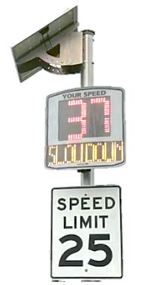
Budget vs. Actuals Reporting
Regular monitoring of actual financial performance against budget
Actuals
Variance Commentary & Course Correction
Budget

Slide 15
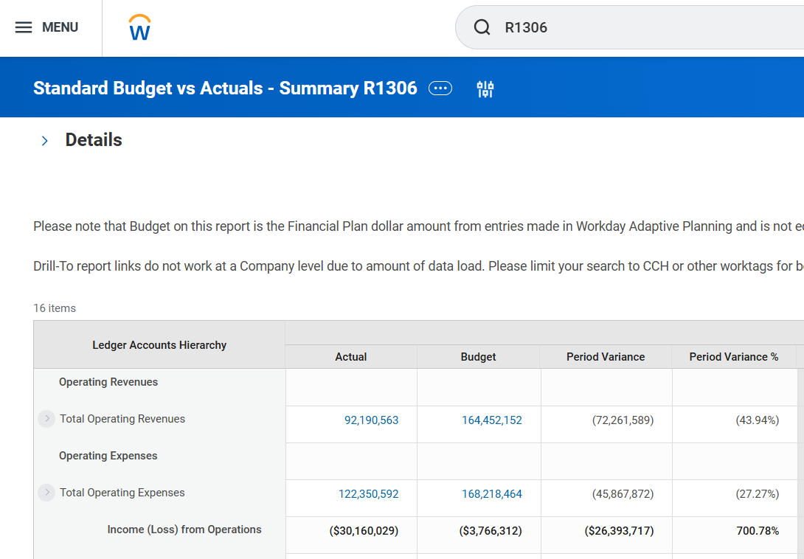
Budget Variance Basics
Analysis → Commentary → Decisions → Action to achieve goals
Two flavors – favorable and unfavorable
Unfavorable
Favorable
Unfavorable

Slide 16
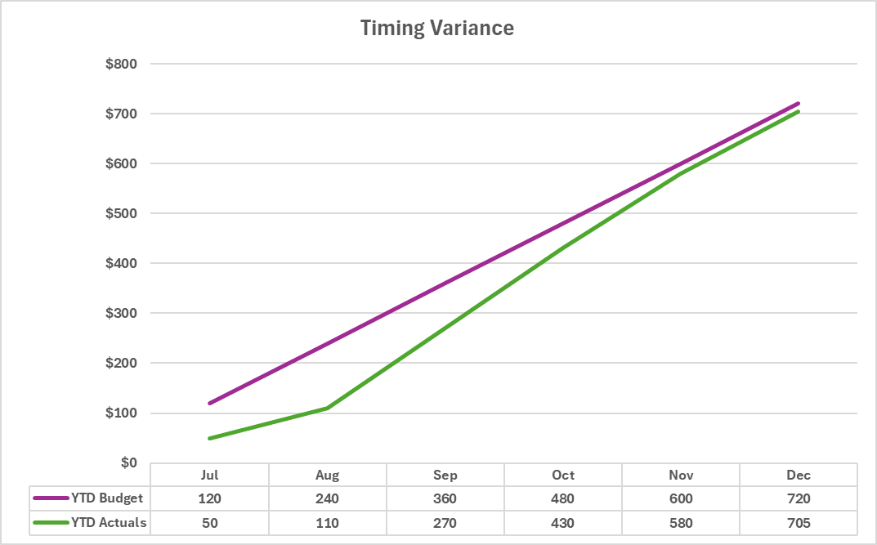
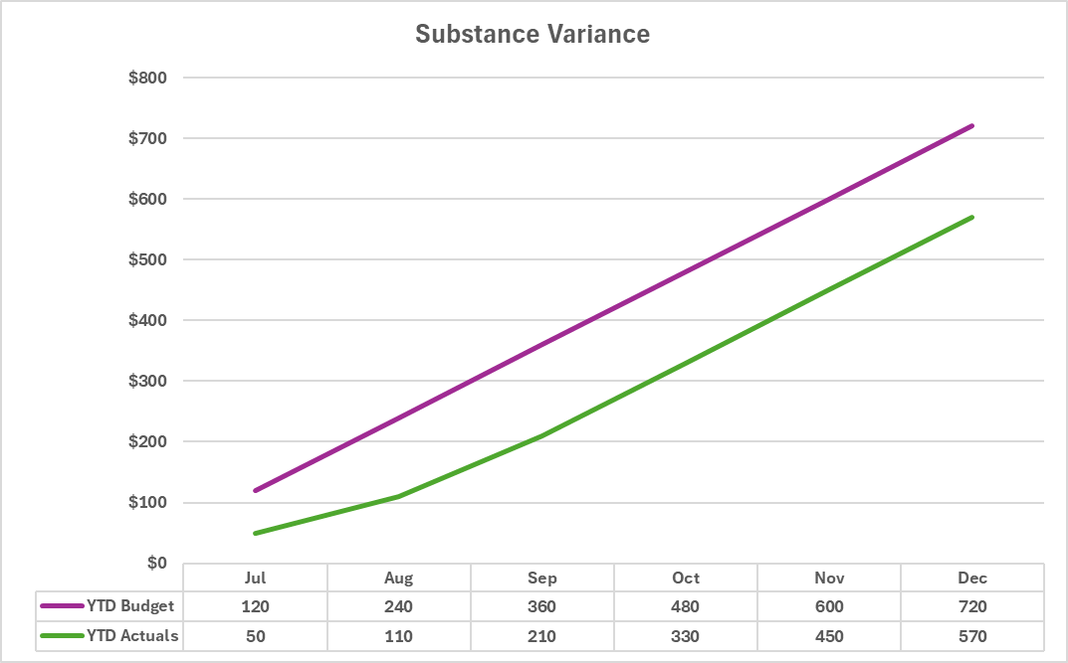
Budget Variance Basics
Two primary drivers of variances– timing and substance
  Timing variances are typically temporary and resolve without intervention
    (e.g., often no action required for resolution)
  Substance variances reflect actual business conditions that are materially different from those assumed or expected in the plan
    (e.g., often will require action for resolution)

Slide 17
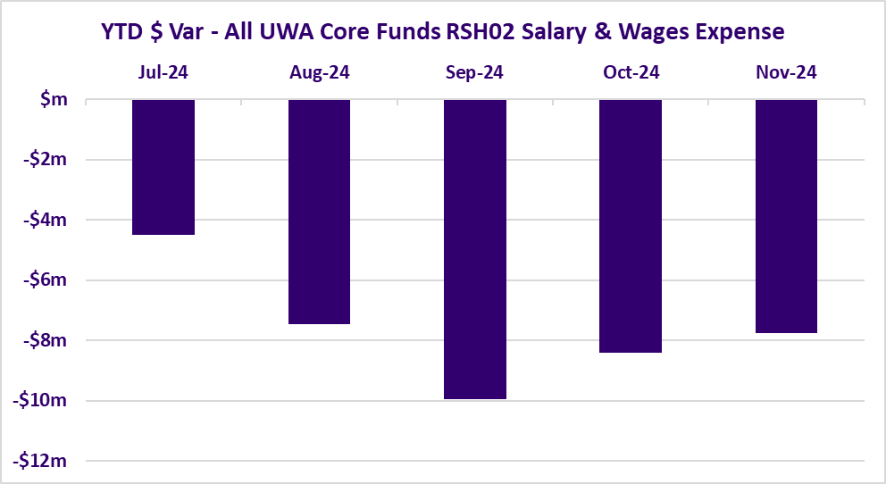
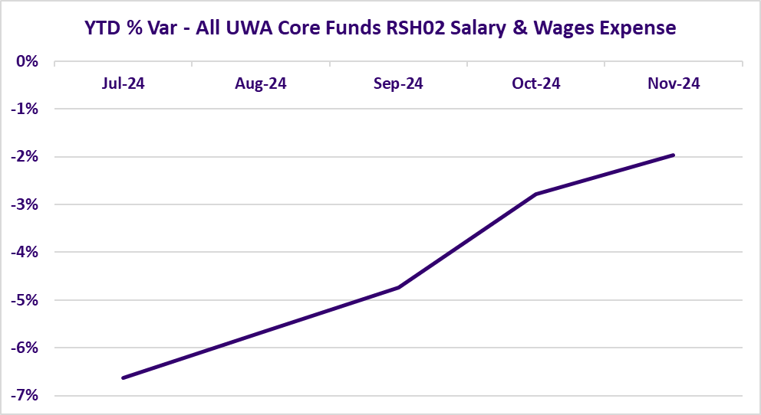
UWA Year-to-Date (YTD) Budget Variance
* Actuals figures above from the Common Book

Slide 18
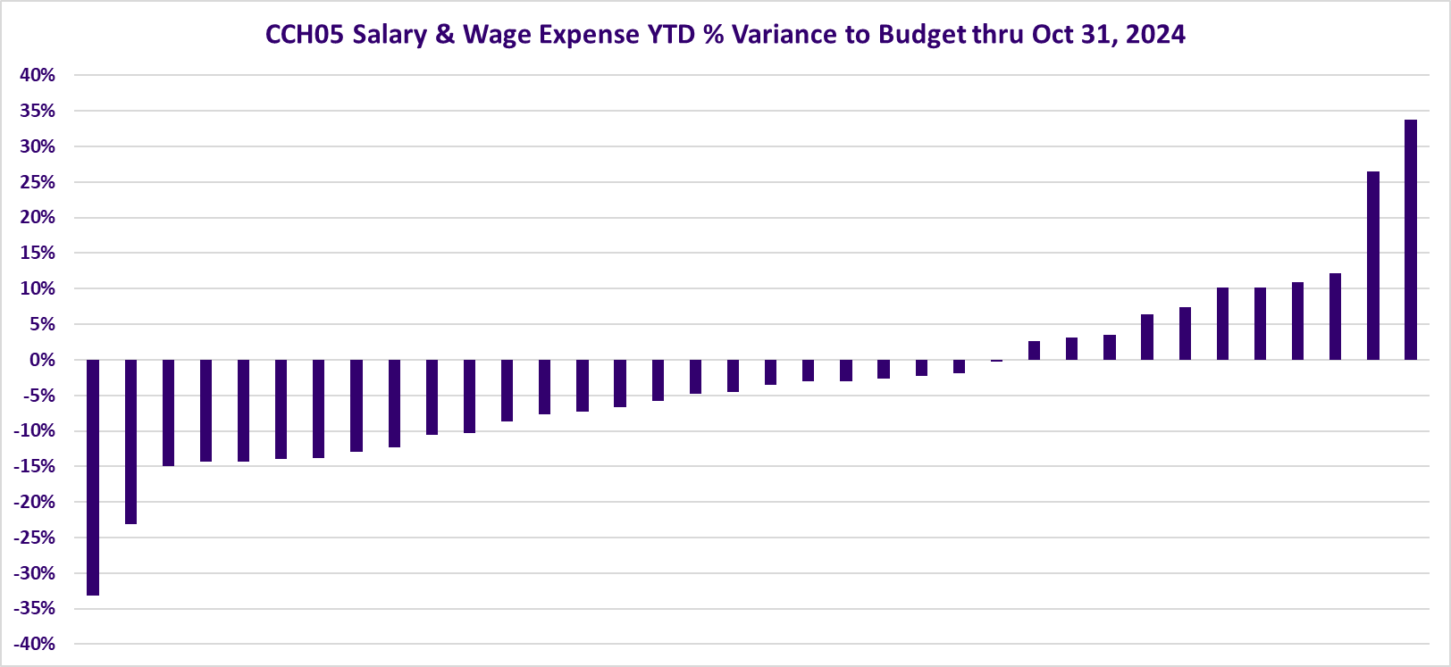
UWA Year-to-Date (YTD) Budget Variance
(Core Funds RSH)
8 units > 5% unfavorable variance
(above budget)
12 units < 5% variance
16 units > 5% favorable variance
(under budget)
* Actuals figures above from the Common Book

Slide 19
Running Budget vs. Actuals Reports
Workday Financials
  R1306 (and variations)
  Adopted Budget only
Workday Adaptive
  E1306 (and variations)
  Must have access to Adaptive
  Three different budget versions available (Adopted, Recast and Proposal)
Enterprise Data Warehouse (EDW)
  Budget data and actuals data exist in separate tables within the EDW
  All budget versions available.
  Unit must have permission to EDW.
  Units responsible to query and join tables to generate budget vs. actuals comparisons

Slide 20
Budget Structure
Budget and Actuals are different data sets with different levels of detail
Level of Detail (worktag + hierarchies) | Actuals (in Financials) | Actuals (in Adaptive) | Budget (in Financials) | Budget (in Adaptive)
Cost Center, Ledger Account, Resource, Fund, Company | Yes | Yes | Yes, required | Yes, required
Function | Yes | No | No | No
Spend Category Revenue Category | Yes | Yes | No | No
Program, Assignee, Activity, Grant, Gift, Inst Initiative | Yes, if used in Actuals | Yes, if used in actuals | Yes, if used in the budget | Yes, if used in the budget
Supplier, Customer, Transaction Type, Journal Source | Yes | No | No | No
Position ID, Job Profile, Worker, Job Family | Yes, with the right permissions | Position only | No | Yes
Pay Component, Earn Type | Yes | No | No | Some
Award, Sponsor | Yes | No | No | No

Slide 21
Monitoring Period Over Period Fluctuations (Actuals)

Slide 22
Controller’s Checklist: Revenues 3a2)
Variance analyses on revenues has been performed at least quarterly to ensure financial sustainability. Departments/Units have done their due diligence to understand fluctuations greater than 5% year-over-year, quarter-over-quarter, and budget-versus-actual. Departments can utilize Income Statement - Period Variance R1287.5 and Standard Budget vs. Actual - Summary R1306

Slide 23
Controller’s Checklist: Expenses 4a2)
Variance analyses on expenses has been performed at least quarterly to ensure financial sustainability. Departments/Units have done their due diligence to understand fluctuations greater than 5% year-over-year, quarter-over-quarter, and budget-versus-actual. Departments can utilize Income Statement - Period Variance R1287.5 and Standard Budget vs. Actual - Summary R1306.

Slide 24
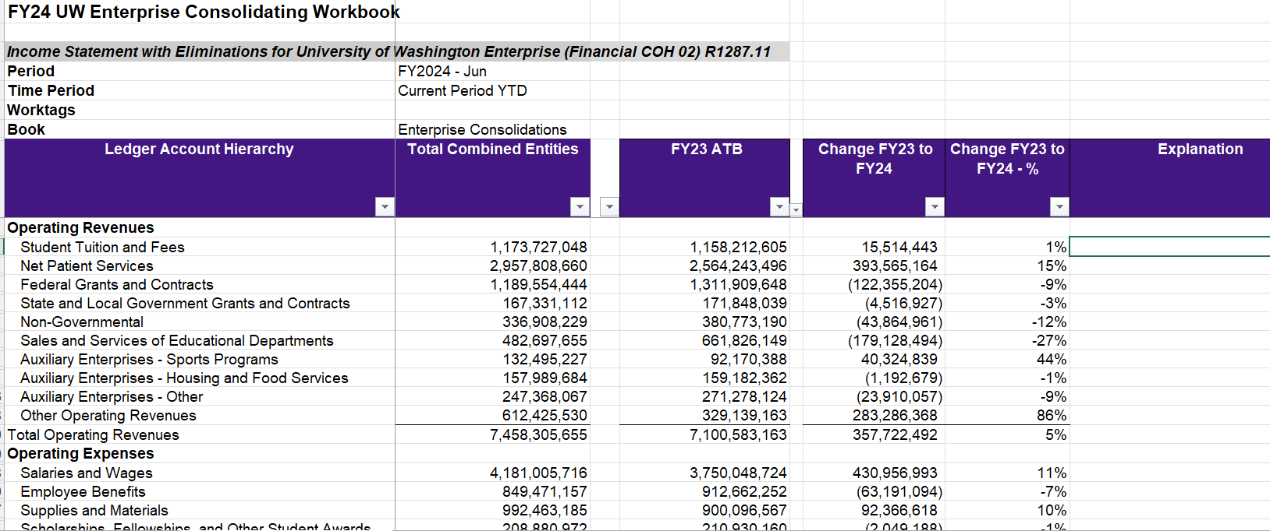
UW Enterprise – Variance Analysis current practice (annual)
Variance analysis performed on variances over 5%
Notes:
Variance Analysis PoP compares
Not a coincidence that Sales and Services dropped and other operating revenues decreased – will talk more about this in follow up conversations about usage of RC other operating revenues (RC2237)
Also, shifted some activities from sales and services (example is lab testing S&S or Patient revenue – is a valuation assertion)
There are many subaccounts under these Ledger Account Summaries – each BU may have a different mix, thus level of granularity that matters

Slide 25
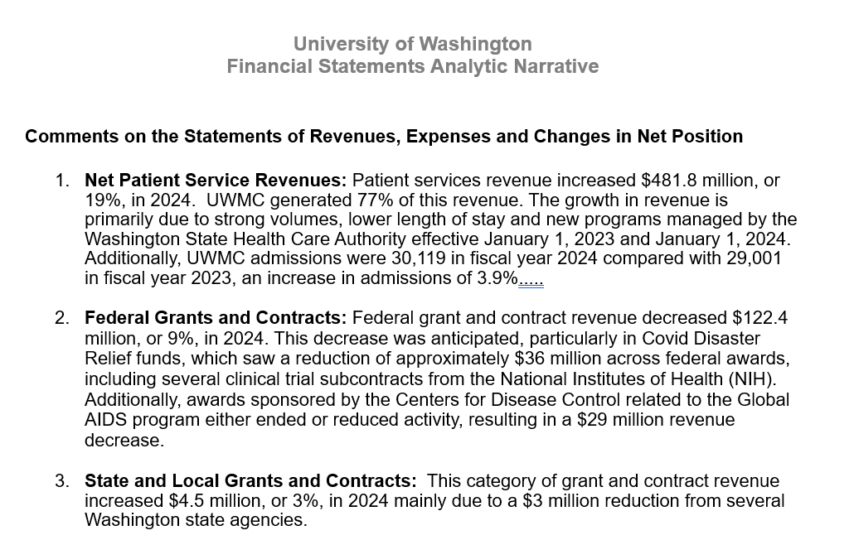
UW Enterprise – Variance Analysis (narrative)
Notes:
Primarily due to – need to explain in writing the logic, justifiable or able to be validated
Was anticipated – points to comparing to the budget

Slide 26
UW Enterprise – Variance Analysis goals
Period over period variance analysis completed on QoQ basis
  Q1 FY 24 compared to Q1 FY25
  Q2 FY 24 compared to Q2 FY25…
QoQ variance analysis explanation/narratives documented and preserved
Accounting supports variance analysis
  Completeness, Existence, Valuation, R&O
Variance analysis practices are in sync between UW Enterprise and Balancing Units

Slide 27
Deficit Monitoring

Slide 28
Deficit Monitoring
Fund and Resource matter
  Recall that Fund determines net position classification
    Net Investment in Capital Assets (400 series)
    Restricted
      Non-Expendable (endowment principal, aka FAS 99-XXXX budgets)
      Expendable (gifts, grants, etc.)
    Unrestricted (ICR, general funds, auxiliary other, etc.)
  Net position by resource
    Net position deficits/surpluses will build by resource
    Can be reported by single CC or by CCH various levels, ultimately CC Managers responsible for CC balances
    Resources come with different aspects
      Building reserves (recharge centers, self-sustaining, core funds)
      Budget plans and planned use of net position reserves vs. increase net position

Slide 29
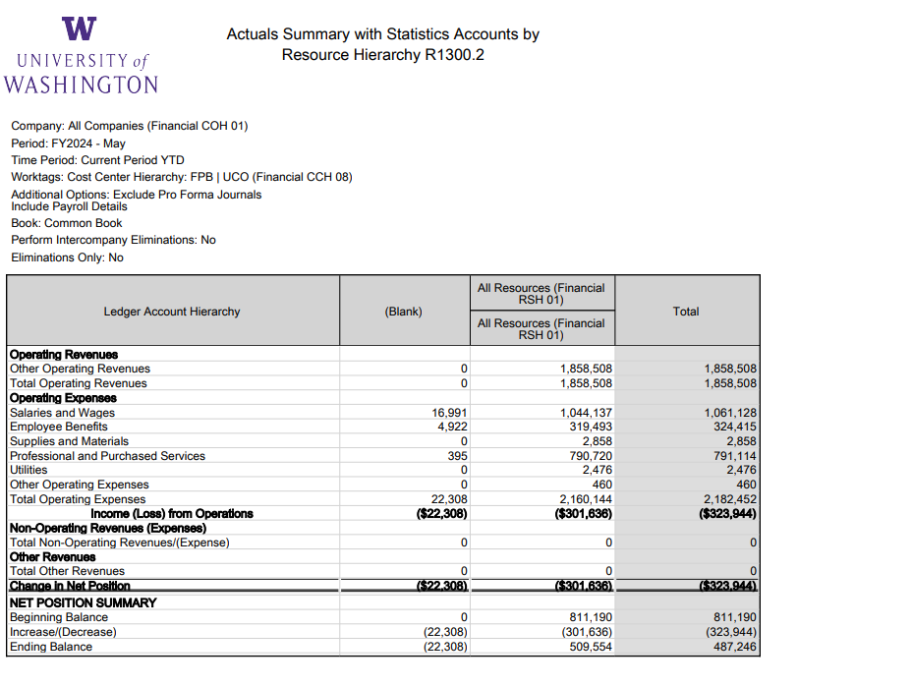




Actuals Summary/Income Statement
Notes:
In Session 1 we spent some time on operating revenues and expenses, non operating, the underlying spend/rev categories… now we see how they flow through to net position
R1300 shows (loss) as negative
Therefore (decrease) in net position
This report shows flow of P&L hitting CCH UCO and affect on NP – discuss how the worktags that make up the rev/exp flow through to NP

Slide 30
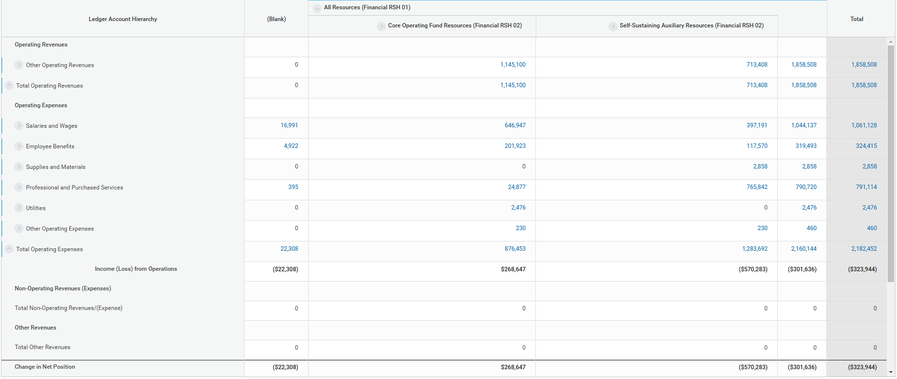
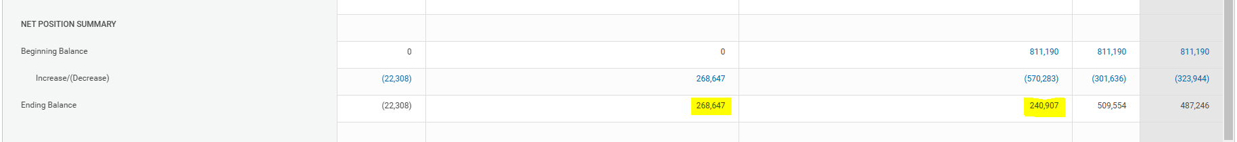




Actuals Summary/Income Statement
Notes:
In Session 1 we spent some time on operating revenues and expenses, non operating, the underlying spend/rev categories… now we see how they flow through to net position
R1300 shows (loss) as negative
Therefore (decrease) in net position
This report shows flow of P&L hitting CCH UCO and affect on NP – discuss how the worktags that make up the rev/exp flow through to NP

Slide 31
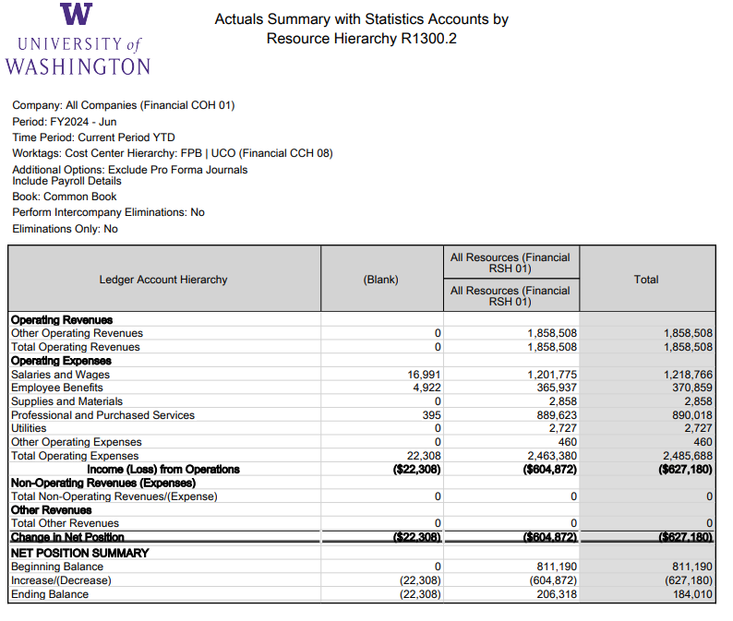




Actuals Summary/Income Statement
Notes:
Move ahead to June (end of year) there is a loss of (627)K
Decrease in net position of (627)K leaves ending balance of 184K
There is a loss of 22,308K in blank resource??
Notice in the blank resource that the “positive” expenses result in a loss

Slide 32
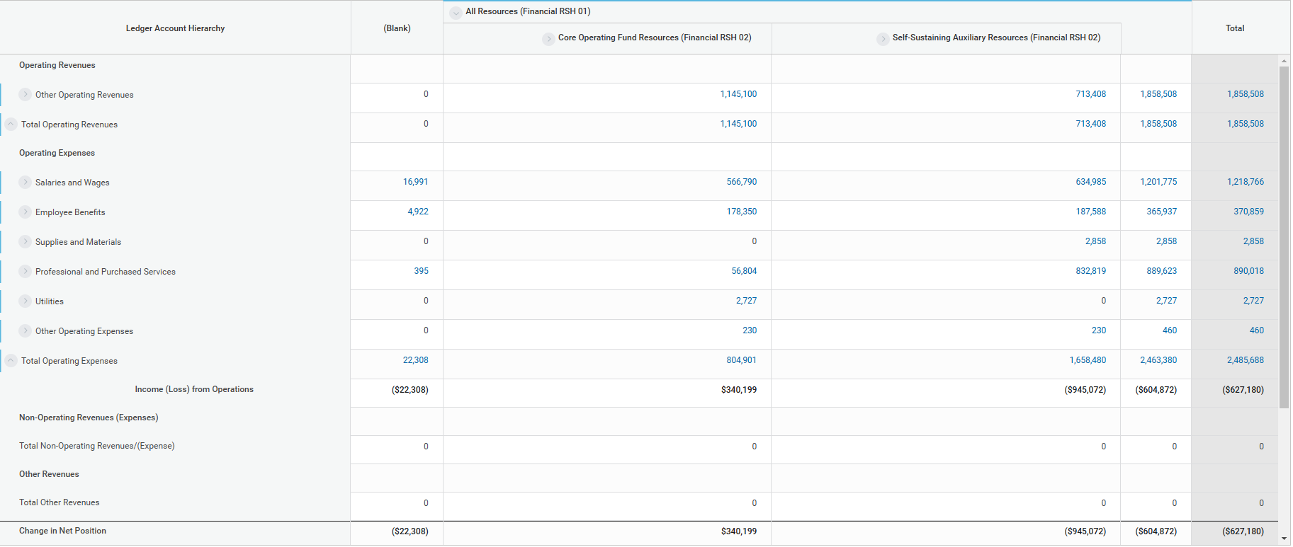
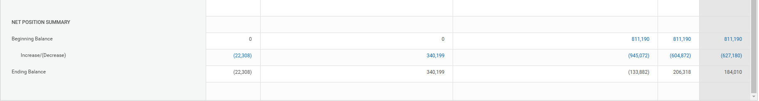


Actuals Summary/Income Statement
Notes:
In Session 1 we spent some time on operating revenues and expenses, non operating, the underlying spend/rev categories… now we see how they flow through to net position
R1300 shows (loss) as negative
Therefore (decrease) in net position
This report shows flow of P&L hitting CCH UCO and affect on NP – discuss how the worktags that make up the rev/exp flow through to NP

Slide 33
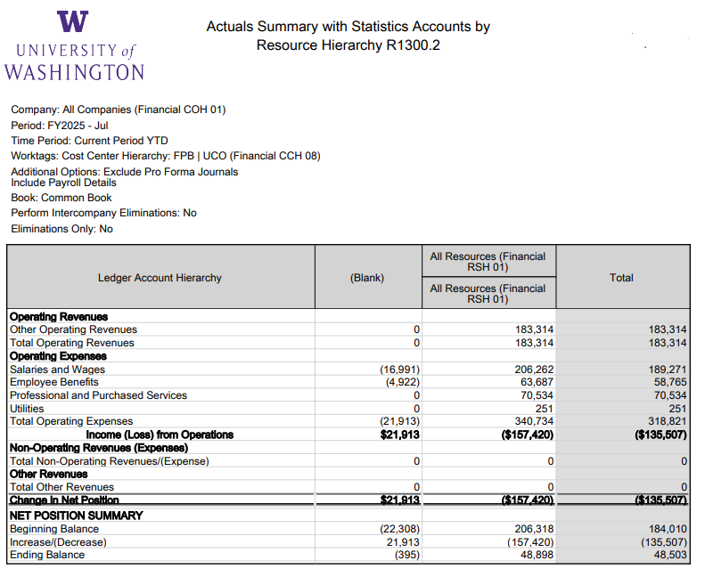





Actuals Summary/Income Statement
Notes:
The net position balance of 184K rolled forward as beginning balance. But we can break this down to many dimensions, including resource. The (22,308) deficit rolled forward but in July it was transferred via payroll account adjustment. Added resource.
Notice that the “negative” in expense results in “income” in the blank resource
**Consider pulling up workday to drill into the PAA

Slide 34
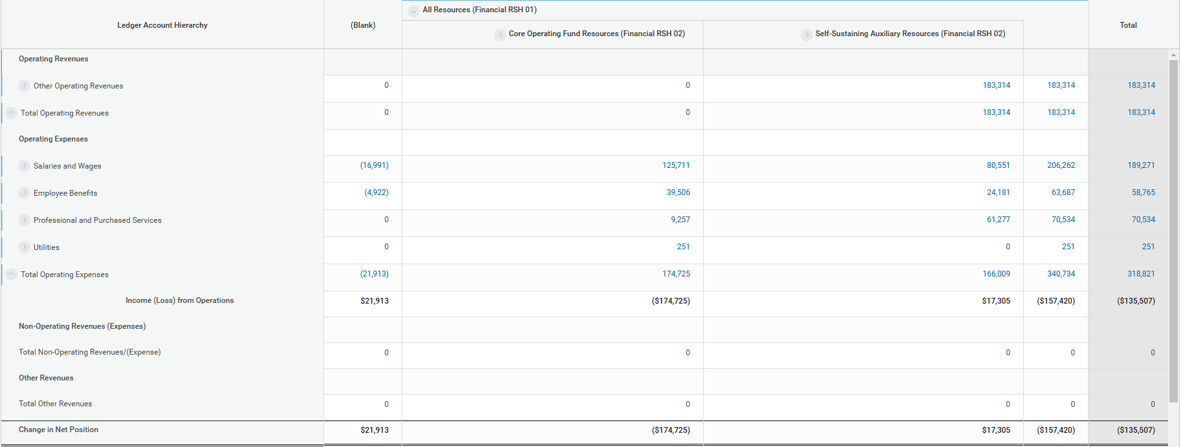
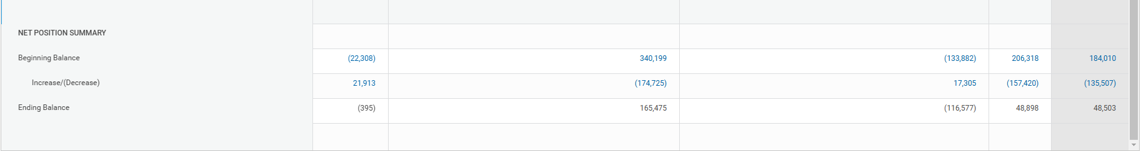
Actuals Summary/Income Statement
Notes:
In Session 1 we spent some time on operating revenues and expenses, non operating, the underlying spend/rev categories… now we see how they flow through to net position
R1300 shows (loss) as negative
Therefore (decrease) in net position
This report shows flow of P&L hitting CCH UCO and affect on NP – discuss how the worktags that make up the rev/exp flow through to NP

Slide 35
Break

Slide 36
Reports

Slide 37
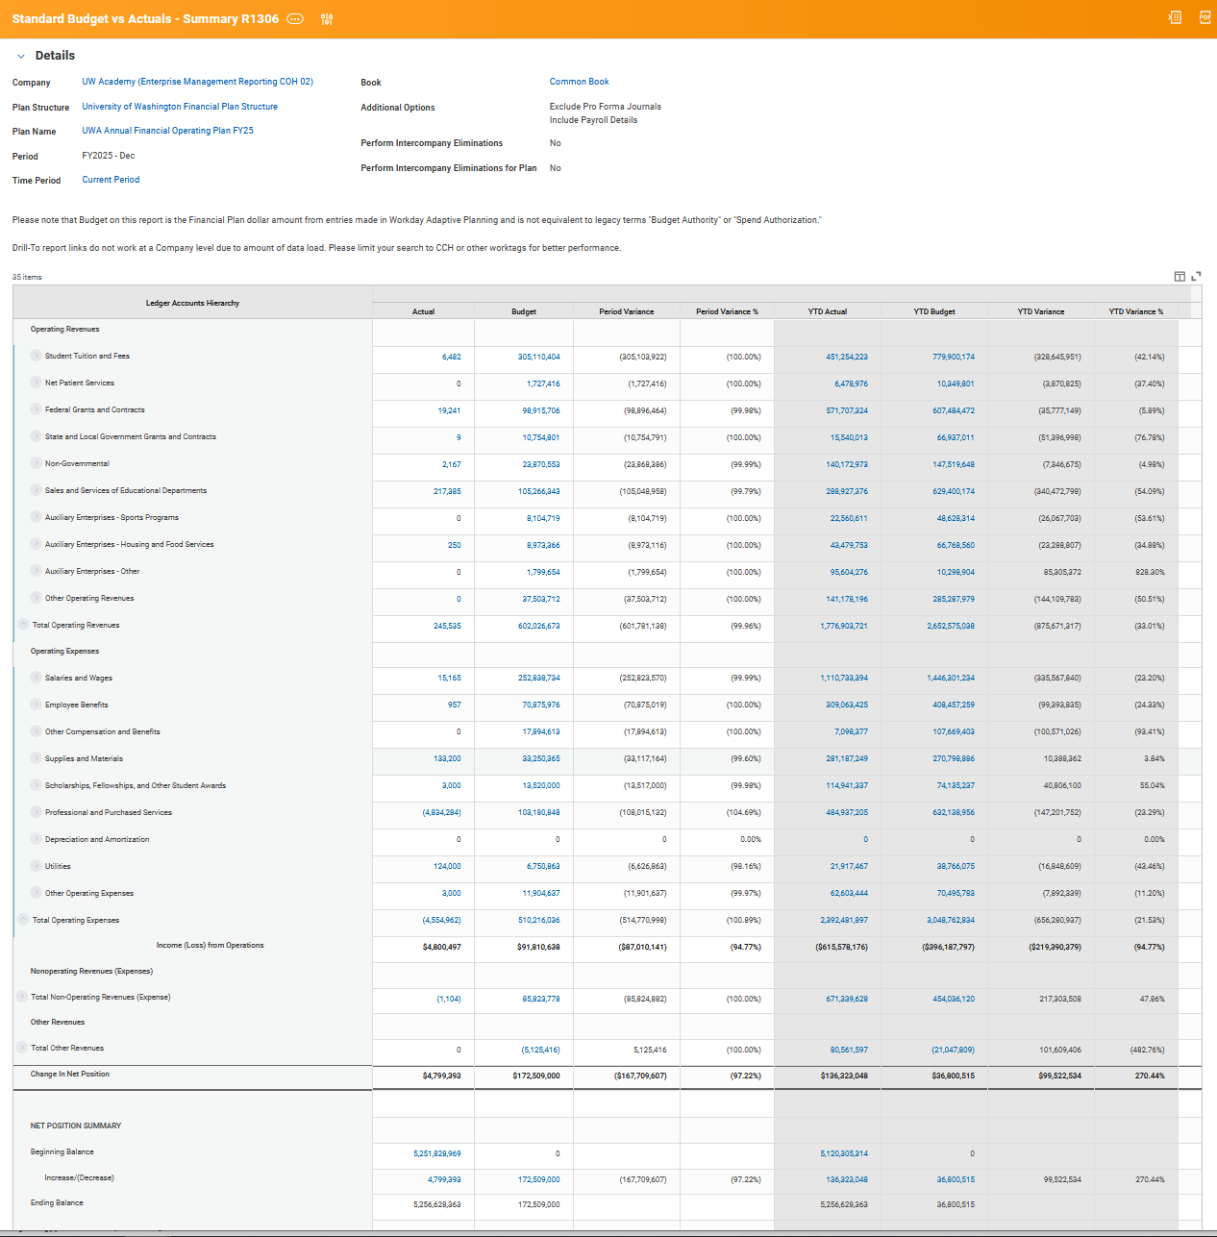
Standard Budget vs Actuals - Summary R1306

Slide 38
Standard Budget vs Actuals - Summary R1306
Common Use(s):
Income Statement Budget vs Actual and Period Comparison
  Ledger or Ledger Account Summary (Hierarchy) Level
  Organizational Worktags and their hierarchies: Company, Cost Center, Balancing Unit

Slide 39
Standard Budget vs Actuals - Summary R1306
Common Use(s):
Compare the Net Position between Budget vs Actual

Slide 40
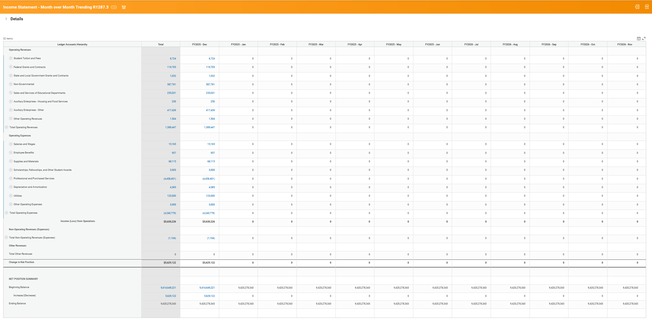
Income Statement - Month over Month Trending R1287.3

Slide 41
Income Statement - Month over Month Trending R1287.3
Common Use(s):
Identifying trends over time and anomalies for Income Statement Ledgers and Net Position

Slide 42
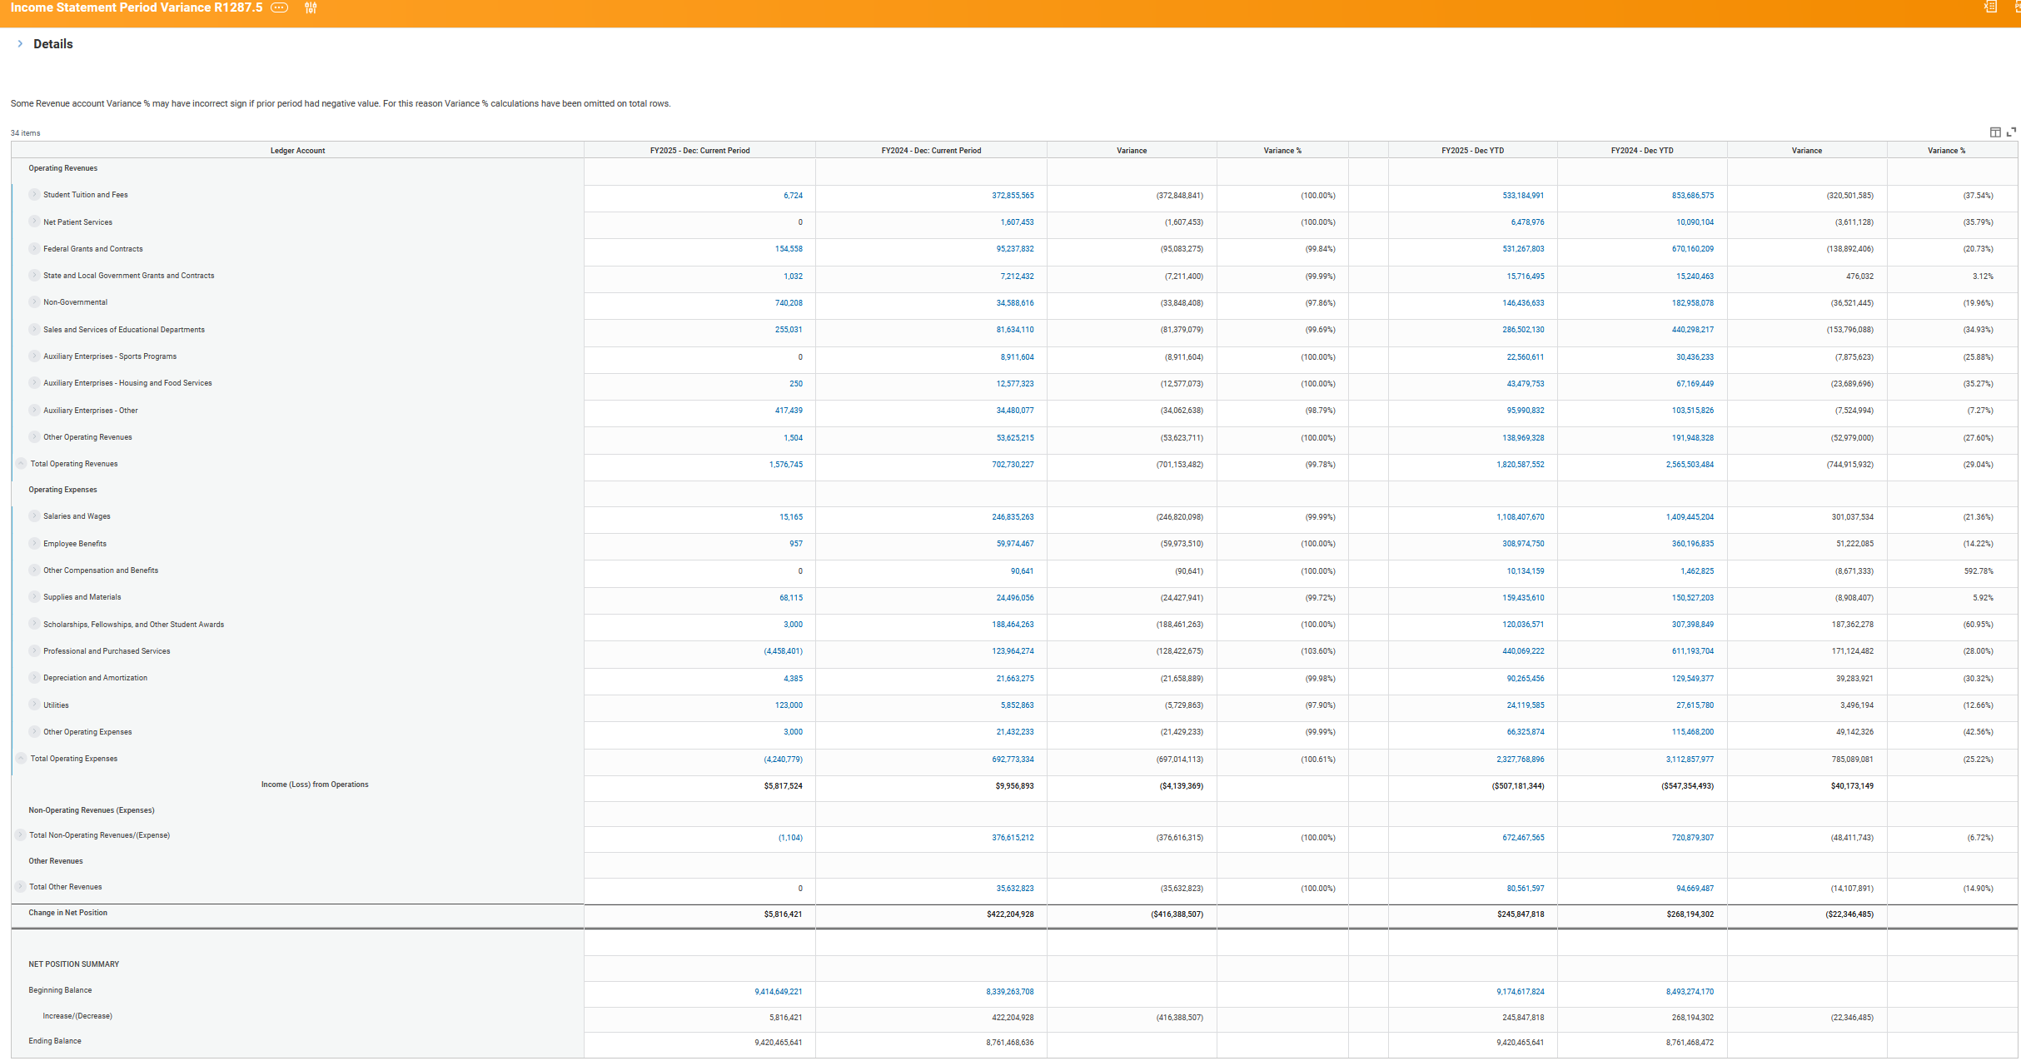
Income Statement Period Variance R1287.5

Slide 43
Income Statement Period Variance R1287.5
Common Use(s):
Identifying trends and anomalies between specific periods for Income Statement Ledgers and Net Position

Slide 44
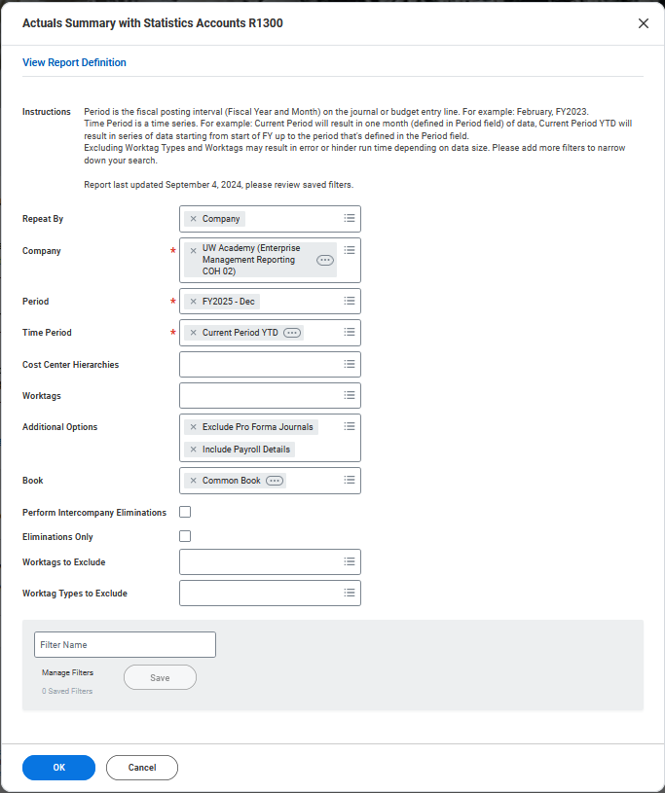
Actuals Summary with Statistics Accounts R1300
Adjust the filter:
"Repeat By" Activity, Company, Cost Center, etc. Will show the selected worktag as columns on the report
"Worktags" will let you filter by most worktags, allowing you to narrow to your unit or department
"Worktags to Exclude" or "Worktag Types to Exclude" allow end users to filter out activities or funding sources. However, utilizing this function may slow down the report generation
Save the filter or pull up a previously saved filter

Slide 45
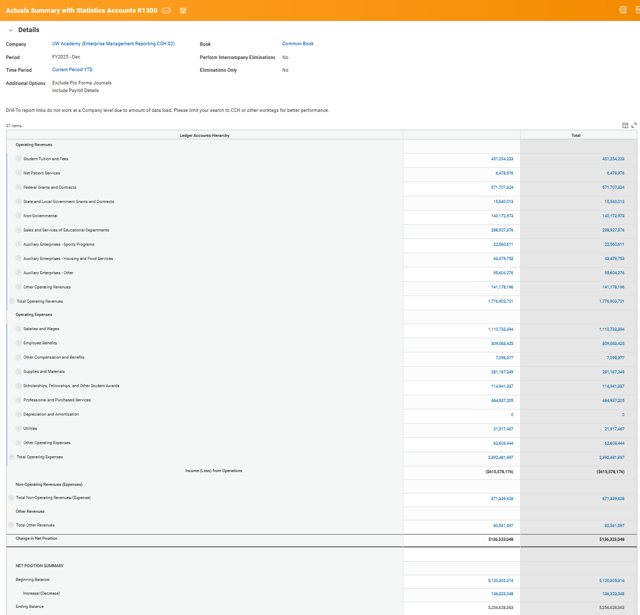
Actuals Summary with Statistics Accounts R1300

Slide 46
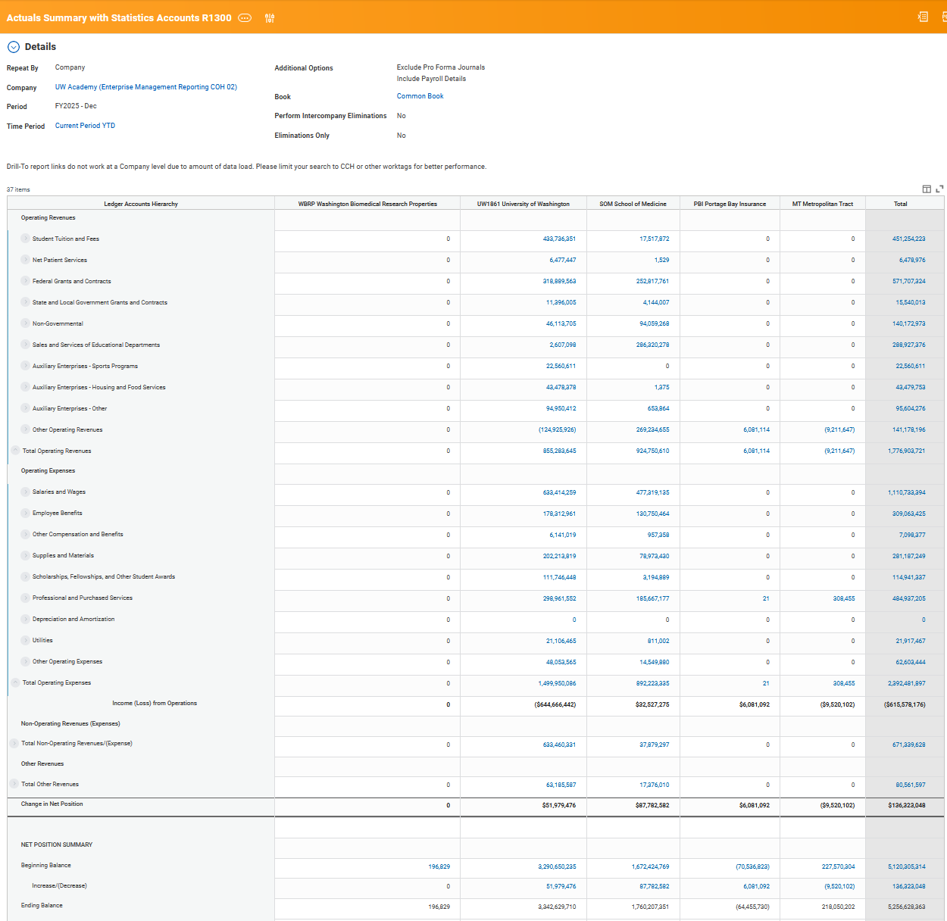
Actuals Summary with Statistics Accounts R1300 with "Repeat By" Company
Common Use(s):
Income Statement Budget vs Actual and Period Comparison
  Ledger or Ledger Account Summary (Hierarchy) Level
  Organizational Worktags and their hierarchies: Company, Cost Center, Balancing Unit

Slide 47
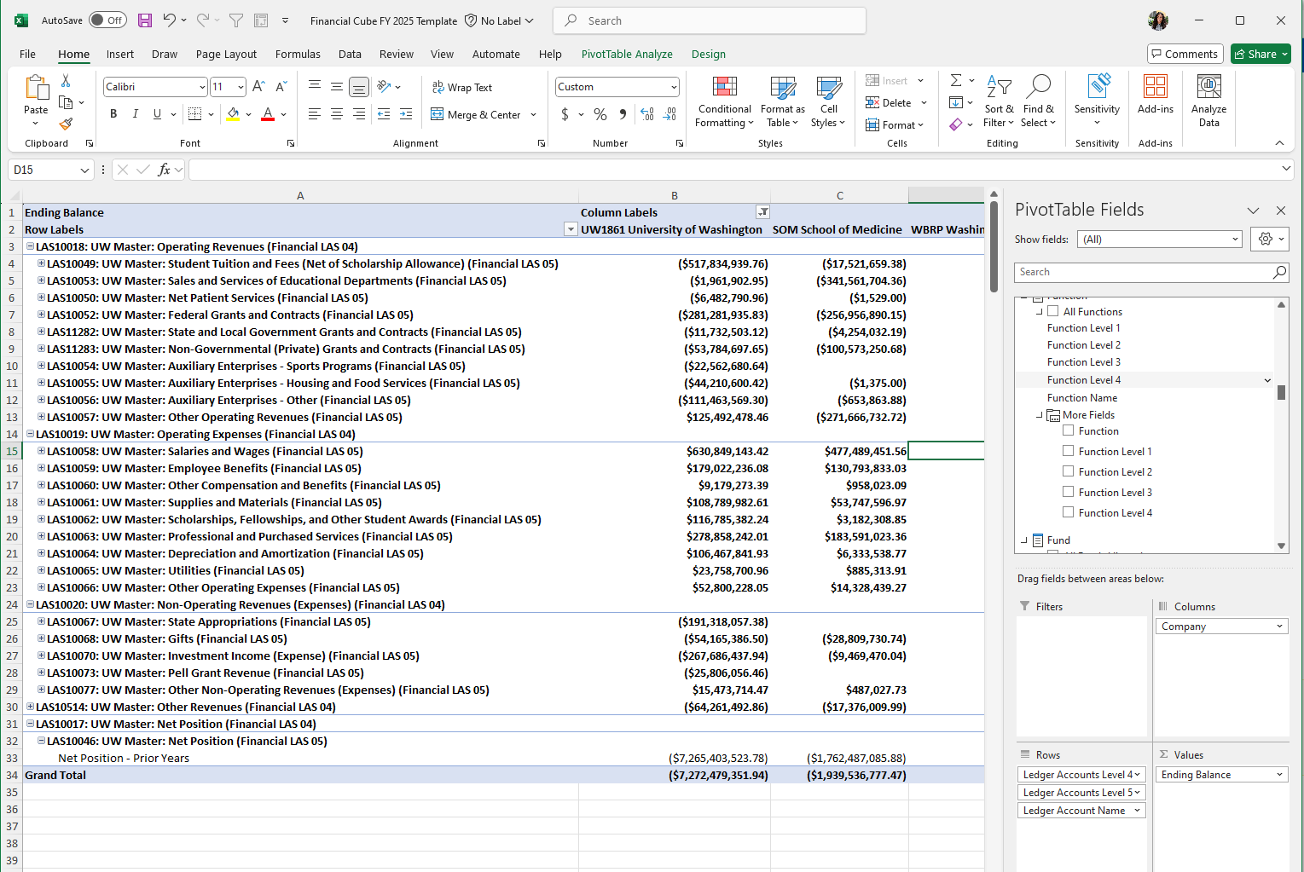
UW Finance Cube FY25

Slide 48
UW Finance Cube FY25
Common Use(s):
Viewing data in an easily customizable way at a summarized level.
Can link to other data, add calcualated fields, and other standard pivot features
Drawback(s):
Transactional detail does not have all worktags or data.
Does not yet have Budget/Plan data fields
Does not include between company (inter) or within a company (intra) eliminations
Book Code functionality is not straightforward
Data is updated daily, so will not reflect the current day's transactions

Slide 49
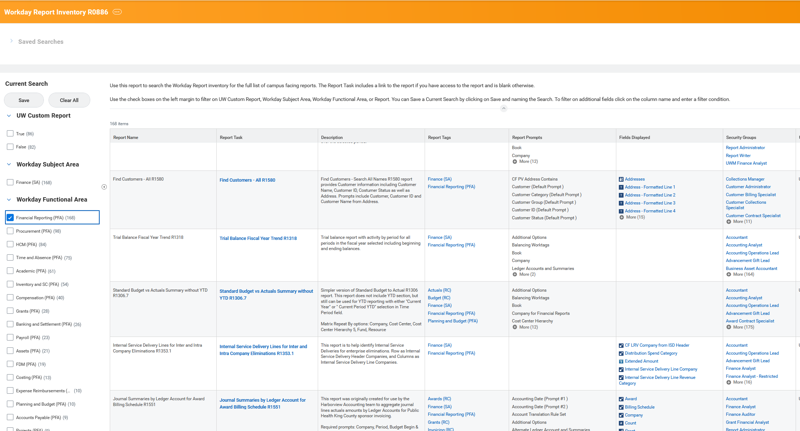
Workday Report Inventory R0886

Slide 50
Workday Report Inventory R0886
Common Use(s):
Search for reports based on functionality
Identify security role(s) needed to review reports

Slide 51
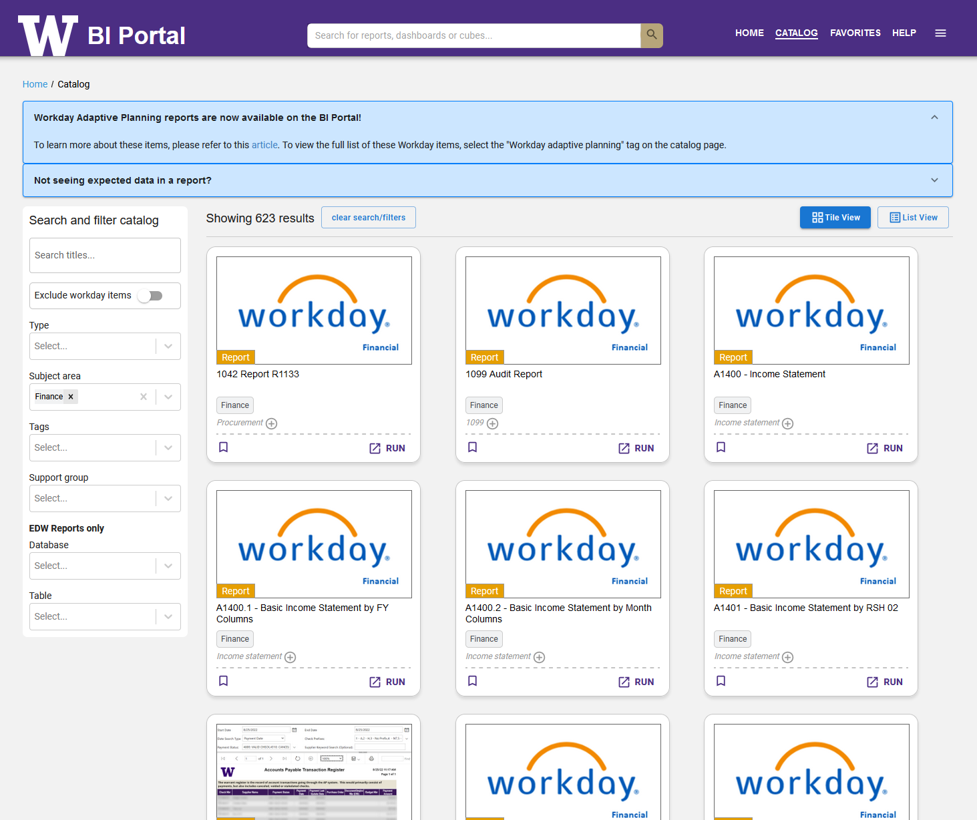
Workday BI Portal

Slide 52
Workday BI Portal
Common Use(s):
Search for reports that exist inside AND outside of Workday
Hint: hover over the picture of the report/Workday logo to view the report description

Slide 53
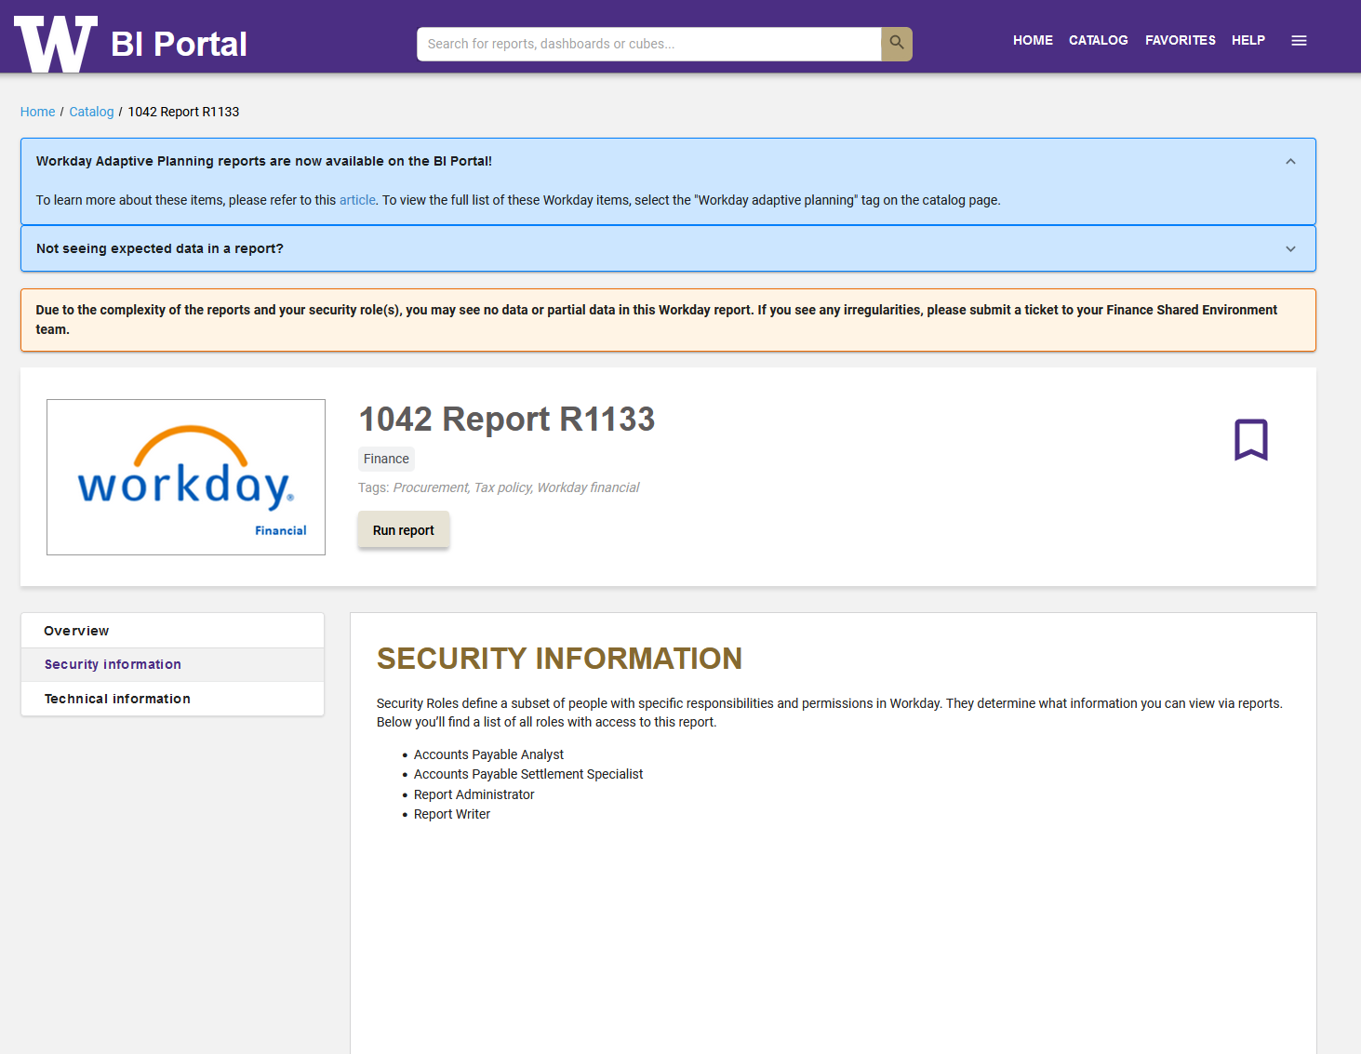
Workday BI Portal

Slide 54
Net Position & Making Corrections Refresh

Slide 55
Net Position Transfers Post FY24
All worktags that carry balances (net position) are rolled forward
  Cost Center, Program, Grant, Gift, Assignee, Fund, etc. (even if inactivated)
Net position balances exist in COMBINATIONS of worktags
  Example: CC123456, PG123456, AS123456 carries net position of $1,000
    Reporting of net position (trial balance, etc)
      CC123456 = $1,000
      PG123456 = $1,000
      AS123456 = $1,000
      Combination CC123456/PG123456/AS123456 = $1,000
  Net position will roll forward under the same premise, in combinations of worktags
  Net position must always be within a Fund (and often a resource, but not always)

Slide 56
Net Position Transfers Post FY24
Inactive worktags with net position will retain that balance
  Best practice is to zero out worktags that carry net position prior to inactivation
  If this occurs, entries may be done to zero out the net position (but the worktag must be active)
    Use an expense ledger
    Debit the combinations of worktags CC / PG / AS / FD / RS $1,000
    Credit the combination without the program CC / AS / FD / RS ($1,000)
    This will net to zero for all worktags, except the PG which is removed net position

Slide 57
What is the equivalent of CTI?
CTI = “cost transfer” with the intention of transferring the amount of an external cost or bundle of costs from a unit (A) to another unit (B), in order to recover all or a portion of incurred costs
ISD – used when regularly incurred via line of business. Key distinction is the recognition of internal revenue
Expense transfer – removes/reduces the expense incurred by the unit (A) transferring the costs and increases the expense incurred by the unit (B) being transferred to. Key distinction is offsetting expense, the same ledger account is used. (i.e. reduce supplies expense to me, increase supplies expense to you)
Funding transfer – transfers funds from a unit (B) to the unit (A) that incurred the original costs. This essentially transfers funds with a generic funding transfer journal to cover the costs incurred by a unit on their behalf. Key distinction is the funding transfer could cover a specific expense transaction, a portion of a transaction, a bundle of transactions, or a portion of a bundle of transactions.
Notes:
All of these have an impact on net position
*ISD shows revenue and expense (internal)
*Expense transfer shows expense and expense (internal)
*Funding transfer shows revenue and revenue (internal)

Slide 58
Shared Environment Sync – 6/25
To see the rest of the slides and listen to the recording: Link

Slide 59
Wrap Up

Slide 60
High Level Do’s and Don’ts
Do – review activity and transactions timely, so corrective action can be taken within the same period if necessary
Do - correct net position balances, due to unintended missing worktags, by (first option) correcting the source, which is typically accounting adjustments or reclass
Don’t – cross fund or resource worktag inappropriately
Do – explore various reporting options to understand better the common book vs. financial reporting book
Do – refer to the common book when contemplating “deficit”
  However, stay tuned for future discussions / direction regarding usage of books

Slide 61
Resources
DATAGroup UW Finance Reporting Wiki is a wealth of knowledge for reporting: https://wiki.cac.washington.edu/x/fxB2D (need to be on UW campus or VPN)
  Reporting & Analytics Office Hours (every 2nd and 4th Friday, 9 a.m.) - link in wiki
How to Use the Cube: Two recorded webinars on the Cube Link
Adaptive – Discuss with the people AdaptivePlannerUWA Security Role for more information
  Budget Planning & Operations team (BPO) Office Hours (Thursdays from 10:00 to 10:45 a.m. throughout the FY26 planning cycle) - Link on Budget Support Resources page

Slide 62
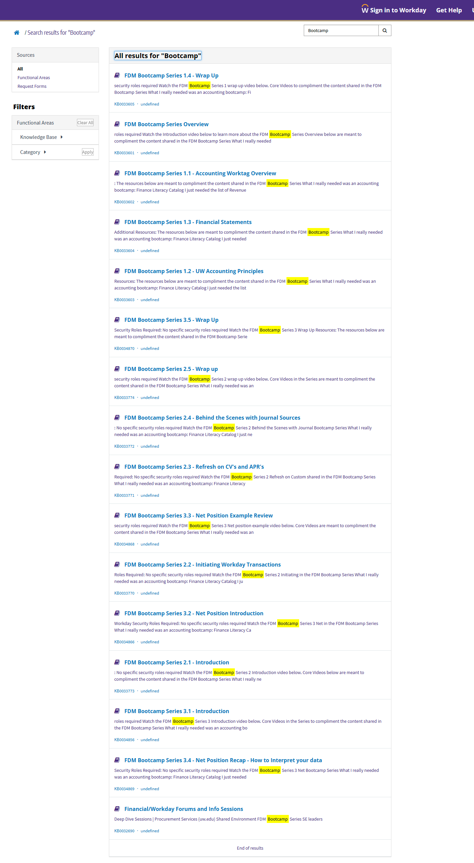
Resources
FDM Bootcamp Series Recordings – UWCF
  Watch each sections of each series in order, to gain the full breadth of knowledge as the content builds on itself throughout the series
  FDM Bootcamp Search - UW Connect Finance Portal
FDM Accounting Bootcamp Full Recordings Link
FDM Handbook Landing Page Link
Funding Transfer Job Aid Link

Slide 63
What’s Next
SE Accounting Forum – 2025
  We will resume the 2nd Tuesday of every month from 10-11 am
  Invites to come shortly

